Slide 1
Occupational therapy in neonatal services and early intervention Second edition
Continuing Professional Development session
Notes:
CPD Session: PowerPoint, notes and group activities
The slides and information in this CPD session can be used as a template, but can also be adapted to reflect local need and priorities.
The overall aim of this resource is to support a continuing professional development session to explore the practice guideline Occupational therapy in neonatal services and early intervention 2nd edition (Royal College of Occupational Therapists 2022).
The resource comprises this PowerPoint presentation and notes which can be used for a one-hour facilitated workshop, or for individual self-directed learning.
There are some interactive activities which are intended to be used to encourage reflection on current practice and to explore some areas in more detail.
Pre-requisite materials:
Guideline document: Occupational therapy in neonatal services and early intervention practice guideline 2nd edition (RCOT 2022).
Other Implementation tools:
Audit Form.
Quick Reference and Implementation Guide.
It is essential that workshop facilitators familiarise themselves with the full guideline document and implementation tools in advance.

Slide 2
Learning outcomes
By the end of this session you will be able to:
Explain the importance of using practice guidelines to inform practice.
Describe aspects of the guideline recommendations in relation to current practice.

Slide 3
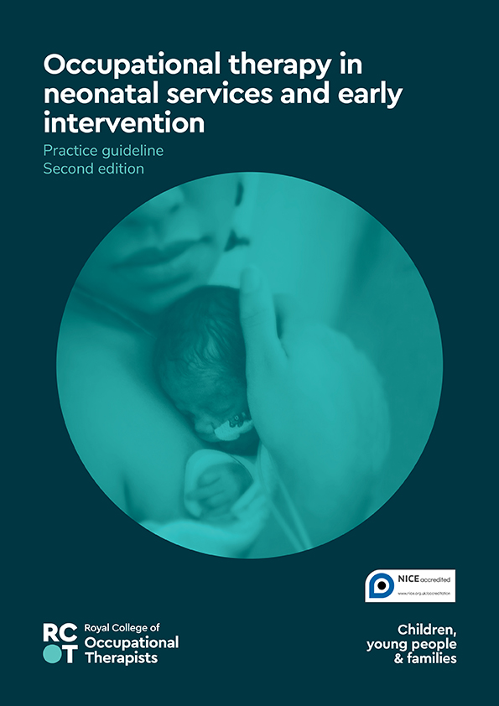
Practice question:
What is the evidence to support occupational therapy in neonatal services and in early intervention?

Slide 4
Objective of the guideline
To provide specific evidence-based recommendations which describe the
most appropriate care or action to be
taken by occupational therapists working
in neonatal services or early intervention.
Notes:
Emphasise that the guideline focuses on ‘high-risk’ infants, and includes all infants born preterm, high-risk infants born at term (e.g. infants with hypoxic ischaemic encephalopathy, neonatal abstinence syndrome, congenital conditions or having undergone complex surgical procedures), infants receiving palliative care and their parents. It is acknowledged that not all infants considered high risk at birth will develop developmental sequelae, but the term ‘high risk’ is used for brevity.

Slide 5
Recommendation categories
Occupation-based assessment
Developmentally supportive care
Pain management
Skin-to-skin (kangaroo) care
Touch
Postural support
Infant feeding
Parent engagement
Parent support
Identifying developmental concerns
Early intervention
Notes:
The recommendations for occupational therapy intervention are based on the synthesis of the best available evidence to date. A total of 35 recommendations are set out in 11categories:
1. Occupation-based assessment
2. Developmentally supportive care
3. Pain management
4. Skin-to-skin (kangaroo) care
5. Touch
6. Postural support
7. Infant feeding
8. Parent engagement
9. Parent support
10. Identifying developmental concerns
11. Early intervention.
The categories loosely represent the stages of an infants’ journey through a neonatal admission and beyond.

Slide 6
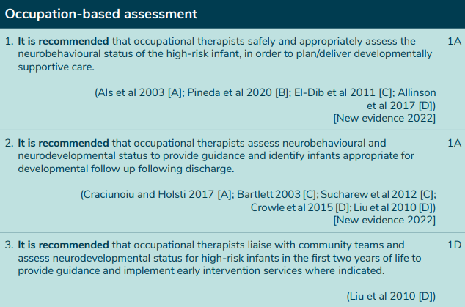

Slide 7
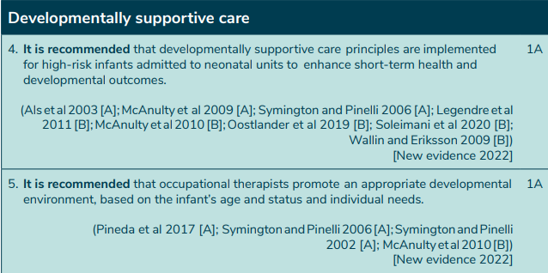

Slide 8
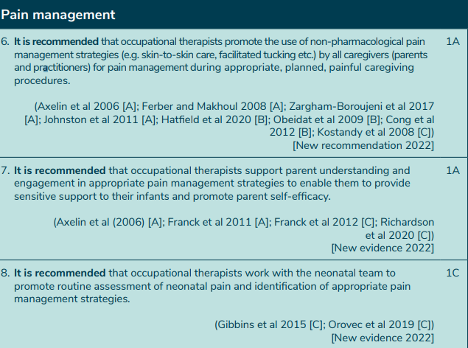

Slide 9
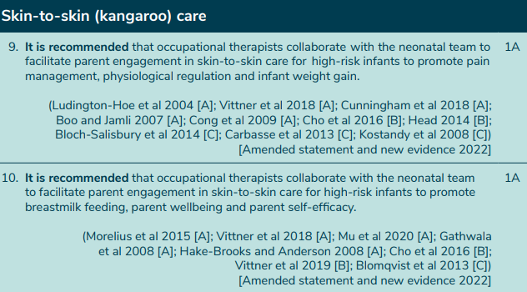

Slide 10
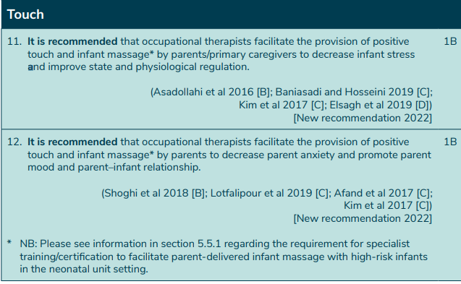

Slide 11
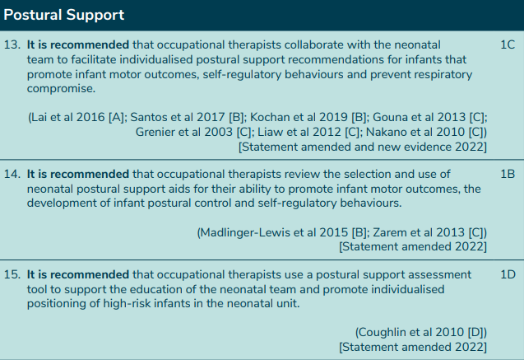

Slide 12
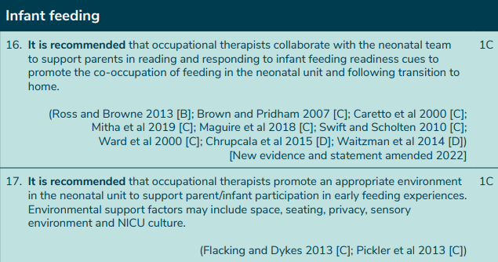

Slide 13
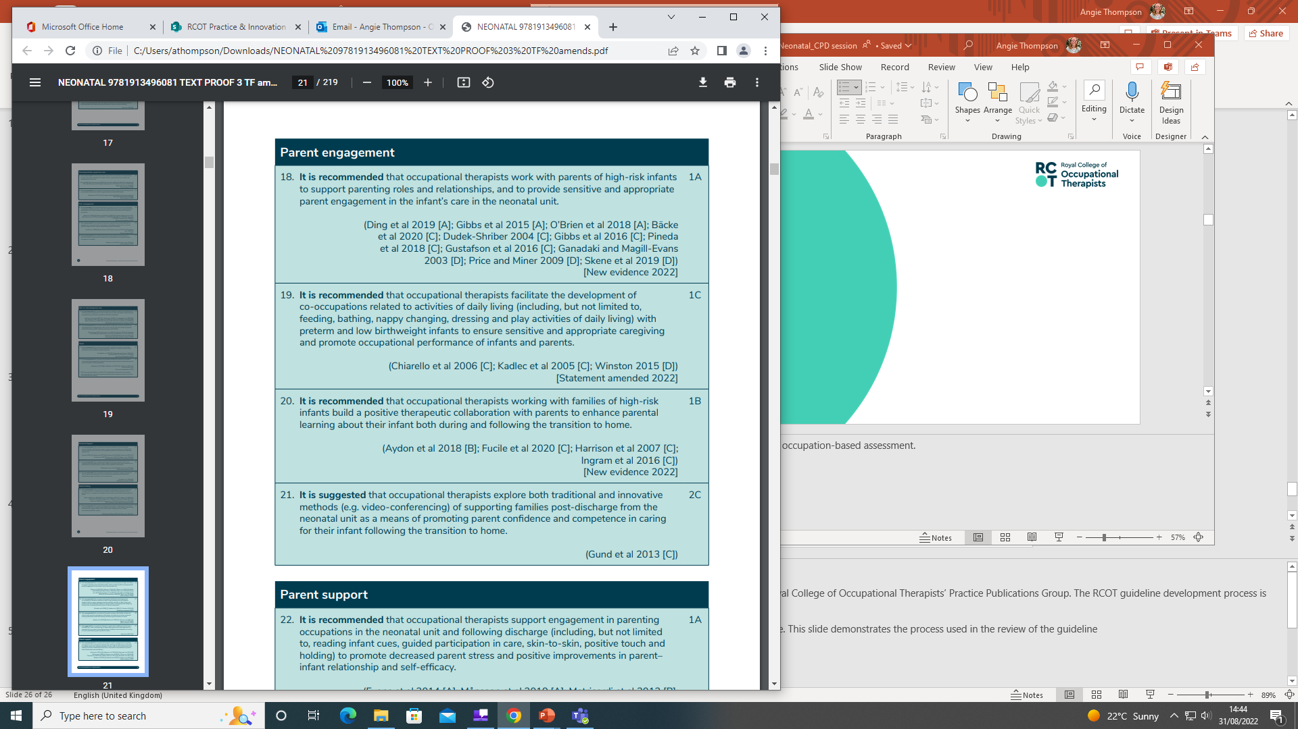

Slide 15
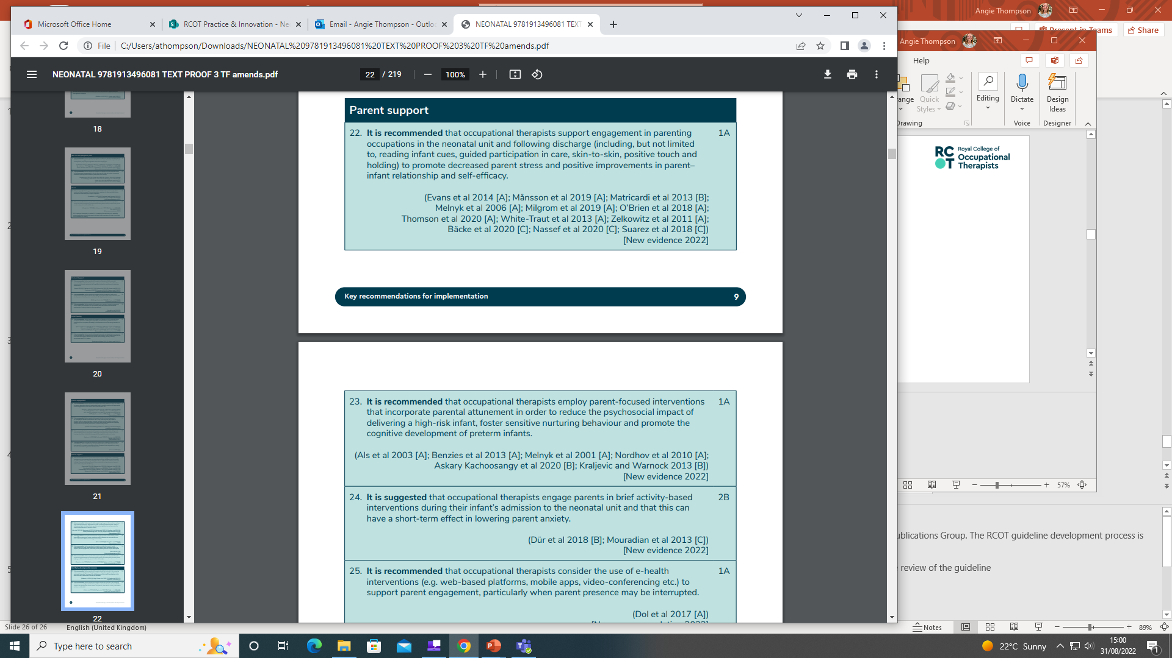

Slide 16
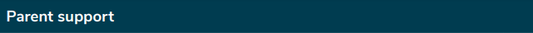
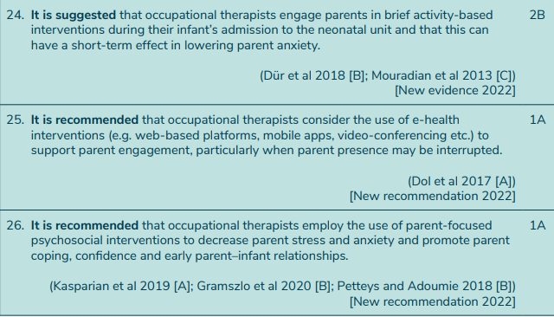

Slide 17
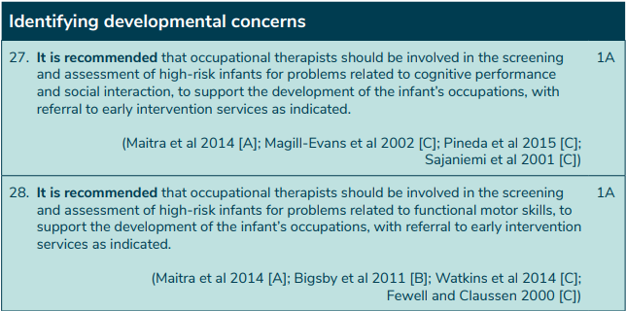
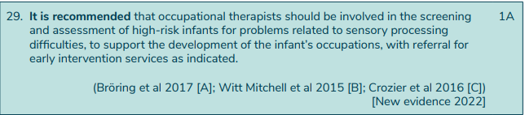

Slide 18
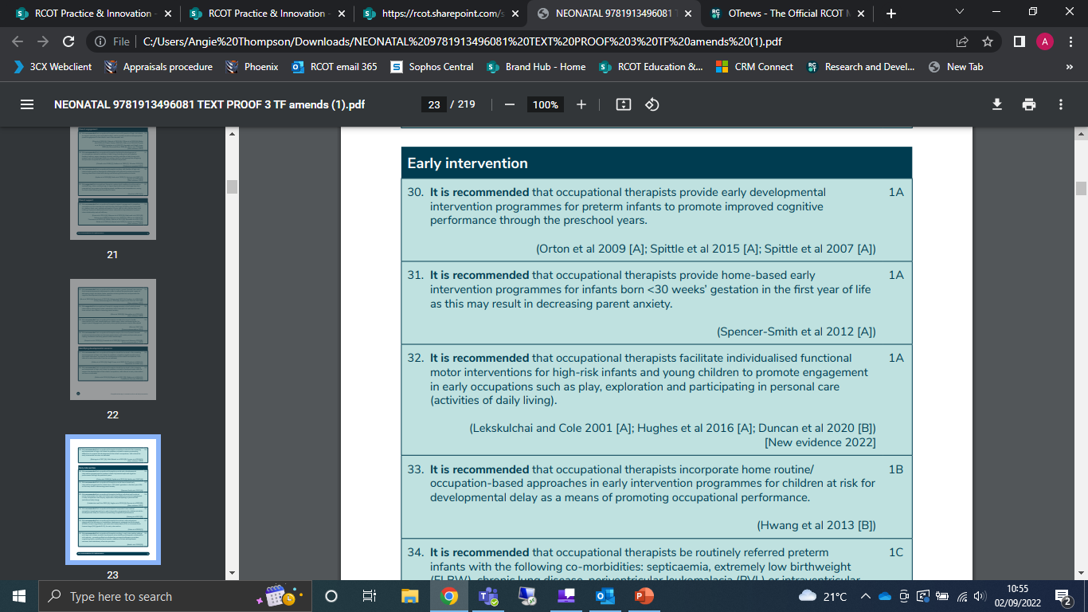

Slide 19
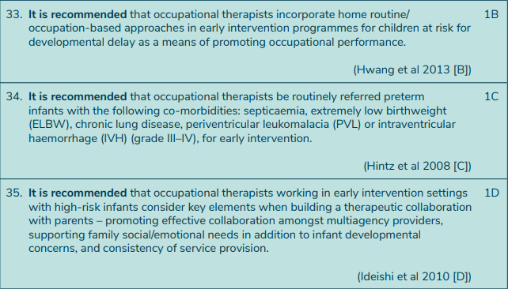

Slide 20
Parents’ perspectives
In your experience, what do you think is the most important support that neonatal occupational therapists could or did provide to you and your baby?
“Reassurance – some support that our daughter was progressing well. It was positive that OTs look at the ‘person’ not a scan; as a parent this is what
you want to hear”
“Helping us to feel confident about babies’ needs and developmental
care”
“Just having easy access to an OT”

Slide 21
Impact of the guideline for you: the practitioner
Challenges / affirms your current practice.
Provides evidence-based recommendations to inform and support your practice.
Raises awareness of benefits and risks and organisational and financial barriers.
Provides a vehicle for you to audit your practice.
Assists in communicating your role to members of the multidisciplinary team.

Slide 22
Impact of the guideline for managers
Provides evidence of the need for occupational therapy in neonatal services and early intervention
Provides a structure to audit the work of occupational therapists within the neonatal services to improve service quality.
Provides a vehicle for justifying service provision.

Slide 23
Case study example
Insert a local case study example here and support a discussion of the application of the guideline.

Slide 24
Guideline resources
Royal College of Occupational Therapists (2022) Occupational therapy in neonatal services and early intervention: practice guideline. 2nd edition. London: RCOT.
Audit form
Quick Reference and Implementation Guide
Resources are available from RCOT’s website at:
https://www.rcot.co.uk/practice-resources/rcot-practice-guidelines

Slide 26
Methodology information

Slide 27
Methodology
1. Guideline review group established
2. Literature search
5. Critically appraise articles
4. Screen findings
6. Review and development of guideline recommendations
7. Peer review, stakeholder and parent consultation
9. Published by
RCOT 2022
8. Final draft approved by RCOT Publications Group

Slide 28
Evidence-based recommendations
The 35 recommendations are based on the evidence available within 138 critically appraised papers.
Each recommendation is assigned:
A strength scoring 1 or 2 (Strong or Conditional)
A quality grading A, B, C or D
(High, Moderate, Low or Very Low)
Notes:
Each article of evidence which met the scope inclusion criteria, identified from the literature search, was critically appraised by two members of the guideline development group, and a quality of evidence grading subsequently determined based on that assessment.
NB Search periods: Occupational therapy specific evidence 2000-2016 (1st edition), 2016-2020 (2nd edition); intervention specific evidence 2000-2016 (1st edition), 2016-2020 (2nd edition).
The quality of evidence grading reflects the typical hierarchy given to study design. For example the highest level (A) reflects consistent results from randomized controlled trials, whilst the lowest (D) includes studies such as case studies or expert opinion. Higher level studies are perceived as being less susceptible to bias.
The strength of the recommendation is scored as either strong (1) or conditional (2).
This is based on the benefits and risks of the evidence. A strong recommendation indicates that benefits appear to outweigh the risks for the majority of the target population, whereas a conditional or suggested recommendation means that the risks and benefits are more closely balanced or there is more uncertainty.
A total of 58% of the evidence was derived from studies of high or moderate quality: Grade A=33% and Grade B=20%. A further 38% of the evidence was Grade C, and 9% Grade D. Thirty-three of the recommendations were graded as strong; and two as conditional.
Each recommendation is specific and is based on the appraised evidence. Details about the studies referenced can be found in the guideline’s evidence tables supplement document.

