Slide 1
Making the most of RCOT Communities
Notes:
Our vision and purpose
The journey that we are to develop our services and support for members
We will offer you an intro on the types of support available across a range of themes, with a spotlight on CPD
Get involved options
Showcasing our members unique stories and voices throughout our presentation

Slide 2
Our digital transformation
A member offer that reflects the needs and opportunities of our people and profession
New member benefits and improved digital experiences
Developed in response to members’ feedback, insights and research findings
More features and functionality to come over time.
Over time we’ll be able to share tailored content and recommendations based on your career stage and interests.

Slide 3
What we’ll cover
What is RCOT Communities?
Making the most of RCOT Communities
A guided tour
How to get involved
Q&A
Next steps

Slide 4
Our speakers today
Nikki Daniels
Head of Professional Development
Christina Fuentes Tibbit
Communities Manager
Emma Grover
Strategic Lead for Professional Development

Slide 5
Overview of RCOT Communities
A dedicated online community platform
A range of networks – by practice area, RCOT region, and professional focus
A growing volunteer community
Included in your membership
Notes:
We heard from members that you want communities that are inclusive, diverse, accessible and relevant. This drove our vision to create inclusive communities where all members can find a place to share, learn and network based on their region, area of practice or professional interest. We want all members to benefit from the wealth of experience across our diverse membership.
Our networks are member-led, and an integral part of our new communities is our improved approach to community leadership. We worked with our volunteers and members to understand how our historic community volunteer roles have evolved and how we can better work with and support community volunteers. Our new approach to community volunteering and leadership will provide better support, integrate more development opportunities and ensure our volunteer management practices are both aligned with our values and wider best practice.
Finally, access to all our networks and leadership roles is open to all members, which is a change from our previous communities model. You can join as many networks as are relevant to you. Remember that meaningful engagement takes time, so focus on the networks where you can gain most value.

Slide 6
Reimagining communities

Slide 7
Start connecting!
In the chat:
Introduce yourself in the chat
Ask a question
Find someone you might like to connect with
Connect with them on RCOT Communities

Slide 8
Transforming communities
Previous communities
Range of communities including Specialist Sections, regions, networks and forums
Some managed by volunteers through formal committees
Specialist Sections required additional subscriptions for members to join –20% uptake
RCOT Communities
More inclusive and accessible for all members irrespective of career stage
Reimagining Communities
Opportunity to promote better learning and development aligned to CPD for members
New volunteer strategy
New Communities model based on practice, regional and professional networks hosted on RCOT Communities
Working with members, volunteers and Specialist Sections and Regions.
No more financial barriers - access included in your membership
Over 800 members participated in test and learn of RCOT Communities platform

Slide 9
Overview of our new networks
Regional – bring local OT communities together
Practice – bring together members from across all backgrounds, career levels and sectors with a shared interest in a practice area
Professional – connect members around pillars of practice and professional issues
Run by volunteers in new leadership roles, mapped to the Career Development Framework.
Not restricted, you can join as many as you like!
Notes:
We heard from members that you want communities that are inclusive, diverse, accessible and relevant. This drove our vision to create inclusive communities where all members can find a place to share, learn and network based on their region, area of practice or professional interest. We want all members to benefit from the wealth of experience across our diverse membership.
Our networks are member-led, and an integral part of our new communities is our improved approach to community leadership. We worked with our volunteers and members to understand how our historic community volunteer roles have evolved and how we can better work with and support community volunteers. Our new approach to community volunteering and leadership will provide better support, integrate more development opportunities and ensure our volunteer management practices are both aligned with our values and wider best practice.
Finally, access to all our networks and leadership roles is open to all members, which is a change from our previous communities model. You can join as many networks as are relevant to you. Remember that meaningful engagement takes time, so focus on the networks where you can gain most value.

Slide 10
Your regional networks
Eastern
London
North West
Northern & Yorkshire
Northern Ireland
Scottish Eastern
Scottish Northern
Scottish Western
South East
South West
Trent
Wales (Cymru)
West Midlands
Notes:
Regional networks
Regional networks aim to strengthen our profession locally by raising our profile and optimising our impact. They’ll bring local OT communities together so we can coordinate activities, share resources and build events near you.

Slide 11
Your initial practice networks
Acute and emergency care
Healthy ageing
Children, young people and families
Dementia care
Frailty
Health and work
Inclusive built environments
Learning disabilities
Long-term conditions
Mental health
Neurological practice
Oncology
Palliative and end of life care
Primary care
Social care
Notes:
Practice networks
Together with our volunteers, we agreed the following initial practice networks. You’ll see they expand on our previous specialisms to recognise further areas of practice.
These networks bring together members from across backgrounds, career levels and sectors with a shared interest in a practice area to support members’ professional lives.
By joining a practice network, you’ll have access to a shared online space to meet and connect with others, share resources and access learning and development opportunities.

Slide 12
Your initial professional networks
Research Connect
Innovation Hub
Leadership network
Facilitating Learning network
Independent Practice network
Notes:
Professional networks
Professional networks connect members around pillars of practice and professional issues.
Our initial professional networks include Research Connect and the Innovation Hub. We’ve also created networks for members to connect around leadership, independent practice and facilitating learning.

Slide 13
Your networking experiences
Tell us in the chat:
What networks have you been part of?
What did you find valuable about being part of that network?
If you’ve joined any networks on RCOT Communities already or what networks you are looking forward to being part of

Slide 14
Let's take a look!

Slide 15
Welcome journey

Slide 16
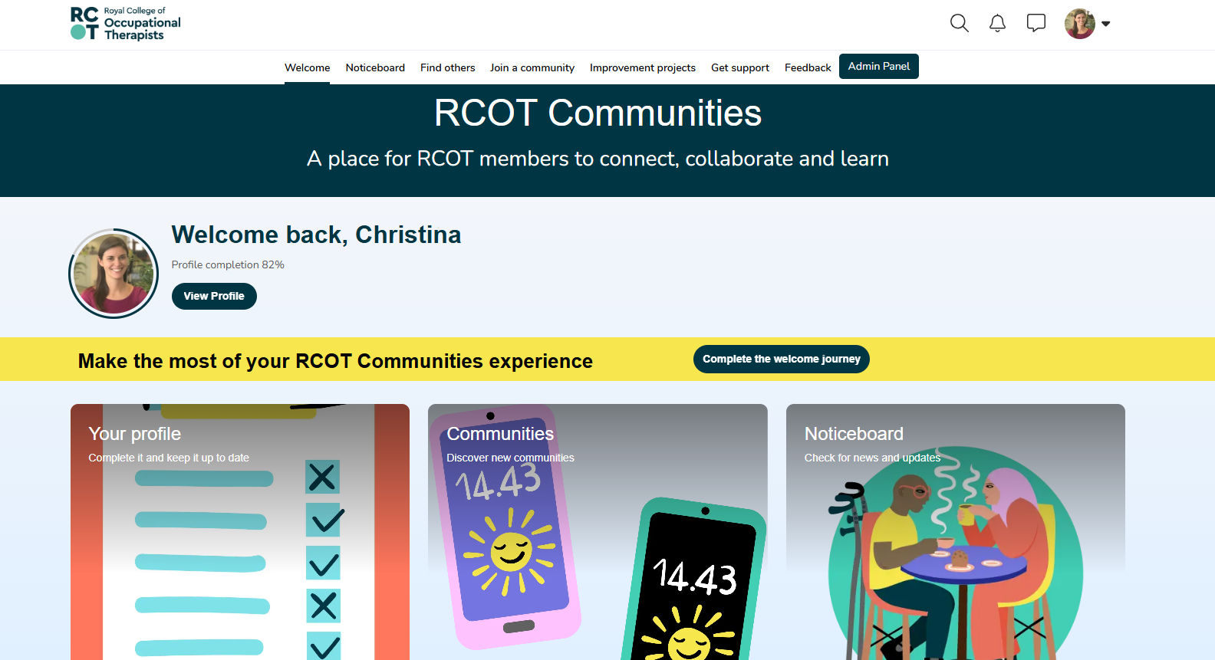
Welcome page

Slide 17
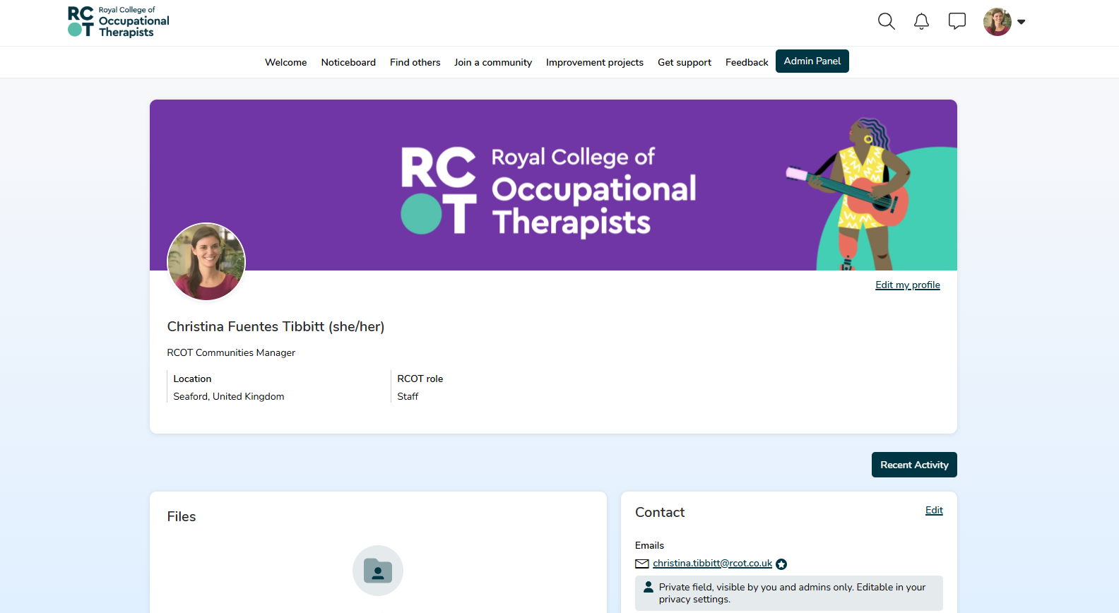
Your profile

Slide 18
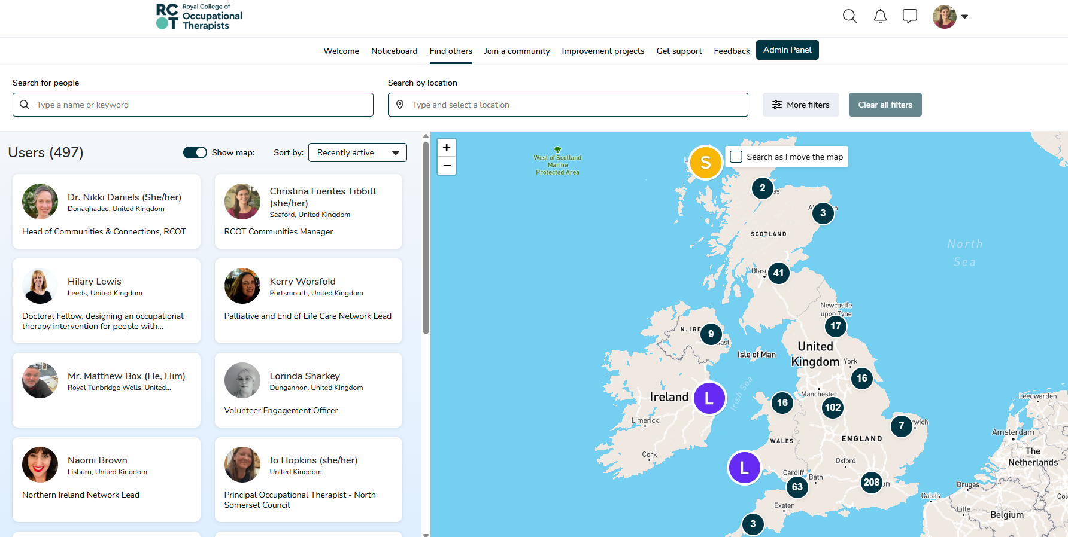
Finding others

Slide 19
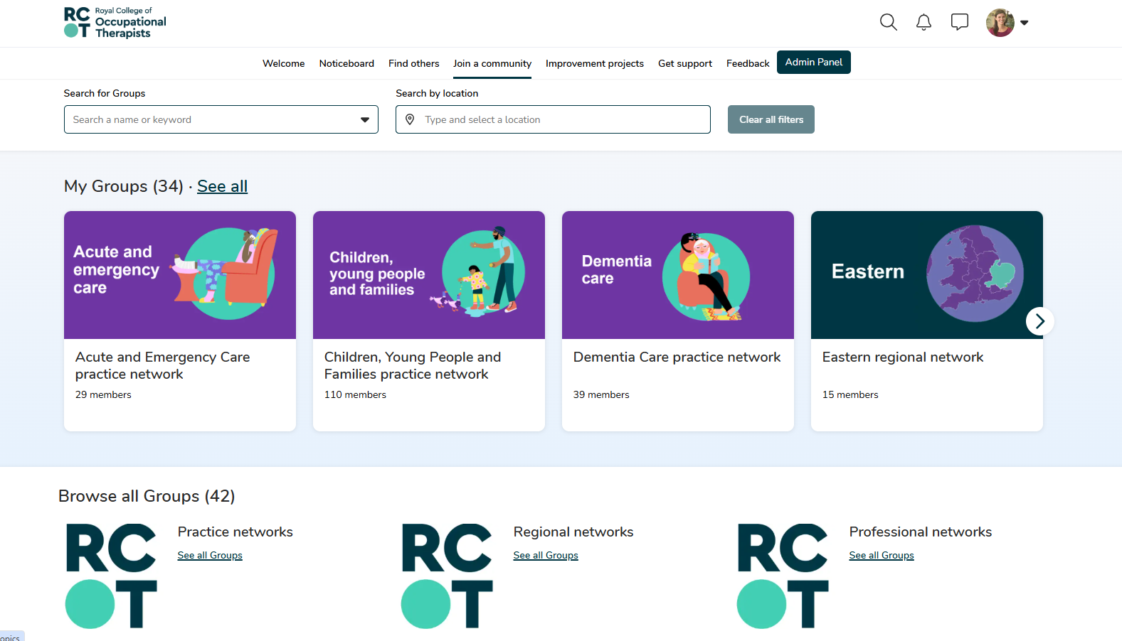
Joining communities

Slide 20
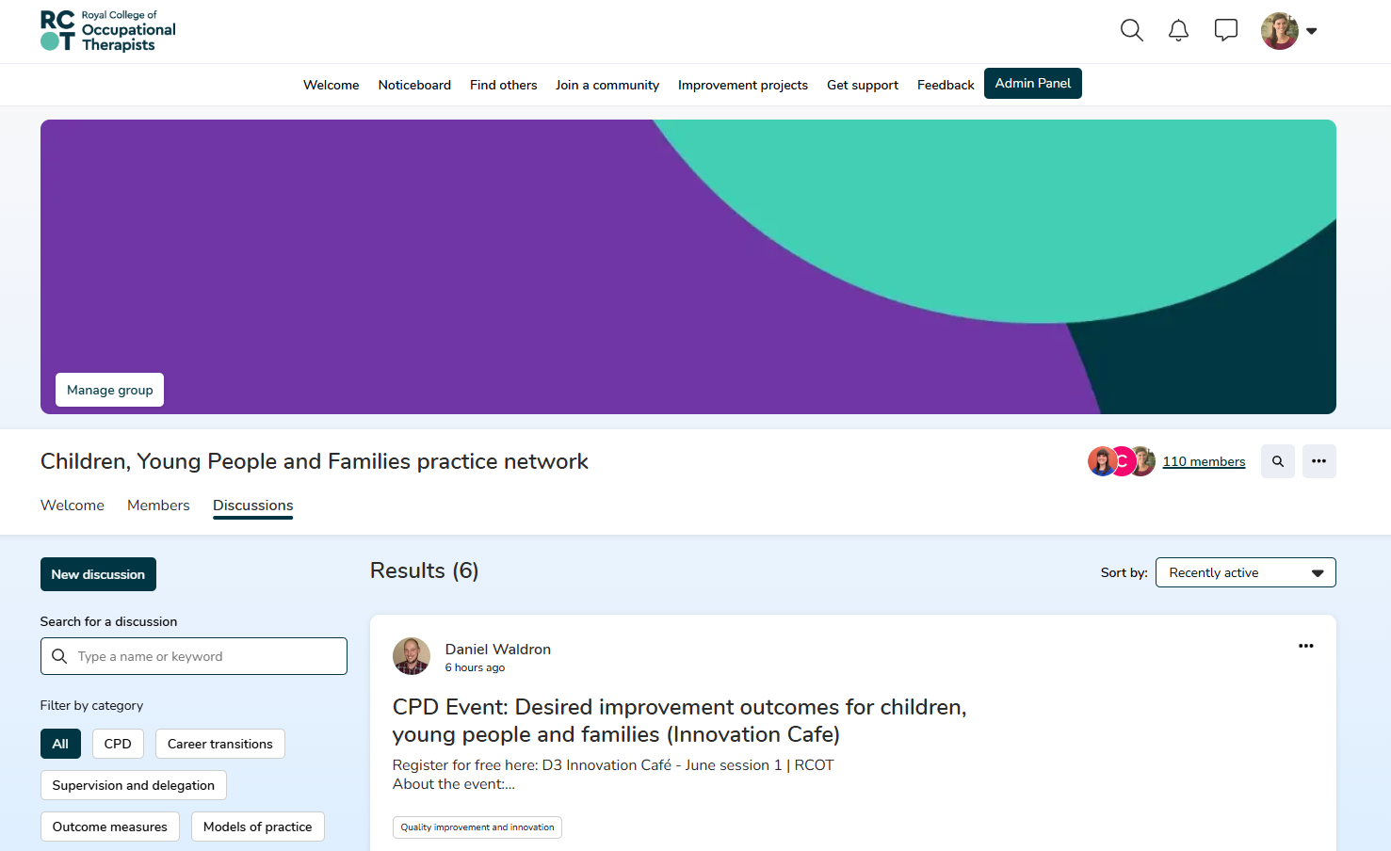
Sharing and discussing

Slide 21
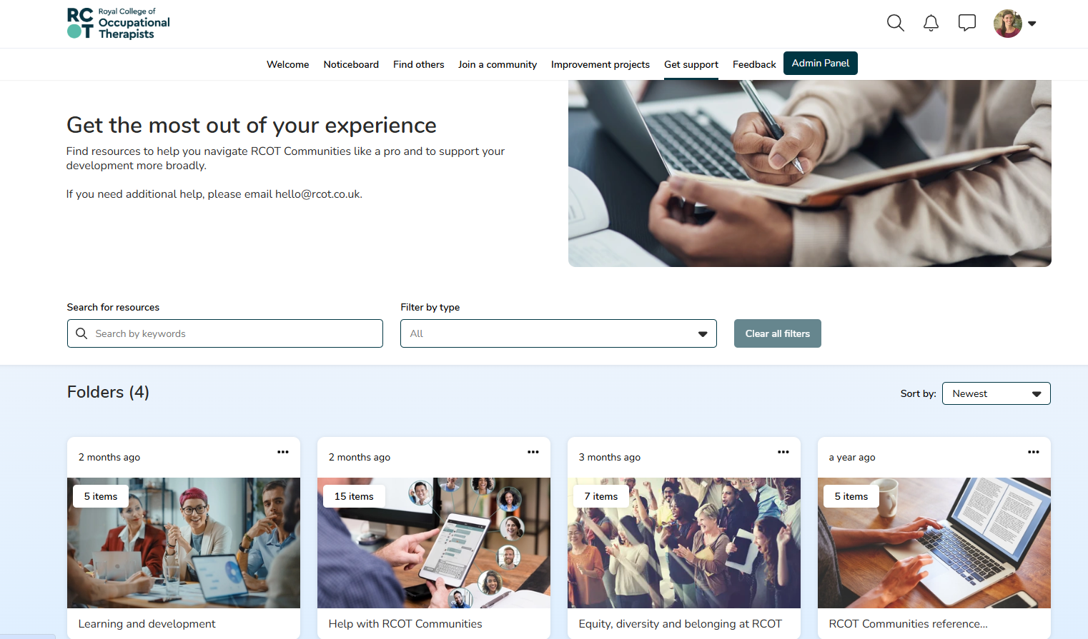
Getting support

Slide 22
How networking supports your CPD
Learn
Learn from and with each other
Build
Build meaningful connections
Showcase
Showcase your strengths
Open
Open up new opportunities

Slide 23
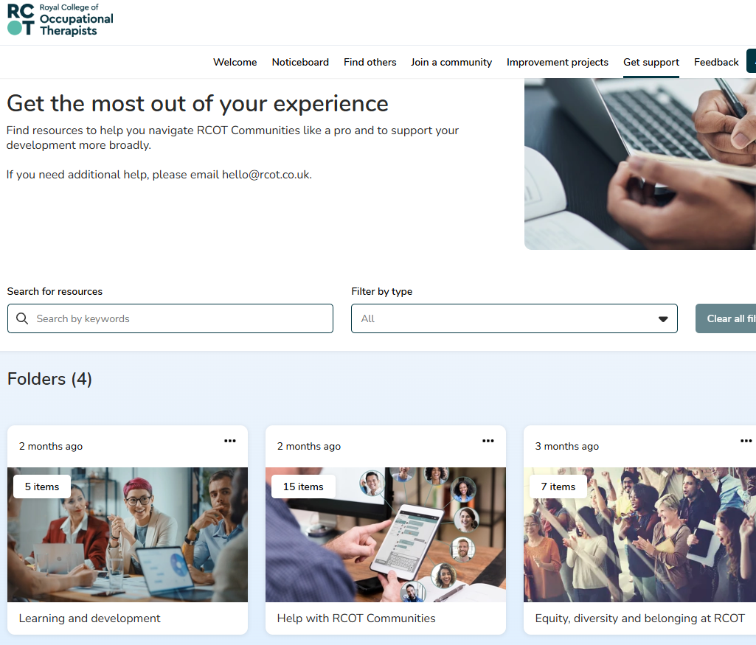
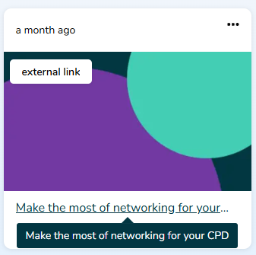
E-learning to make the most of networking for your CPD

Slide 24
Capture your learning and reflections
Read, reflect on and contribute to discussions
Join RCOT Communities to start connecting
Complete e-learning or other CPD resources
Record in your CPD portfolio to capture your learning and reflections
Start a discussion post of your own to ask questions or share your learning and reflections

Slide 25
Volunteering with RCOT
We’re on the lookout for passionate volunteers to help us build dynamic and thriving communities within RCOT.
Are you ready to take your professional development to the next level?
Grow your skill set
Make meaningful impact
Enhance your career
Apply online for volunteer roles

Slide 26
Benefits of volunteering with us

Slide 27
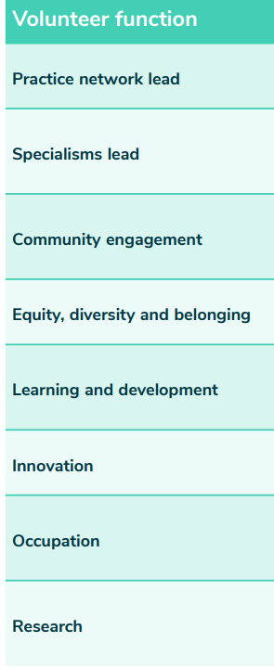
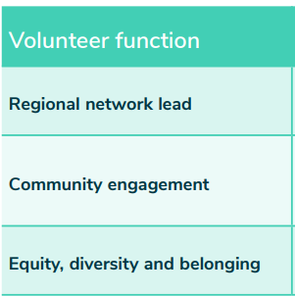
What roles are available?
Practice networks
Regional networks
Leads
strategic, focusing on vision and direction
Career Development Level 7/8
Coordinator
operational, ensuring effective implementation of activities
Career Development Level 5/6

Slide 28
Help build the collective value of the community
Join RCOT Communities and completed welcome journey
Join your regional network
Join approx. 1–3 networks that reflect your interests
Introduce yourself in the discussion board
Share your own knowledge and experience
Take part in discussions to share insights to inform needs
Record your learning in your CPD portfolio
Help shape your community by volunteering
Tell colleagues and peers

Slide 29
Actions you could take
Get started with RCOT communities - welcome journey!
1
Join your RCOT regional network
3
Explore the practice and professional networks relevant to your development needs
4
Consider a volunteer role to help lead and shape your networks
5
Connect with your peers
6
Record your activities in your CPD portfolio
7
Complete our learning resource to reflect on networking as an effective CPD activity
2

Slide 30
Questions?

