Slide 1
Introducing your new RCOT member benefits
Notes:
Our vision and purpose
The journey that we are to develop our services and support for members
We will offer you an intro on the types of support available across a range of themes, with a spotlight on CPD
Get involved options
Showcasing our members unique stories and voices throughout our presentation

Slide 2
Our speakers today
Steve Ford, Chief Executive
Clare Cochrane, Director of Brand & Marketing
Dr Nikki Daniels, Head of Professional Development
Dr Christina Fuentes Tibbitt, Communities Manager

Slide 3
Transforming your membership experience

Slide 4
Our digital transformation
A member offer that reflects the needs and opportunities of our people and profession
New member benefits and improved digital experiences
Developed in response to members’ feedback, insights and research findings
More features and functionality to come over time
Over time we’ll be able to share tailored content and recommendations based on your career stage and interests

Slide 5
Your new member benefits and improved digital services
A new and more user-friendly website
RCOT Communities, your online networking platform
An upgraded digital version of OTnews
More streamlined access to all your RCOT digital services
An enhanced online member account
All included in your membership

Slide 6
How transforming your digital experiences supports you
More personalised content and experiences for members
Better and more seamless access to benefits and services on the go
Improved data and insight and evidence based decisions about future improvements
Stronger advocate for our profession
More user-friendly, accessible and compatible with assistive technology

Slide 7
Our new website
Notes:
They’ll soon be lots of opportunities to connect and network with peers across RCOT communities. We have a new member benefit that’s coming next year. One which will support your CPD in lots of different ways.

Slide 8
About our new website
More accessible
More intuitive navigation
New resource centre
Gateway to digital services
Enhanced online account
Inclusive language
Tested with members of AbleOT
Aiming for AA rating – Web Content Accessibility
Your secure login gives you seamless access
Use CPD portfolio, RCOT Communities and Digital Library
Take control of your membership
Set your preferences for how you want to hear from us
Easily search and find professional standards and practice resources
Browse our Digital Library
Access BJOT
More user-friendly
Upgraded search function
Fresh look and feel
Optimised for desktop, tablet or mobile
Compatible with assistive technology
Explore OT topics
Notes:
RCOT resource centre | RCOT Unlocking the potential: Leveraging artificial intelligence in therapeutic practices | RCOT
Understanding the needs of LGBTQ+ older people |RCOT
Opt out of OT news print version

Slide 9
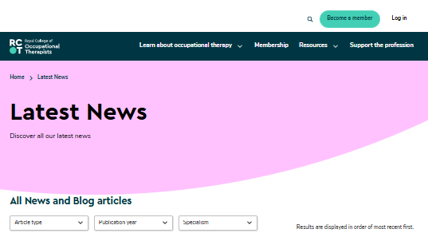
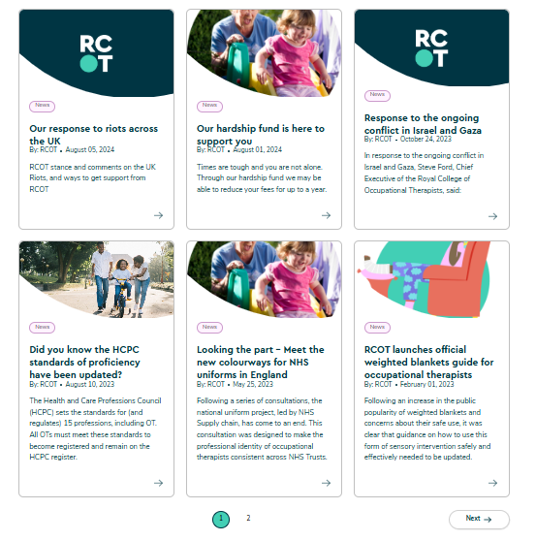
Navigating news – landing page

Slide 10
News – detail page

Slide 11
RCOT Communities
Notes:
They’ll soon be lots of opportunities to connect and network with peers across RCOT communities. We have a new member benefit that’s coming next year. One which will support your CPD in lots of different ways.

Slide 12
Overview of RCOT Communities
A dedicated online community platform
A range of networks – by practice area, RCOT region, and professional focus
A growing volunteer community
Included in your membership
Notes:
We heard from members that you want communities that are inclusive, diverse, accessible and relevant. This drove our vision to create inclusive communities where all members can find a place to share, learn and network based on their region, area of practice or professional interest. We want all members to benefit from the wealth of experience across our diverse membership.
Our networks are member-led, and an integral part of our new communities is our improved approach to community leadership. We worked with our volunteers and members to understand how our historic community volunteer roles have evolved and how we can better work with and support community volunteers. Our new approach to community volunteering and leadership will provide better support, integrate more development opportunities and ensure our volunteer management practices are both aligned with our values and wider best practice.
Finally, access to all our networks and leadership roles is open to all members, which is a change from our previous communities model. You can join as many networks as are relevant to you. Remember that meaningful engagement takes time, so focus on the networks where you can gain most value.

Slide 14
Overview of our new networks

Slide 15
Transforming communities
Previous communities
Range of communities including Specialist Sections, regions, networks and forums
Some managed by volunteers through formal committees
Specialist Sections required additional subscriptions for members to join –20% uptake
RCOT Communities
More inclusive and accessible for all members irrespective of career stage
Reimagining Communities
Opportunity to promote better learning and development aligned to CPD for members
New volunteer strategy
New Communities model based on practice, regional and professional networks hosted on RCOT Communities
Working with members, volunteers and Specialist Sections and regions
No more financial barriers – access included in your membership
Over 800 members participated in test and learn of RCOT Communities platform

Slide 16
Your regional networks
Eastern
London
North West
Northern & Yorkshire
Northern Ireland
Scottish Eastern
Scottish Northern
Scottish Western
South East
South West
Trent
Wales (Cymru)
West Midlands
Notes:
Regional networks
Regional networks aim to strengthen our profession locally by raising our profile and optimising our impact. They’ll bring local OT communities together so we can coordinate activities, share resources and build events near you.

Slide 17
Your initial practice networks
Acute and emergency care
Healthy ageing
Children, young people and families
Dementia care
Frailty
Health and work
Inclusive built environments
Learning disabilities
Long-term conditions
Mental health
Neurological practice
Oncology
Palliative and end of life care
Primary care
Social care
Notes:
Practice networks
Together with our volunteers, we agreed the following initial practice networks. You’ll see they expand on our previous specialisms to recognise further areas of practice.
These networks bring together members from across backgrounds, career levels and sectors with a shared interest in a practice area to support members’ professional lives.
By joining a practice network, you’ll have access to a shared online space to meet and connect with others, share resources and access learning and development opportunities.

Slide 18
Your initial professional networks
Research Connect
Innovation Hub
Leadership network
Facilitating Learning network
Independent Practice network
Notes:
Professional networks
Professional networks connect members around pillars of practice and professional issues.
Our initial professional networks include Research Connect and the Innovation Hub. We’ve also created networks for members to connect around leadership, independent practice and facilitating learning.

Slide 19
Volunteering with RCOT
We’re on the lookout for passionate volunteers to help us build dynamic and thriving communities within RCOT.
Are you ready to take your professional development to the next level?
Grow your skill set
Make meaningful impact
Enhance your career
Apply online for volunteer roles

Slide 20
RCOT Communities
Your online space where you can connect with your peers
Build your profile and share your interests
Join networks, engage in discussions and connect 1:1
All included in your RCOT membership!

Slide 21
Welcome journey

Slide 22
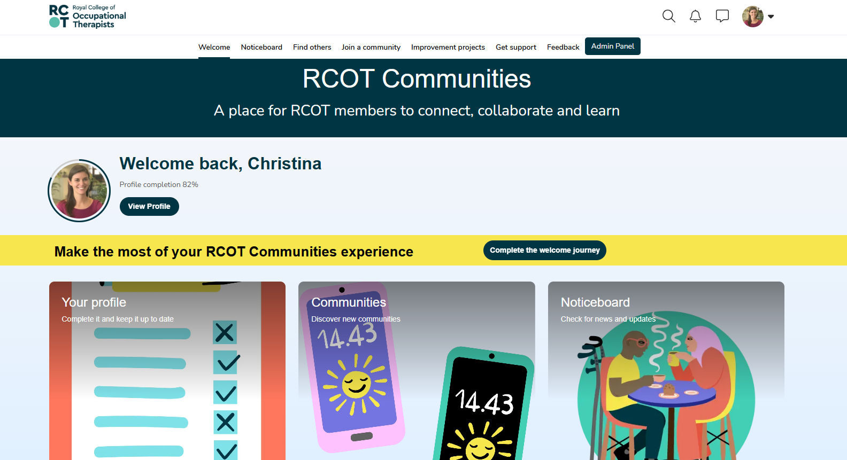
Welcome page

Slide 23
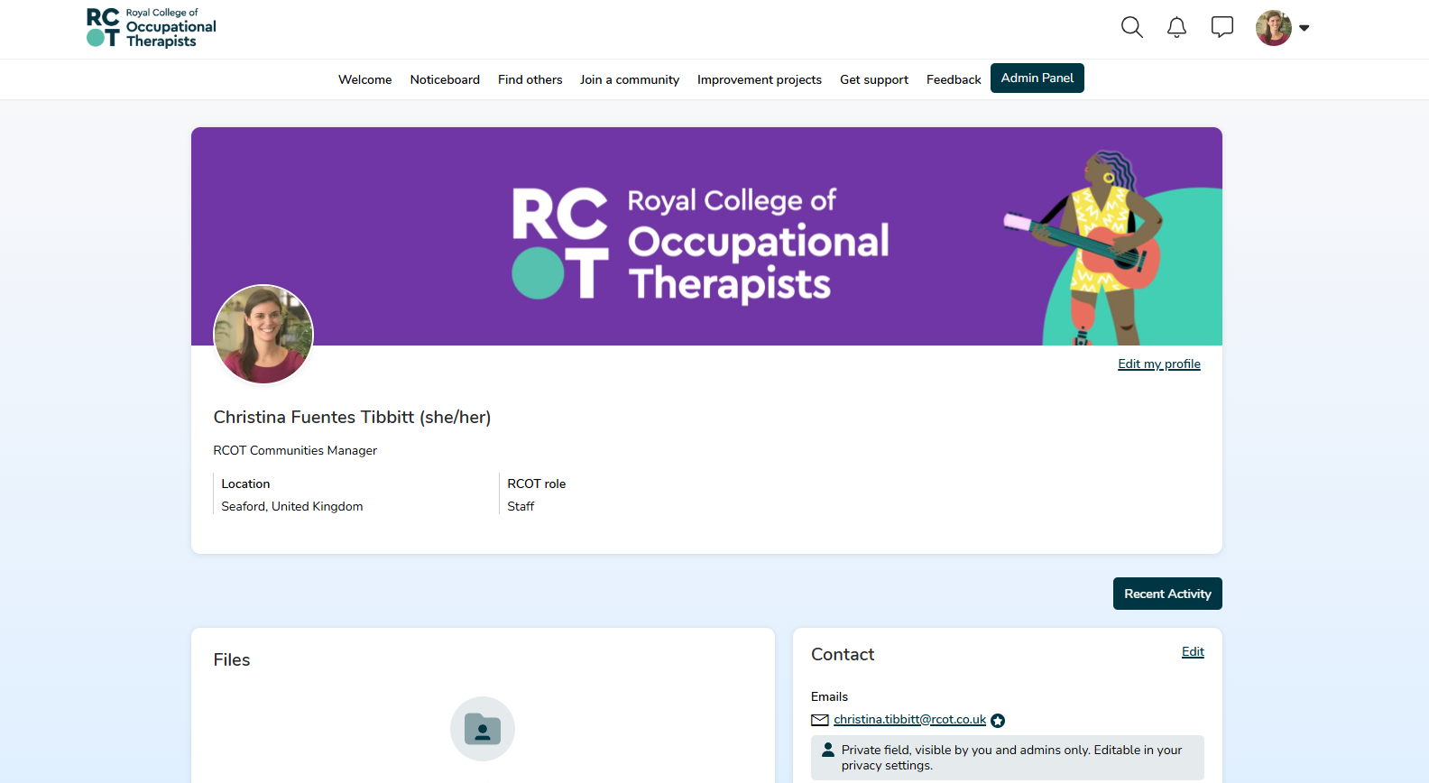
Your profile

Slide 24
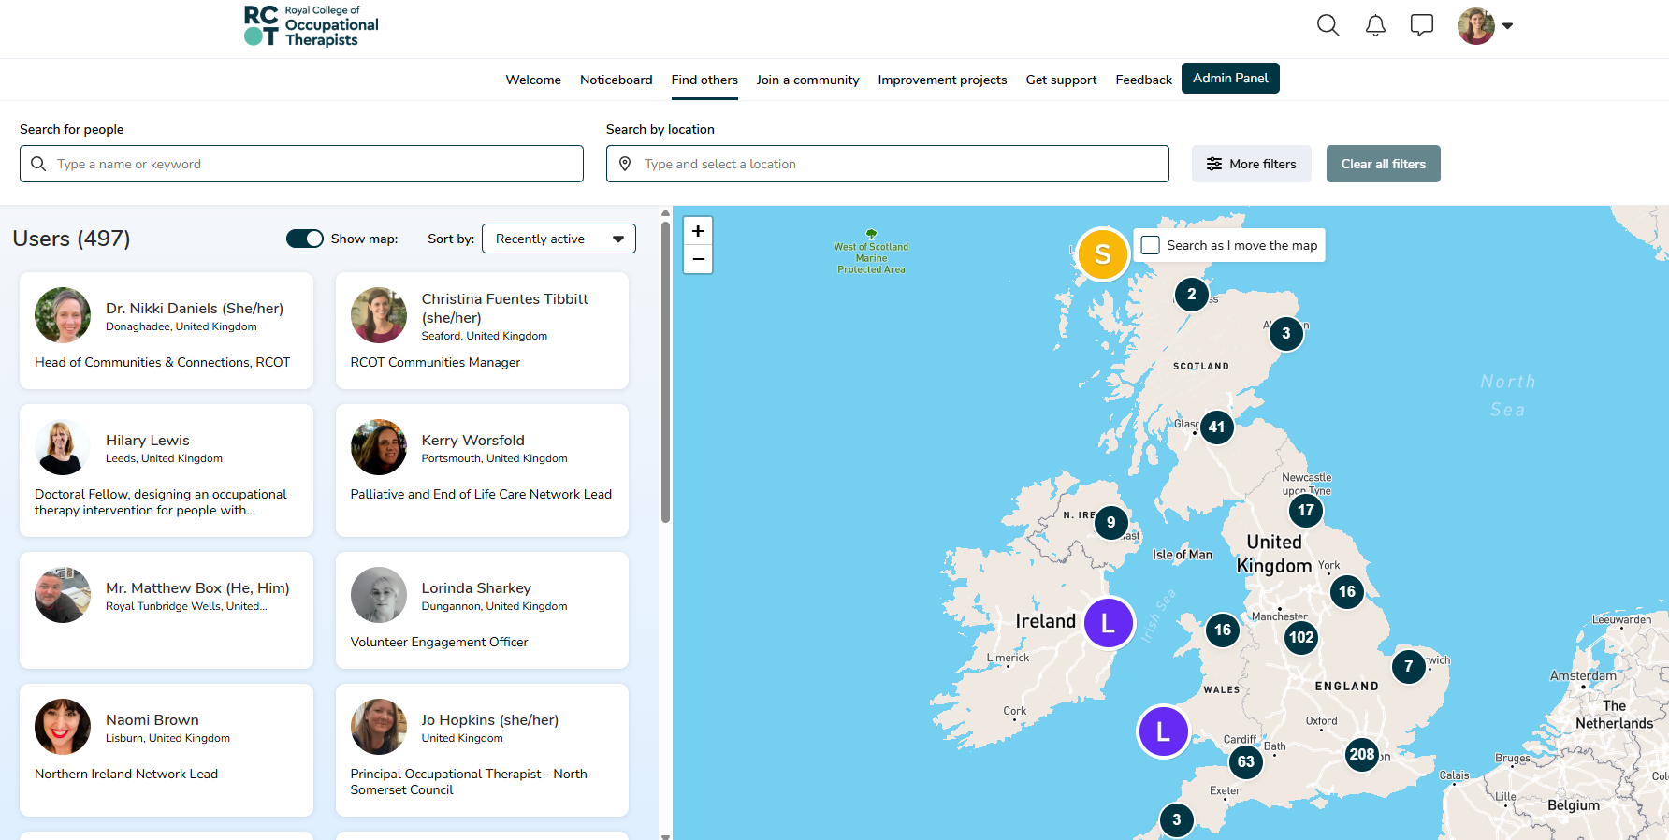
Finding others

Slide 25
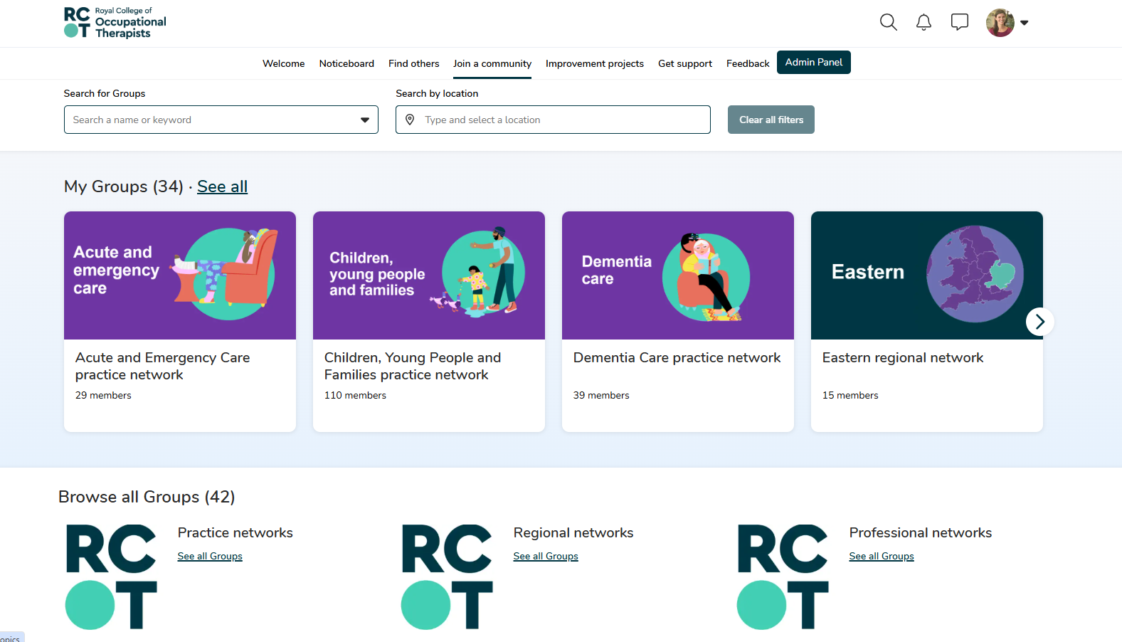
Joining communities

Slide 26
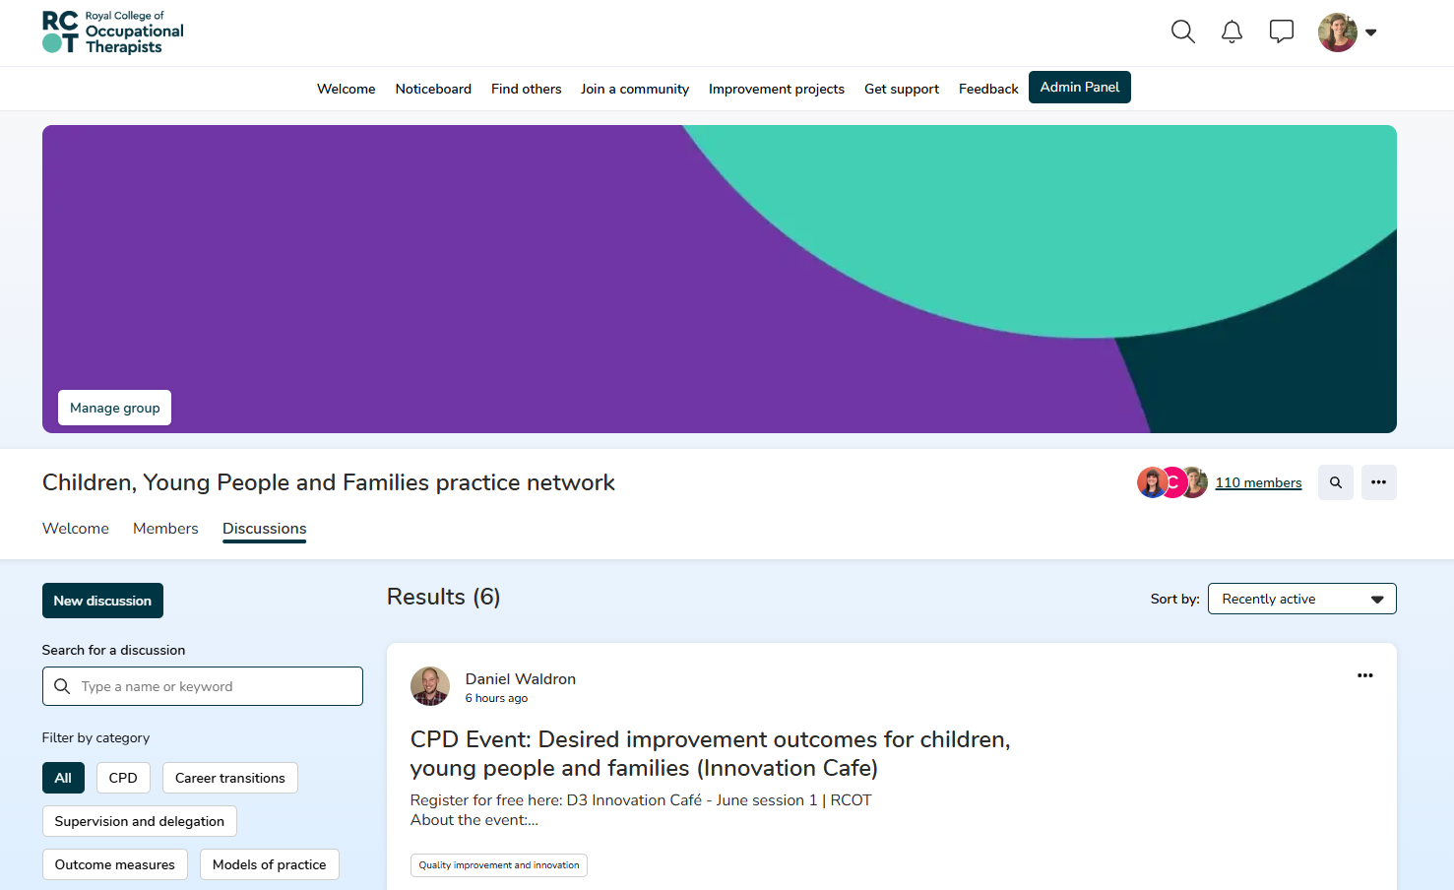
Sharing and discussing

Slide 27
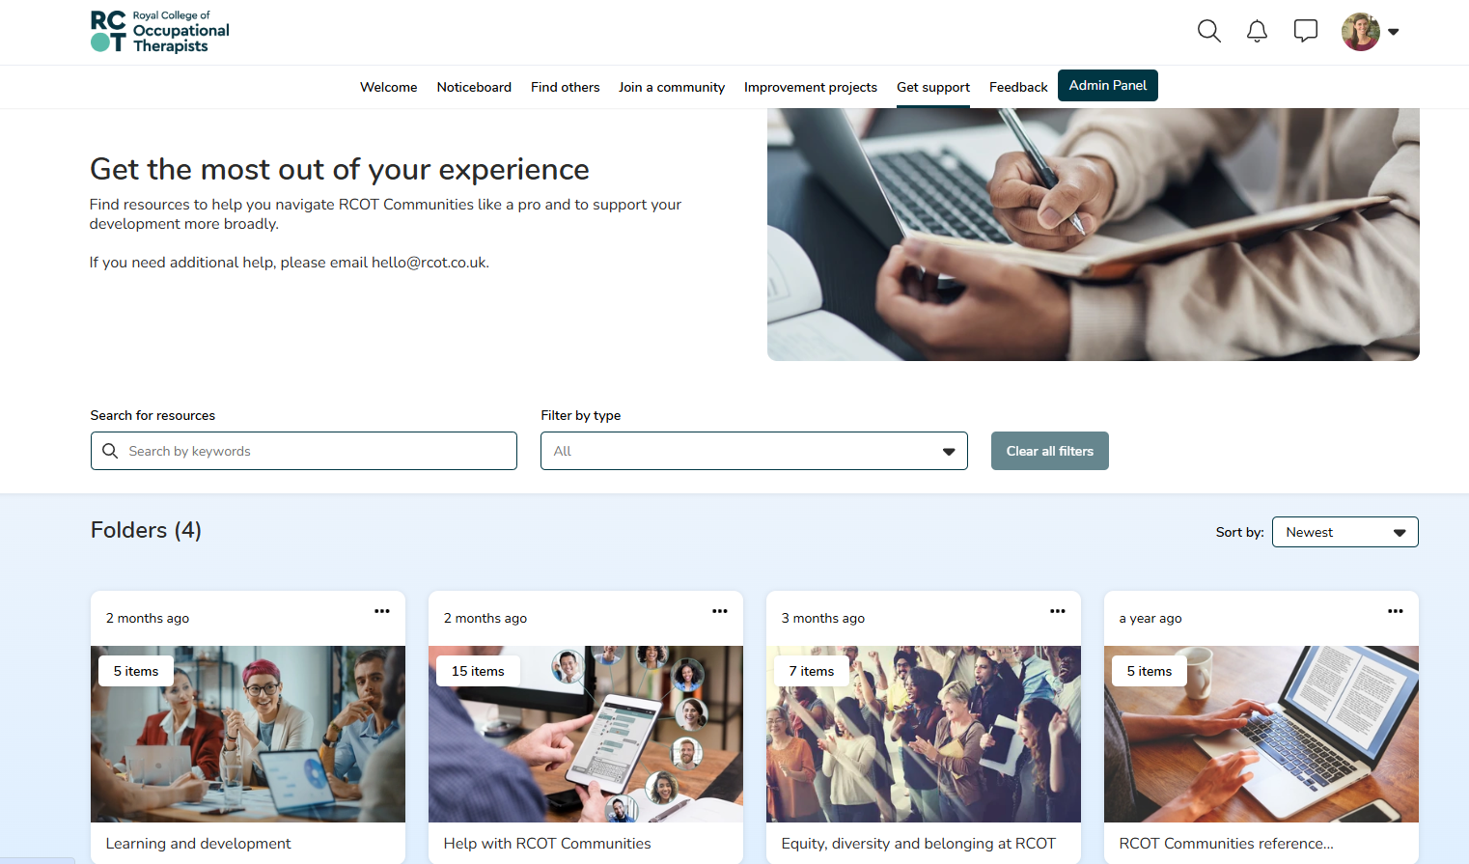
Getting support

Slide 28
Your RCOT member benefits

Slide 29
Unlock your digital benefits in 3 steps!
activate your new online member account
1
build your community
3
personalise your profile and preferences
2

Slide 30
Questions?

