Slide 1
RCOT website walkthrough
Notes:
Our vision and purpose
The journey that we are to develop our services and support for members
We will offer you an intro on the types of support available across a range of themes, with a spotlight on CPD
Get involved options
Showcasing our members unique stories and voices throughout our presentation

Slide 2
Our speakers today
Clare Cochrane, Director – Brand and Marketing
Anna Faithfull, Head of Digital Channels

Slide 3
Transforming your membership experience

Slide 4
Our digital transformation
A member offer that reflects the needs and opportunities of our people and profession
New member benefits and improved digital experiences
Developed in response to members’ feedback, insights and research findings
More features and functionality to come over time.
Over time we’ll be able to share tailored content and recommendations based on your career stage and interests.

Slide 5
Your new member benefits and improved digital services
A new and more user-friendly website
RCOT Communities, your online networking platform.
An upgraded digital version of OTnews
More streamlined access to all your RCOT digital services
An enhanced online member account
All included in your RCOT membership

Slide 6
How transforming your digital experiences supports you
More personalised content and experiences for members
Better and more seamless access to benefits and services on the go
Improved data and insight and evidence based decisions about future improvements
Stronger advocate for our profession
More user friendly, accessible and compatible with assistive technology

Slide 7
About our new website

Slide 8
Our website journey to date
Ongoing user feedback
Member research
Dedicated website discovery
Design and build
User testing
Launch
Notes:
1.5 years end to end – understanding the issues, and looking for ways to solve them
Mobile-first approach to ensure we can support busy OTs on the go

Slide 9
What we achieved in discovery
Used insight from a dedicated member review project – ensuring we could better meet identified needs
Pulled together insights around content performance
Streamlined the content and navigation
Looked at software options for our website platform, as well as the member portal – ensuring a ‘future forward’ solution, as well as single sign-on to other member-benefit platforms

Slide 10
Testing strategy
User acceptance testing
Usability testing with RCOT members, non-members, and partners
Content written in plain English and peer-reviewed
Five in-depth and focused testing sessions with a dedicated external accessibility partner
‘Pen testing’ to ensure the site is secure
Ongoing accessibility compliance
Thank you to AbleOT who supported us with accessibility testing
Notes:
Working with users with different impairments or access needs to understand how they can use the site and identify barriers. Testers had a range of impairments including sight impairments, physical impairment, neurodivergence and hearing impaired, or cognitive impairment

Slide 11
Our approach to accessibility
AA accessibility rating
Woven into design, code, and content
Dedicated accessibility testing
Notes:
Accessible and inclusive language and text
Inclusive, easy to read, and reflect realistic search terms
Call to actions that make sense out of context
Aiming for ~12 YO reading age (~18 years for academic content)
Built with assistive technology in mind
Compatabile with assistive technology (screen readers, magnifiers, other plug ins)
Use of headings, bullet points, buttons for links or actions, yellow highlight (focus) used for tabbing
Intuitive order of content
Alternative text to give context to images used for visually impaired users or those using screen readers
A more cohesive browsing experience
Secure and seamless integration and single sign on for different RCOT services and benefits
Ability to set preferences to tailor content and information
Third party software and features meet same accessibility standards (e.g. cookie plug-in, payment forms etc.)

Slide 12
Long-term website goals
A more user-friendly experience for members and website visitors:
Improved navigation, better layouts for readability (and findability), expanded use of colour as an identifier
Group together related content, focused on specialisms and career stages
Improved online member account with better self-serve options and tailored content suggestions
Single point of access to all the digital systems and tools your RCOT membership offers:
CPD portfolio
Resource Centre including Digital library
RCOT Communities
Improving our approach to accessibility

Slide 13
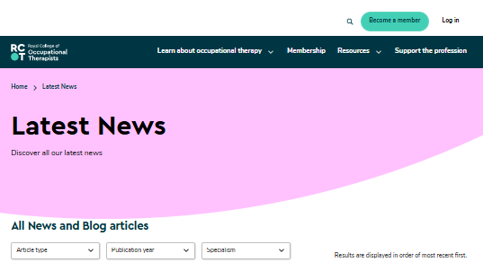
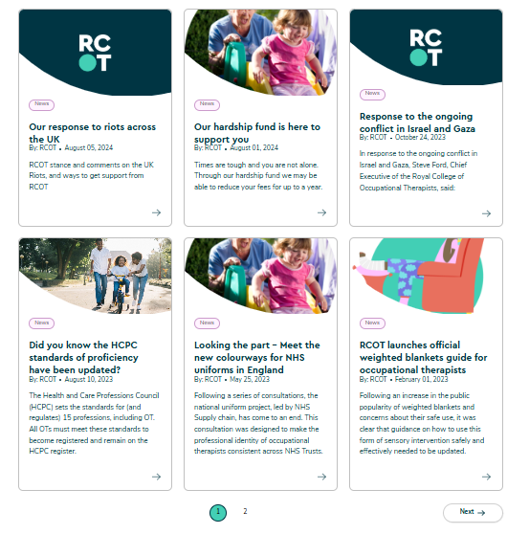
Navigating news – landing page

Slide 14
News – detail page

Slide 15
About our new website
More accessible
More intuitive navigation
New resource centre
Your gateway to digital services
Enhanced online account
Inclusive language
Tested with members of AbleOT
Aiming for AA rating – Web Content Accessibility
Your secure login gives you seamless access
Use CPD portfolio, RCOT Communities and Digital Library
Take control of your membership
Set your preferences for how you want to hear from us
Tell us what you want to hear more about
Easily search and find professional standards, practice resources, explore OT topics
Browse Digital Library resources
Access BJOT resources
More user-friendly
Upgraded search function
Fresh look and feel
Optimised for desktop, tablet or mobile
Compatible with assistive technology

Slide 16
Lets take a look!

Slide 17
Navigation
Insert recorded demo of the website here, to be talked through live but with the actual moving through the site recorded
Important to pick up on where things now sit, particularly if popular pages have moved
Showcase any new features

Slide 18
Registering for a web account
Insert recorded demo of the website here, to be talked through live but with the actual moving through the site

Slide 19
Your membership account
Insert recorded demo of the website here, to be talked through live but with the actual moving through the site
Demo should cover key elements of the account
Info on where to find your benefits and how to access them – cpd portfolio, communities etc

Slide 20
Your profile
Walkthrough of setting up the profile and what each preference will mean for them in the future

Slide 21
Your RCOT member benefits

Slide 22
Unlock your digital benefits in 3 steps!
activate your new online member account
1
build your community
3
personalise your profile and preferences
2

Slide 23
Join our next events
Making the most of RCOT Communities: Monday 19 May, 12–1pm
Introducing your new RCOT benefits: Thursday 29 May, 3–4pm
Book your place here: Events | The Royal College of Occupational Therapists

Slide 24
Questions?

