Slide 1
Right Support, Right Time
Unlocking the Power of OT
Notes:
Welcome and thanks for joining.
This session introduces the Royal College of Occupational Therapists’ new campaign:
Right Support, Right Time: Unlocking the Power of OT.
The campaign positions occupational therapy at the heart of health and care.
It’s about shifting the focus to prevention – helping people earlier, easing pressure across services, and showing how OT is an essential part of the solution.
As occupational therapists, we see the impact of early support every day – this campaign helps us share that with others.
It’s about making occupational therapy more visible and better understood across health, education and care.
I’ll start by talking about why this matters and what needs to change.
Then we’ll open up the conversation about what this means for us and how we can use it in conversations with the people who shape services, systems and support.

Slide 2
The power of early support
Occupational therapy helps people stay well for longer and avoid crises – especially when occupational therapists are involved early.
Our timely input helps manage changes before they become complex and entrenched.
Right Support,
Right Time
Notes:
Early support makes all the difference and as occupational therapists we are uniquely placed to provide it.
We help people stay well and avoid crises, but only if we’re involved early enough.
Our input can prevent needs from becoming more complex, entrenched or costly to manage.
We don’t just respond to problems, we help stop them from escalating in the first place.
This matters to everyone in the system – whether you're working in education, commissioning, primary care or employment – because early OT involvement leads to better outcomes and more sustainable services.
We want to shift the mindset from ‘wait and see’ to ‘act early’ – and show how occupational therapy enables that shift.

Slide 3
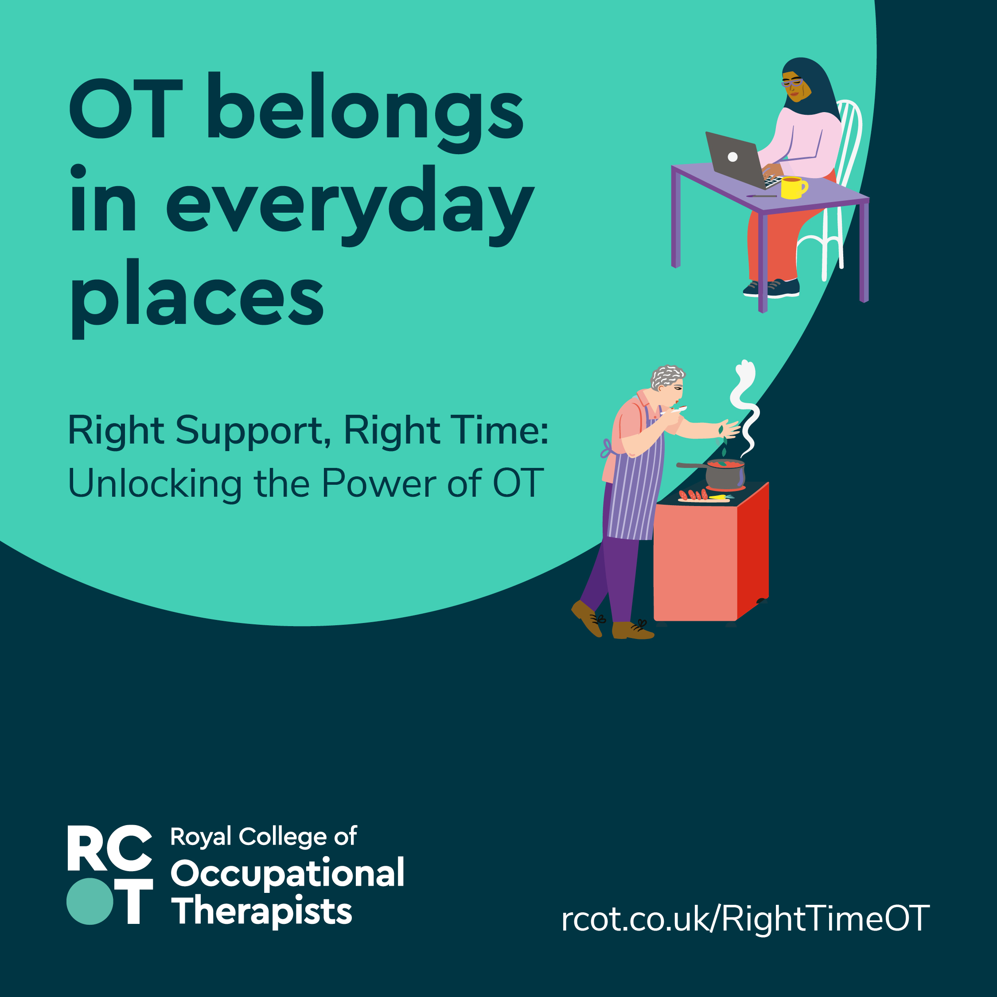
Unique skills, maximum impact
Occupational therapists bring unique skills that make the biggest difference when used early and in the right way.
Our person-centred approach looks at the whole person – environment, routines, goals and challenges – to offer practical, everyday solutions.
Notes:
Occupational therapists bring a unique skillset that’s often overlooked – but it’s exactly what’s needed to support people earlier and more effectively.
We take a whole-person approach – looking at someone’s environment, routines, goals and challenges – not just their diagnosis or symptoms.
This allows us to offer practical, everyday solutions that fit into real lives and real settings.
When we’re involved early and able to work in the right way, our impact is significant – for individuals, families and services.
That’s why we’re asking you to think differently about how and when occupational therapy is used.

Slide 4
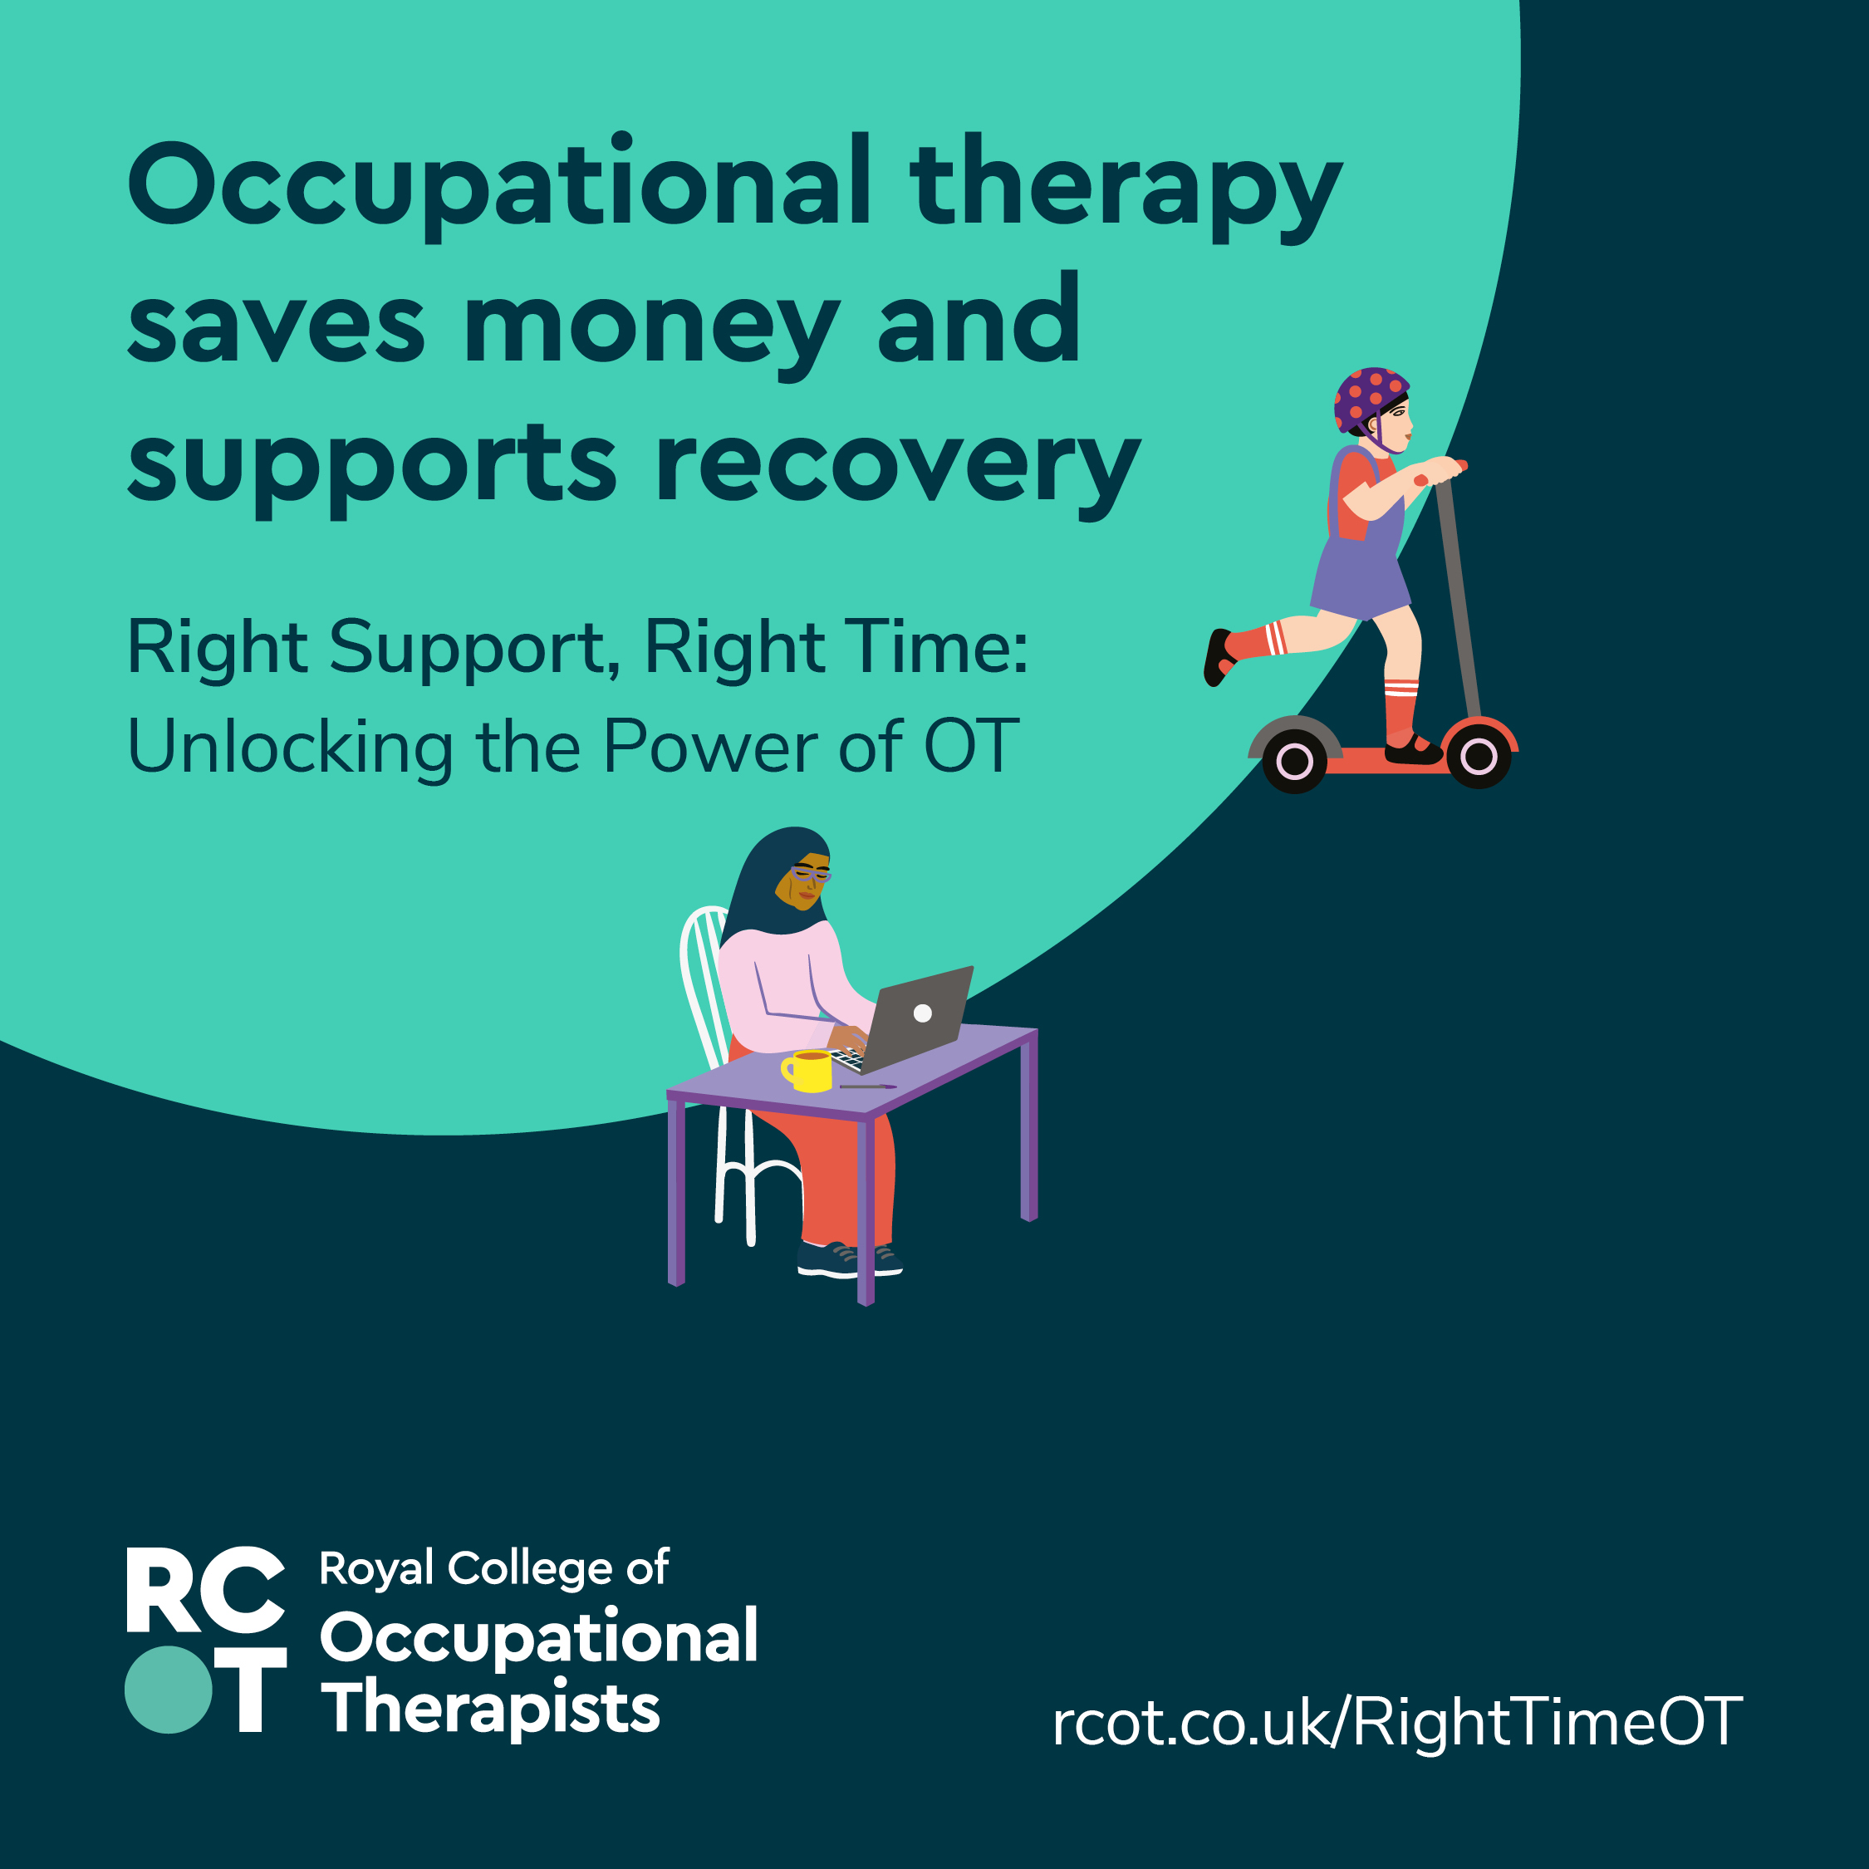
Reducing pressure across systems
Occupational therapists help ease pressure across health, social care and special education services.
  We support safe discharge from hospital and recovery in familiar settings.
  We enable people to live well in their communities.
  We help people take part in education, employment and leisure.
  We prevent needs from escalating and reduce reliance on acute services.
Notes:
Occupational therapy plays a vital role in helping health, social care and special education services work more effectively.
By supporting safe discharge from hospital, enabling people to live well in their communities, and helping them take part in education, employment and leisure, we reduce pressure on acute services.
This isn’t just better for individuals – it helps prevent needs from escalating and reduces long-term reliance on services.
Occupational therapists offer practical, high-impact solutions that make systems more sustainable and responsive to people’s needs.
It’s time to recognise the full value of occupational therapy in creating better outcomes and more efficient services.

Slide 5
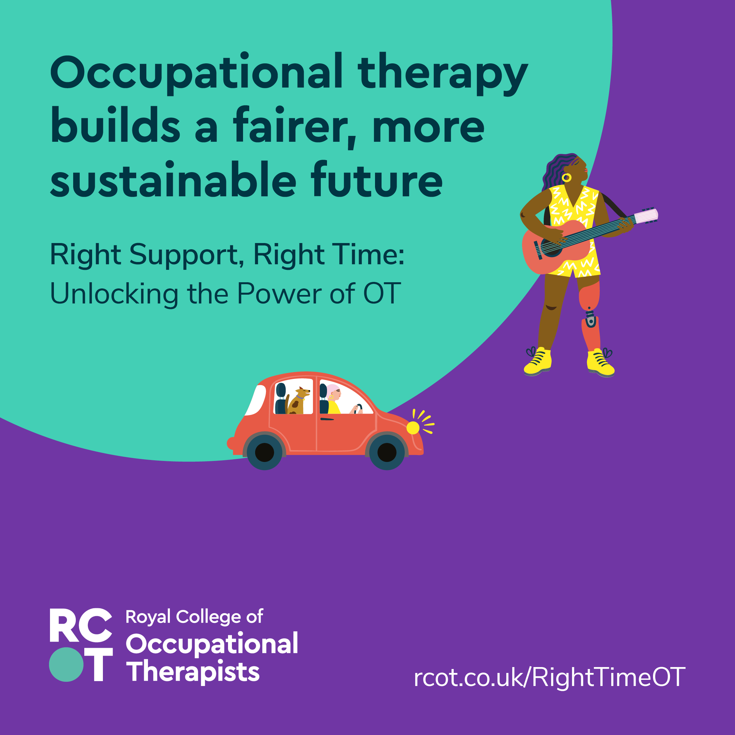
Supporting inclusion and sustainability
Occupational therapists help reduce health inequalities and improve sustainability.
  We connect people to activities that support their health and wellbeing.
  We promote social inclusion by supporting participation in work, education and leisure.
  We help prevent illness by getting involved early and responding to population needs.
  We support people to engage with their communities and build meaningful lives.
  We reduce demand on hospital services, saving time, costs and energy.
Notes:
Occupational therapy helps create fairer, more sustainable systems.
We help reduce health inequalities by connecting people to the activities that support their wellbeing – including work, education, leisure and community participation.
By getting involved early, we help prevent illness and reduce long-term reliance on services.
Our approach promotes social inclusion and can offer a route out of poverty for many.
Occupational therapists also support sustainability by helping services respond to population needs, reducing unnecessary hospital admissions and making better use of resources, time and energy.
Occupational therapy is a catalyst for inclusive, efficient and future-ready services.

Slide 6
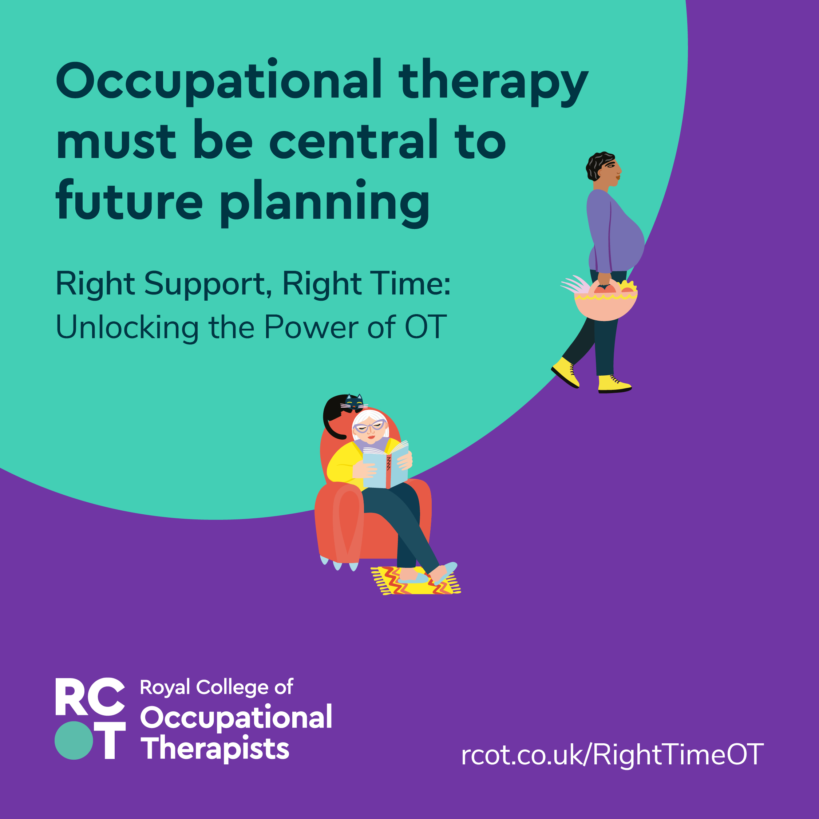
Shifting the focus to prevention
We need to move from crisis-driven care to prevention-focused approaches.
The right support at the right time has the greatest impact.
This means involving occupational therapists early and enabling us to work in ways that make full use of our expertise.
Notes:
As occupational therapists, we see the difference early support can make – and we know how often people only get help when things have already reached crisis point.
We want to change that – to shift the focus from reacting to problems, to preventing them.
The right support at the right time doesn’t just improve outcomes – it reduces pressure on services and helps people live better lives.
That means involving us earlier and enabling us to work in ways that make full use of our expertise.
We’re asking you to think about how your services could work differently – and how occupational therapy could help make that happen.

Slide 7
Embedding in communities
Notes:
To make prevention-focused care a reality, occupational therapists need to be embedded in the places where people live, work and seek support.
That means being part of everyday settings – like GP practices, schools, housing services and community mental health teams.
We need to be visible and accessible – not just in hospitals or specialist services, but across the whole system.
The next few slides will show what this looks like in practice – across children’s services, hospitals, workplaces and primary care.
These are the kinds of conversations we want to be having – with the people who shape services and decide where OT is used.

Slide 8
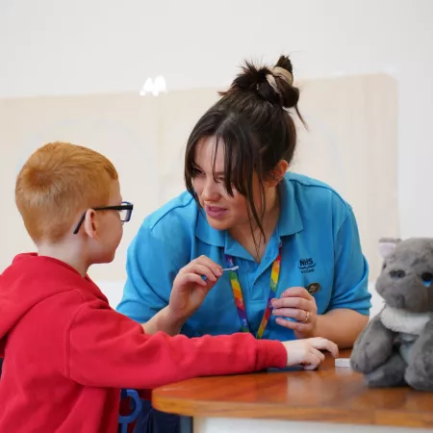
Helping children to thrive
When children are seen by occupational therapists early, their needs are less likely to become complex.
With the right support at the right time, occupational therapy helps children thrive, reach their potential and live their best lives.
Notes:
Occupational therapists working with children can make a huge difference – especially when we’re involved early.
We help identify and address needs before they become more complex or entrenched.
With the right support at the right time, children are more likely to thrive – in their development, learning, and everyday life.
This is about enabling children to reach their full potential, not just managing difficulties.
For those working in education, commissioning or planning services – this is a call to think about how and when OT is involved, and how early support can change outcomes.

Slide 9
Reducing readmissions and easing pressure
In hospitals, occupational therapists help people recover safely at home, reducing the risk of readmission and easing pressure on the NHS and social care.
In emergency departments, our input during triage can speed up access to the right care and sometimes prevent admission altogether.
Notes:
In hospital settings, we help people recover safely at home – reducing the chance they’ll need to come back.
That means fewer readmissions, smoother discharges, and less pressure on stretched services.
In emergency departments, we can be part of triage – helping people get the right care sooner and sometimes avoiding admission altogether.
This is about using our skills where they have the most impact – not just at the end of a pathway, but right at the start.
If you’re involved in designing hospital services or managing patient flow, this is a chance to think differently about how and when occupational therapy is used.

Slide 10

Keeping people in work
Occupational therapists use rehabilitation-focused approaches to prevent long-term absence and unemployment.
By addressing barriers to work early, we help people stay employed, reduce the harms of unemployment, and promote accessible, sustainable employment – recognising work as a key health outcome.
Notes:
Occupational therapists support people to stay in, return to, or thrive in work – using rehabilitation-focused approaches tailored to individual needs.
We identify and address barriers early – whether physical, psychological, social or environmental – before they lead to long-term absence or unemployment.
Work is widely recognised as a key health outcome, and our role is to help people maintain that connection.
This kind of proactive support reduces the harms of unemployment and promotes accessible, sustainable employment.
For employers, HR teams and occupational health providers – this is about recognising OT as a vital part of workforce wellbeing and retention.

Slide 11

Proactive support in primary care
In GP surgeries and community settings, occupational therapists provide early support that prevents problems from escalating.
We help people manage long-term conditions, mental health needs, fatigue, frailty and more – using innovative approaches like AI risk-spotting, memory clinics and therapy-led pain management to improve lives and reduce system pressure.
Notes:
In primary care, occupational therapists offer early, proactive support that helps prevent problems from escalating.
We work with people managing long-term conditions, mental health needs, fatigue, frailty, and more – often before they reach crisis point.
Our approach is practical and person-centred, helping people build resilience, self-manage and stay safe and well.
We’re already using innovative methods – like AI to spot risk, memory clinics for early dementia and therapy-led alternatives to pain medication.
For GPs and primary care teams, this is about recognising how OT can reduce demand, improve outcomes and support integrated care.

Slide 12
A central role in future planning
Occupational therapy must be central to the future of health, education and care.
By recognising its value and enabling occupational therapists to work in the right way, we can build a proactive, person-centred system that supports people to live well and thrive.
Notes:
Occupational therapy isn’t a nice-to-have – it’s central to building the kind of health, education and care systems we all want to see.
When we’re recognised, resourced and enabled to work in the right way, we help create proactive, person-centred systems that truly support people to live well.
This campaign is about making that case – clearly, confidently and collectively.
As occupational therapists, we’re ready to be part of the solution. We just need the system to make space for us.
Thank you – and we look forward to working with you to make this happen.

Slide 13
Right Support, Right Time: Unlocking the Power of OT

