Slide 1
Transitioning to practice
Today's speakers:
Dr Nikki Daniels
Head of Professional Development
Carolyn Hay
Head of Education
Sheetal Girdhari
Head of Marketing Services

Slide 2


Slide 3
Four actions for you:
1.
Get connected
2.
Recognise your skills, knowledge, and goals
3.
Raise your profile
4.
Stay informed

Slide 4
Be a part of your RCOT community
1.
Get connected

Slide 5
Start connecting
In the chat:
What networks are you part of?
What networks are you looking forward to being part of?
Share the benefits of being part of a network
1.
Get connected

Slide 6
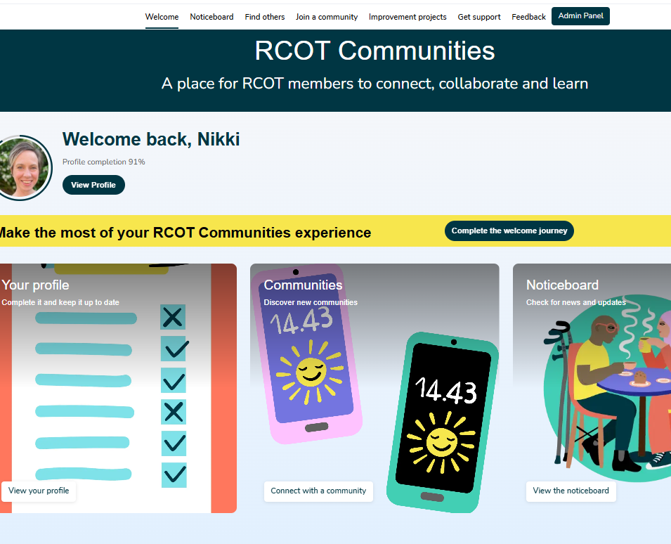
RCOT Communities: a new place to connect
A space for meaningful professional relationships
Inclusive and accessible for all members
Connect through shared challenges, aspirations, and values
Join member-led professional, practice, and regional networks
Access tailored activities and resources shaped by member insights
Engage flexibly – share resources, ask questions, co-create ideas
Learn from diverse experiences and perspectives
Collaborate to drive innovation and influence the future of occupational therapy in the UK
Notes:
As occupational therapists, you deserve a professional home — somewhere that supports growth, celebrates achievements and connects you with others who truly understand your journey.
RCOT is that home.
And with RCOT Communities, our new online engagement platform, you can foster meaningful professional relationships.
It’s inclusive and accessible, ensuring that every member feels welcome and supported.
This is where you can connect with others who share your challenges, aspirations and values—whether through professional, practice, or regional networks that are led by members themselves.
What makes RCOT Communities unique is its flexibility. You can engage when it suits you—sharing resources, asking questions, or co-creating ideas.
The activities and resources available are shaped by member insights, making them highly relevant and responsive to your needs.
At its heart, RCOT Communities is about learning from each other’s diverse experiences.
It’s a place to collaborate, drive innovation, and influence the future direction of occupational therapy across the UK.

Slide 7
Your initial professional networks
Research Connect
Innovation Hub
Leadership
Facilitating Learning
Independent Practice
Artificial Intelligence and Technology
Notes:
Our professional networks connect members around pillars of practice and professional issues.
Our initial professional networks include Research Connect and the Innovation Hub. We’ve also created networks for members to connect around leadership, independent practice, facilitating learning and most recently AI and techonology,.

Slide 8
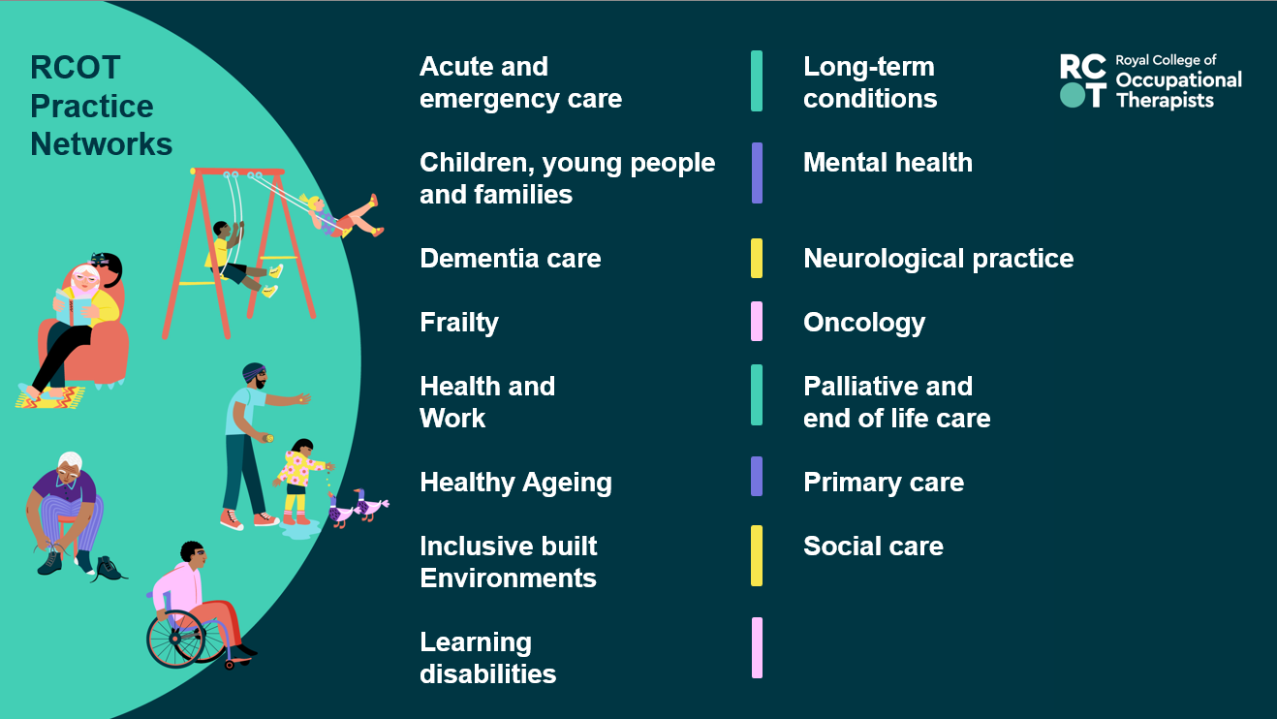
Notes:
Occupational therapists across the UK are connecting through vibrant practice networks.
These communities offer a space for peer support, shared learning, and professional growth.
Whether you're looking for guidance, inspiration, or simply to connect with others who understand your area of practice, these networks help OTs feel supported and stay connected to the wider profession.

Slide 9
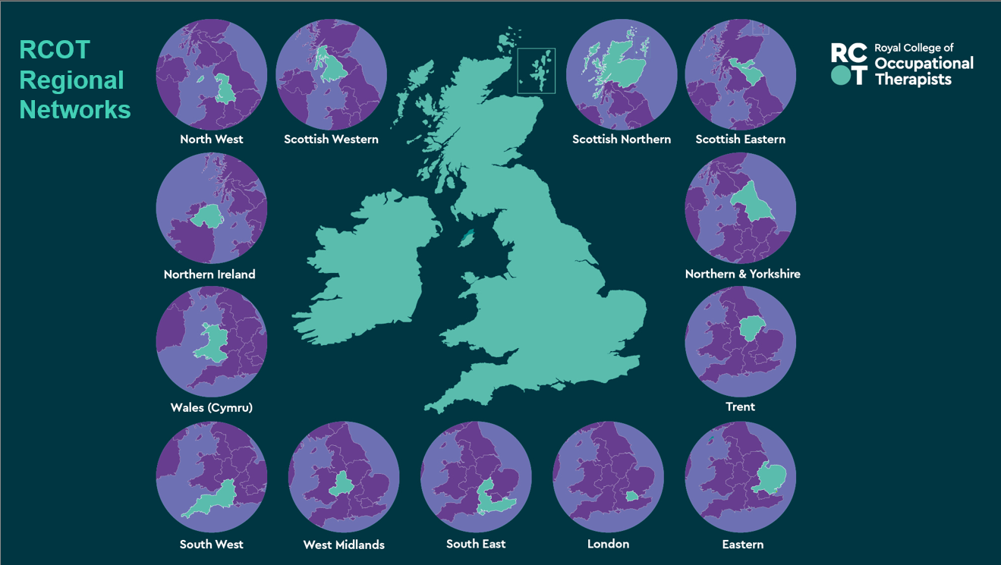

Slide 10
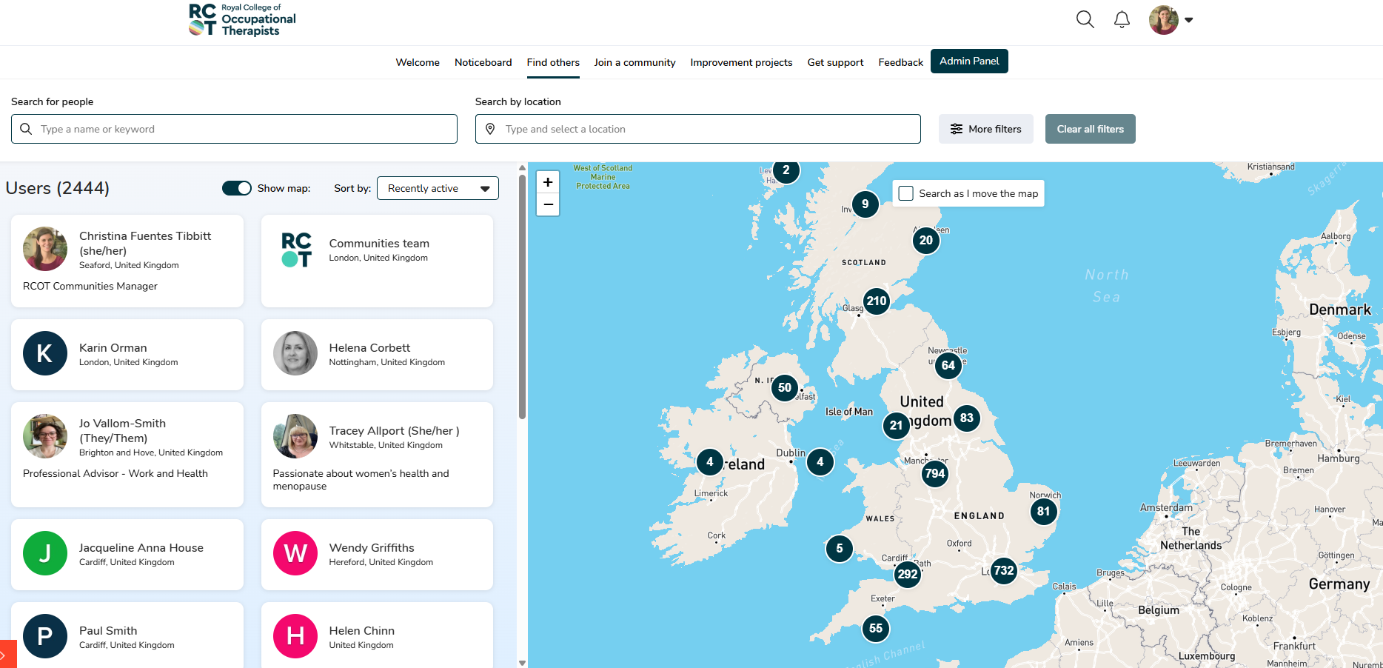
Finding others
Notes:
One of the most exciting features of RCOT Communities is the member directory. If you click on ‘Find others’ in the top toolbar, you’re taken to the directory of all members and staff on the platform who have agreed to share their rough location. The map is interactive, so you can zoom into different areas to see which members are nearby, and you can then click on their profiles and send them direct messages if you’d like.

Slide 11
Invest in your development with RCOT
2.
Recognise your skills, knowledge and goals
Notes:
Your work makes a difference — and it deserves to be seen.
We celebrate the achievements of occupational therapists across the UK.
Whether you’re publishing research, leading innovation or supporting your community, we’re here to help you shine.

Slide 12
The why behind professional development
Supports personal and professional learning and growth
Leads to career opportunities and progression
Ensures safe and effective practice
Improves service delivery
Benefits the people we work with
To meet our professional standards, including audit
Getting into good habits as you transition to practice is a great place to start!

Slide 13
We know CPD is essential
We’ll help you develop good CPD habits
to ensure safe and effective practice, and to comply with HCPC CPD standards
We’ll support you to record your CPD
so you feel as prepared as possible for future CPD audits
We’ll give you a place to record your reflections
to support your lifelong learning and career development
Notes:
One of the most practical tools you get with RCOT membership is your very own CPD portfolio.
It’s designed to help you capture your learning and development throughout your career — all in one place.
You can record activities, reflections and evidence on the go, making it easy to stay organised and up to date.
It’s also built to help you meet HCPC CPD standards, so when audit time comes around, you’ll feel confident and prepared.
It’s about taking the stress out of CPD and making it work for you

Slide 14
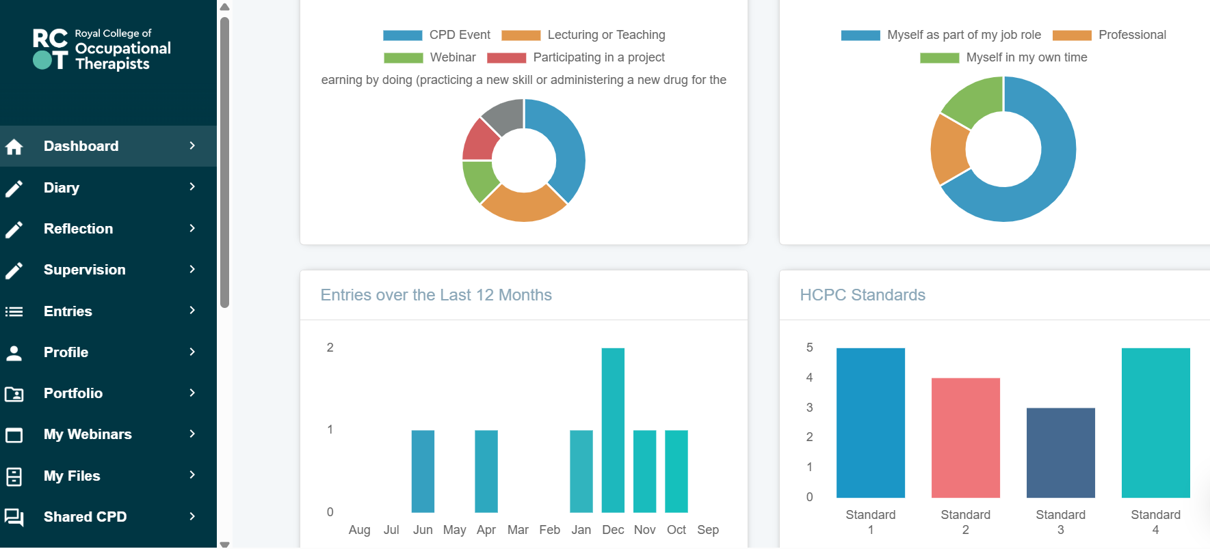
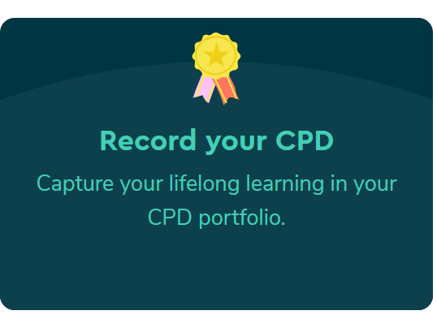
Your CPD portfolio

Slide 15



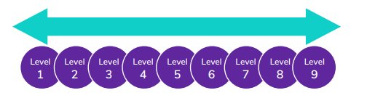

Slide 16
Celebrate your achievements and those of your colleagues
3.
Raise your profile
Notes:
Your work makes a difference — and it deserves to be seen.
We celebrate the achievements of occupational therapists across the UK.
Whether you’re publishing research, leading innovation or supporting your community, we’re here to help you shine.

Slide 17

Elevate your and your peers' professional reputation
Be proud of being part of your respected membership body
Become a volunteer, ambassador and changemaker
Get published in OTnews and BJOT
Share your stories
Nominate colleagues for awards and vote for Council peers
Get involved in OT Week and our annual campaign and raise your and the profession's profile
Notes:
Your work — and the work of your peers — deserves to be recognised.
Use your member logo to show you’re part of a respected professional body.
Share your stories, publish in OTnews or BJOT, and help raise the profile of the profession.
You can also nominate colleagues for awards or vote for Council members — it’s a great way to celebrate others and shape the future.
Whether you volunteer, join a network or support a campaign like The Power of OT, there are so many ways to get involved and make an impact.

Slide 18
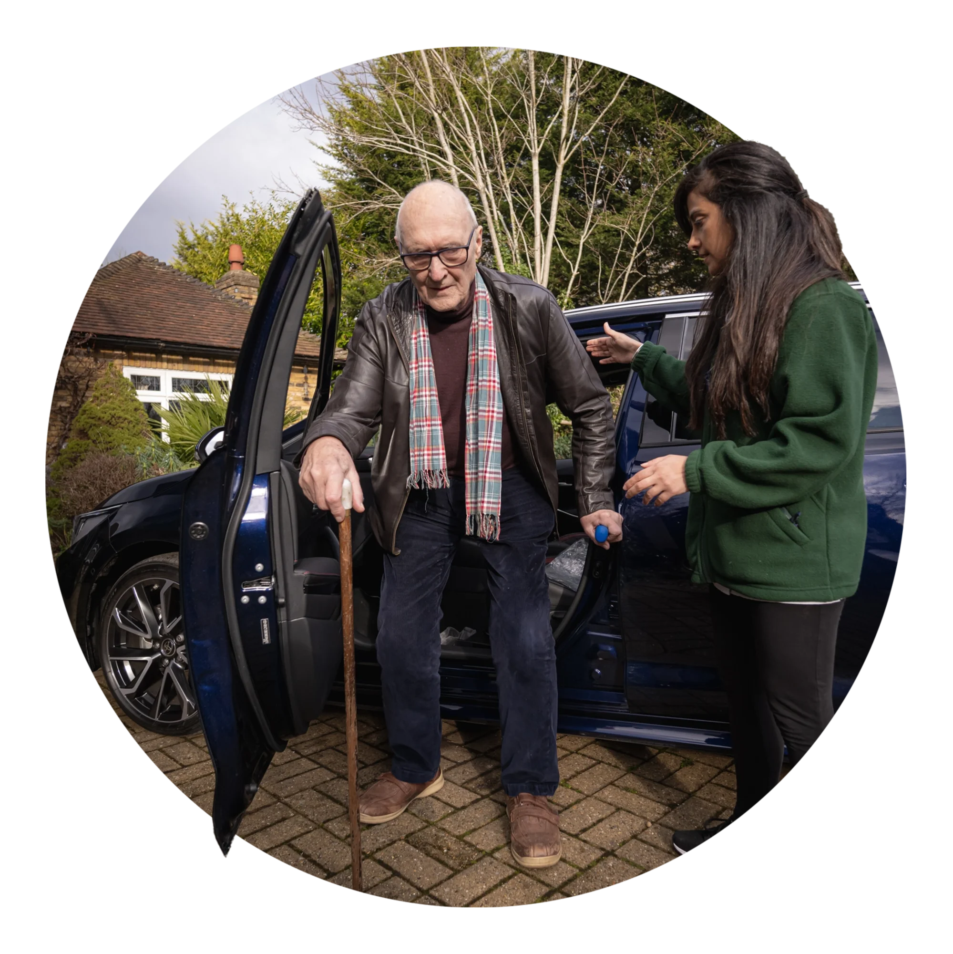
Make your voice count
Share your insights through consultations, surveys, and RCOT Communities
Join networks, cafés, and advisory groups
Collaborate on research, placements, and innovation
Support campaigns like The Power of OT and the Innovation Hub
Shape national strategies and co-design change projects
Champion equity, diversity, and belonging in your practice
Notes:
You bring the insight — and we’ll give you the platform.
Whether it’s through consultations, surveys, or discussions on RCOT Communities, your voice matters.
You can also get involved in networks, cafés, and advisory groups to collaborate on research, placements, and innovation.
Support campaigns like The Power of OT or contribute to projects like the Innovation Hub — and help drive meaningful change.
We believe every member has the power to lead change — and we’re here to help you do just that.
From shaping national strategies to championing equity and influencing policy, we’ll support you to lead with confidence.

Slide 19

Volunteer and be a change agent
Shape the future: build vibrant, connected communities
Develop new skills: leadership, collaboration and CPD
Build strong connections with like-minded professionals
Make an impact: lead initiatives that reflect your community’s needs
Gain recognition for your contributions
Notes:
Volunteering with RCOT is a powerful way to grow professionally while making a meaningful impact.
You’ll help shape vibrant communities, develop leadership and collaboration skills, and build strong professional networks.
Your contributions will be recognised, and you’ll be supported every step of the way — from onboarding to peer support and annual reflection.
It’s a chance to thrive while helping others do the same.

Slide 20
Access exclusive resources and stay up to date
4.
Stay informed
Notes:
Your work makes a difference — and it deserves to be seen.
We celebrate the achievements of occupational therapists across the UK.
Whether you’re publishing research, leading innovation or supporting your community, we’re here to help you shine.

Slide 21
Learn and research
Research Connect
Innovation Hub
Events and learning opportunities – attend webinars, workshops and conferences
Access resources 24/7 to support practice, learning, research and CPD
New digital resource centre
Digital Library with online databases, books, journals, RCOT publications, theses and grey literature
Alongside the OT titles, you’ll find topics such as leadership and equity, diversity and belonging
Leadership
Facilitating Learning
Leadership
Facilitating Learning
Notes:
You’ll have access to a wide range of learning opportunities — from webinars and workshops to our Annual Conference.
You can access resources 24/7 to support your practice, learning, research and CPD.
Our new digital resource centre brings everything together in one easy-to-use space.
The Digital Library is packed with online databases, journals, books, RCOT publications, theses and grey literature.
And it’s not just OT-specific — you’ll also find content on leadership, equity, diversity and belonging to support your broader development.

Slide 22
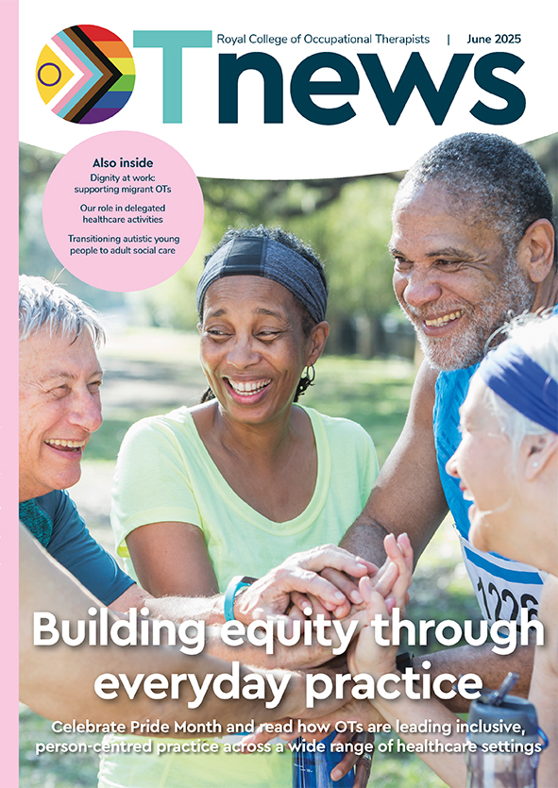
Your essential updates and tools
OTnews, your monthly membership magazine
Highlight, your monthly email update
Supplier Directory, connecting you to trusted products and services.
Social media stories and news
R&D Bulletin, your research newsletter
British Journal of Occupational Therapy (BJOT)
Notes:
We’ll keep you in the know with OTnews, your monthly magazine full of real stories and insights.
Highlight lands in your inbox each month with quick updates and opportunities.
Follow us on social media for daily inspiration and news.
Into research? The R&D Bulletin and BJOT give you the latest thinking and evidence.
And when you're looking for trusted tools and services, our Supplier Directory helps you find the right fit for your practice.
However you like to stay informed and equipped, we’ve got you covered.

Slide 23

Help shape our Early Career Standards
Establishing a sense of belonging and inclusion
Structured supervision and support
Professional development and lifelong learning
Sustaining personal health and wellbeing
Professional identity and networking
Developing professional capabilities

Slide 24






Leading the profession
Workforce Strategy and national action plans
Influencing policy and government across all four nations
Putting inclusion and EDB at the heart of everything we do
Raising awareness of the power of OT through our annual campaign and OT week
Funding to support research and innovation
Recognising excellence and lifetime achievement with our awards
Notes:
We’re not just supporting the profession — we’re leading it forward.
Our Workforce Strategy and national action plans are setting the direction for the future.
We’re making sure inclusion and equity are at the heart of everything we do — not just in words, but in action.
We’re investing in research and innovation, giving members the funding and support to explore new ideas and improve practice.
We’re influencing policy across all four nations, making sure occupational therapy has a strong voice where decisions are made.
Through our campaigns and OT Week, we’re raising awareness of the power of occupational therapy with the public and policymakers.
And we’re recognising the incredible work of our members through awards that celebrate excellence and lifetime achievement.

Slide 25
Welcome our guest speaker, Anna Fischer
Anna Fischer
Occupational Therapist
Health and Social Care Partnership Edinburgh

Slide 26
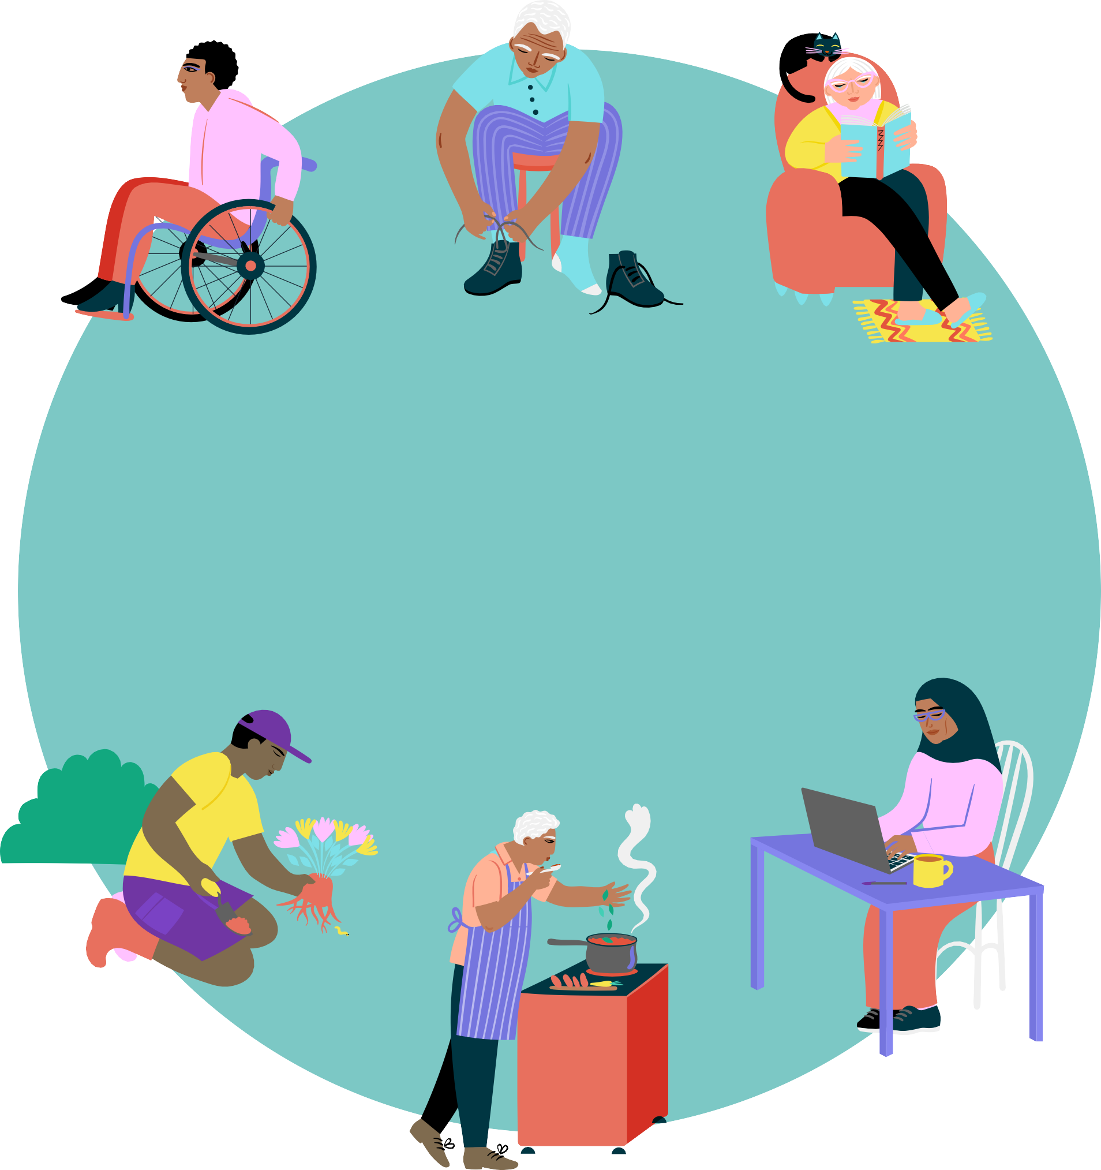

Join our community today!
Connect and collaborate
Develop and thrive
Drive change
Notes:
Ready to join? Now’s the time.
Becoming a member means getting the support, resources and community you need to thrive.
You can speak to our Membership team, come to a “Maximise your membership” event or just get in touch.
Email us at membership@rcot.co.uk or call 020 3141 4600 — we’ll help you get started.

Slide 27
Representation, professional advice, support, and insurance
UNISON membership offers workplace representation, legal support and financial assistance for you and your family
Professional Advisory Service helpline, guidance and support groups
HCPC CPD audit support
Professional Indemnity Insurance up to £10million per member
Financial support through our hardship fund to keep you connected with your community
Notes:
We’re here to support you — whether you need help right now or guidance for the long term.
Through our partnership with UNISON, you get access to legal services, financial assistance and compensation when you need it most.
You’re also covered by professional indemnity insurance — up to £10 million — whether you’re working, volunteering or on placement in the UK or overseas.
And if you ever face a complex professional issue, our dedicated advisory team is here to help you navigate it with confidence.
It’s about knowing you’re protected, supported and never alone.

Slide 28
Support you to learn, grow and progress
Help you to understand and meet the HCPC CPD standards with your own CPD portfolio
Improve your practice with access to our Digital Library and peer reviewed research with BJOT
Keep you up to date through our magazine, journal and newsletter
Plot your progress and journey through our Career Development Framework
Take the next step in your career with our easy-to-use jobs board
Build your knowledge through evidence spotlights and practice guidelines
Notes:
You’ll have access to a wide range of tools to support your learning and development.
We help you understand and meet HCPC CPD standards, so you can feel confident in your practice.
Build your knowledge with evidence spotlights and practice guidelines tailored to your area of work.
Improve your practice with access to our Digital Library and peer-reviewed research through BJOT.
And stay informed with our magazine, journal and newsletter — keeping you connected to the latest in the profession.
You can track your progress using our Career Development Framework — a great way to reflect on where you are and where you want to go.
And when you're ready for your next step, our jobs board makes it easy to find your first or next role.

Slide 29
What’s on your ‘to-do’ list?
1.
Get connected
2.
Recognise your skills, knowledge, and goals
3.
Raise your profile
4.
Stay informed

Slide 30
Questions?

