Slide 1
Maximise your membership
Your membership
Your growth
Your future
Notes:
Welcome everyone and thank you for being here.
Today’s session is all about what it means to be part of RCOT — not just as a member, but as someone who’s shaping the future of occupational therapy.
Your membership is more than a subscription. It’s a connection to a professional home, a support system and a platform for growth.
Whether you're just starting out or well into your career, RCOT is here to help you thrive.
In this session, we'll walk you through the value of being a member — from personalised support and professional development to advocacy, community and impact.
Let’s explore how RCOT can support your journey, every step of the way.
Please introduce yourself in chat, we'd love to hear from you.
This session will be recorded and available as soon as we have added captions to the recording for accessibility. The presentation slides from today will also be shared with you.

Slide 2
Who we are
We’re RCOT, the Royal College of Occupational Therapists. We’ve championed the profession and the people behind it for over 90 years; today, we’re thriving with over 36,000 members.
Notes:
So, who are we?
We’re RCOT — the Royal College of Occupational Therapists.
We’ve been championing the profession and the people behind it for over 90 years.
We’re proud to represent a thriving community of more than 36,000 members across the UK.
Our role is to support, connect and advocate for occupational therapists at every stage of their career.
Whether you're in practice, education, research or leadership, we’re here to help you make a difference.
Before we dive into the details, here’s a short video that brings RCOT to life.
It captures who we are, what we stand for and how we support occupational therapists across the UK.
Let’s take a look.

Slide 3
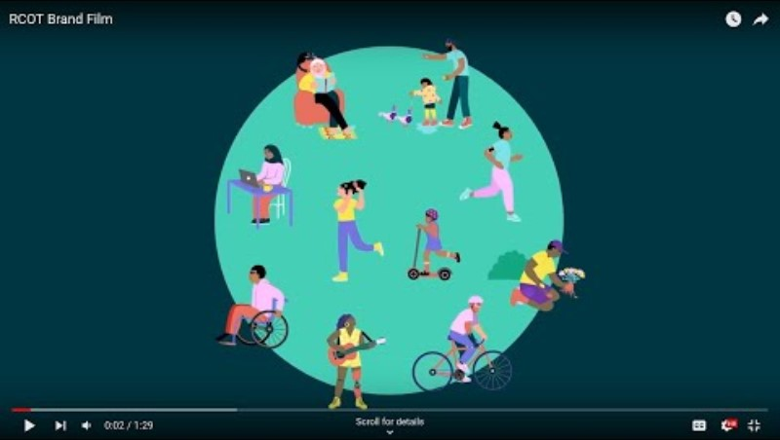
Notes:
VIDEO WILL PLAY AUTOMATICALLY IN VIEW MODE AND RUN A MINUTE AN A HALF
Before we dive into the details, here’s a short video that brings RCOT to life.
It captures who we are, what we stand for and how we support occupational therapists across the UK.
Let’s take a look.

Slide 4
Your membership
With more than ever before, including innovative tools, vibrant networks, endless growth opportunities and support when you need it, you’ll have everything you need to achieve your best.
We’ve got your back and we’ll help you flourish.
Notes:
So, why be part of the RCOT community?
Today, we’ll look at what membership really means — and how it supports you, your career and the wider profession.
And how there is now more than ever before.
Let’s explore the value of being part of something bigger.

Slide 5
Your professional home
Belong, connect, support and celebrate with RCOT
Notes:
As occupational therapists, you deserve a professional home — somewhere that supports growth, celebrates achievements and connects you with others who truly understand your journey.
RCOT is that home.

Slide 6
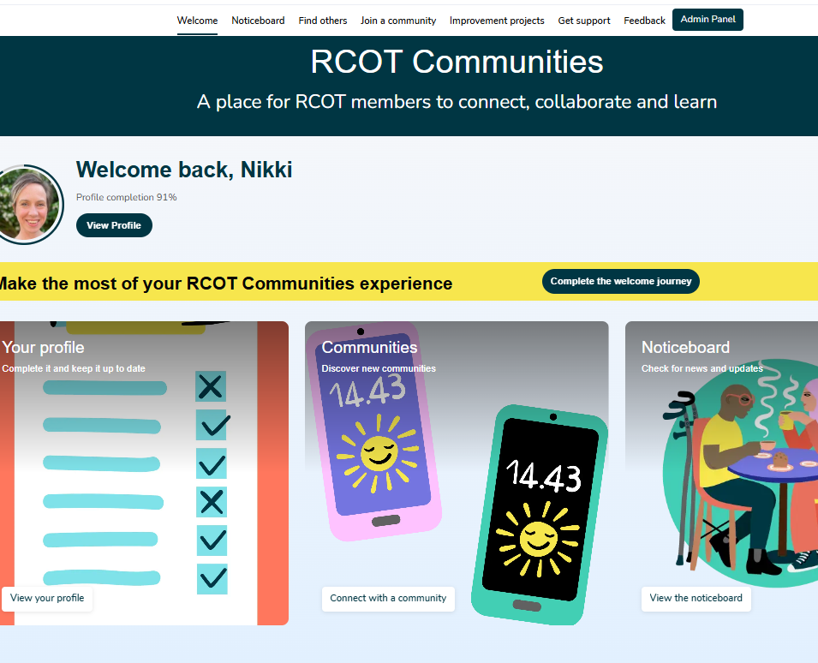
RCOT Communities: a new place to connect
A space for meaningful professional relationships
Inclusive and accessible for all members
Connect through shared challenges, aspirations, and values
Join member-led professional, practice, and regional networks
Access tailored activities and resources shaped by member insights
Engage flexibly – share resources, ask questions, co-create ideas
Learn from diverse experiences and perspectives
Collaborate to drive innovation and influence the future of occupational therapy in the UK
Notes:
I’m going to introduce you to RCOT Communities, our new online engagement platform, where you can foster meaningful professional relationships.
RCOT Communities is inclusive and accessible, ensuring that every member feels welcome and supported.
This is where you can connect with others who share your challenges, aspirations and values—whether through professional, practice, or regional networks that are led by members themselves.
What makes RCOT Communities unique is its flexibility. You can engage when it suits you—sharing resources, asking questions, or co-creating ideas.
The activities and resources available are shaped by member insights, making them highly relevant and responsive to your needs.
At its heart, RCOT Communities is about learning from each other’s diverse experiences. It’s a place to collaborate, drive innovation, and influence the future direction of occupational therapy.

Slide 7
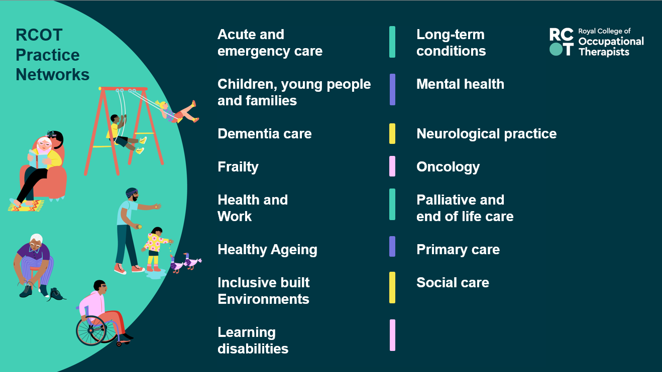
Notes:
Occupational therapists across the UK are connecting through vibrant practice networks on RCOT Communities.
These communities offer a space for peer support, shared learning, and professional growth.
Whether you're looking for guidance, inspiration, or simply to connect with others who understand your area of practice, these networks help OTs feel supported and stay connected to the wider profession.

Slide 8
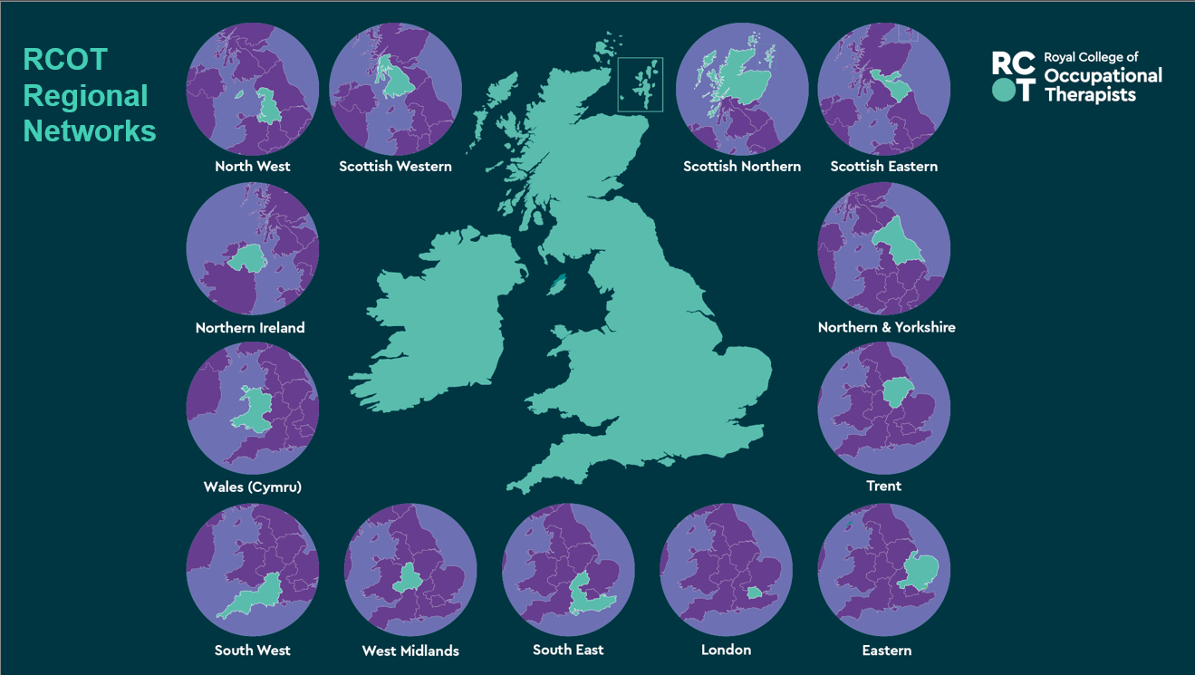
Notes:
You can also connect with OTs in your regional network on RCOT Communities.
Regional networks aim to strengthen our profession locally by raising our profile and optimising our impact. They bring local OT communities together so we can coordinate activities, share resources and build events near you.

Slide 9
Your initial professional networks
Research Connect
Innovation Hub
Leadership
Facilitating Learning
Independent Practice
Artificial Intelligence and Technology
Notes:
Finally, our professional networks connect members around pillars of practice and professional issues.
Our initial professional networks include Research Connect and the Innovation Hub. We’ve also created networks for members to connect around leadership, independent practice, facilitating learning and most recently AI and technology.

Slide 10
Take a look at RCOT Communities
Notes:
Let’s now take a quick look at RCOT Communities and how you can join and engage with our networks and your fellow members.

Slide 11
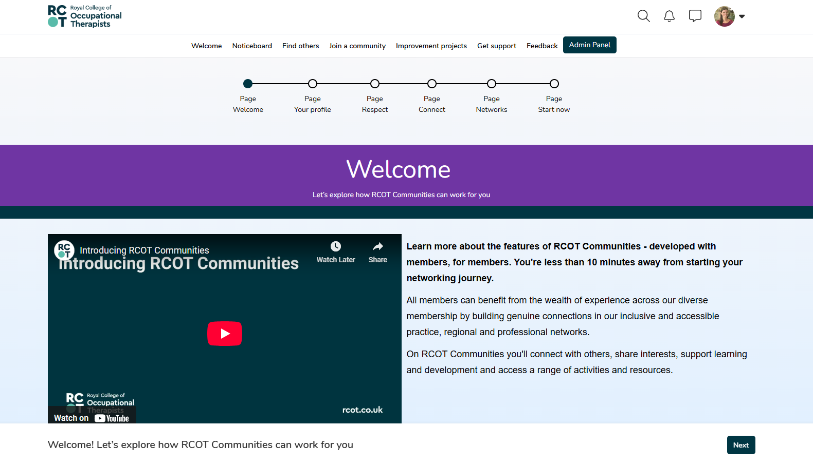
Welcome journey
Notes:
When you first login to RCOT Communities, you’re taken to our Welcome journey. Take a few minutes to go through this short e-resource to familiarise yourself with RCOT Communities features, guidance and best practice.

Slide 12
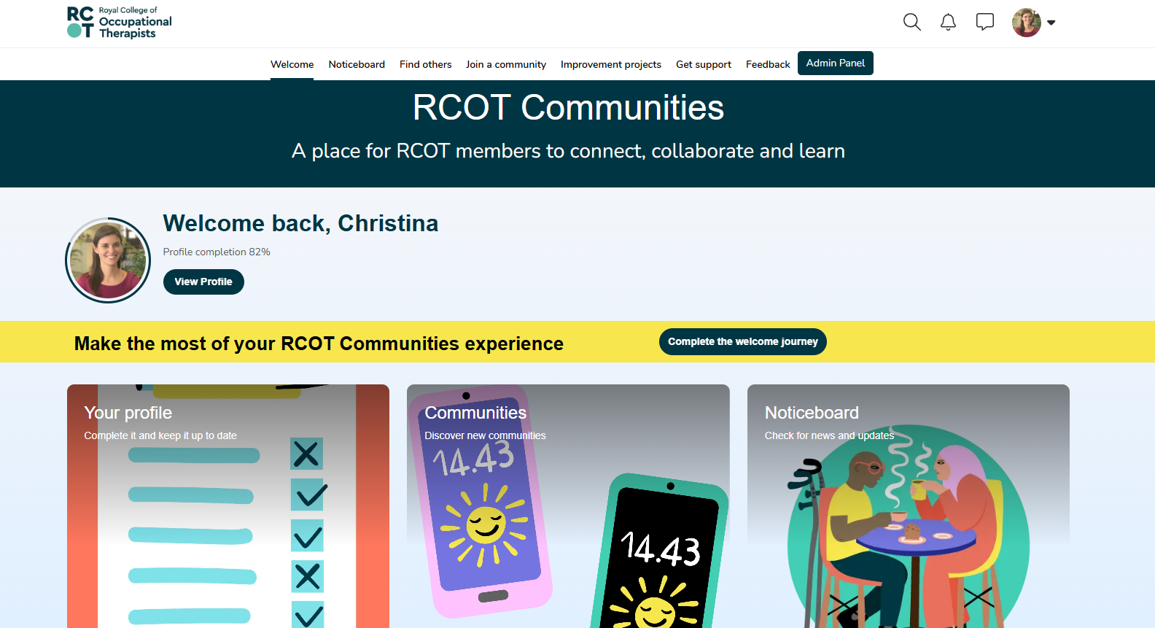
Welcome page
Notes:
Every subsequent time that you login to RCOT Communities, you’ll be taken to the welcome page. This page highlights the different areas of the platform that you may want to engage with. You can use this page to navigate the platform, or you can use the top toolbar that appears on every page.

Slide 13
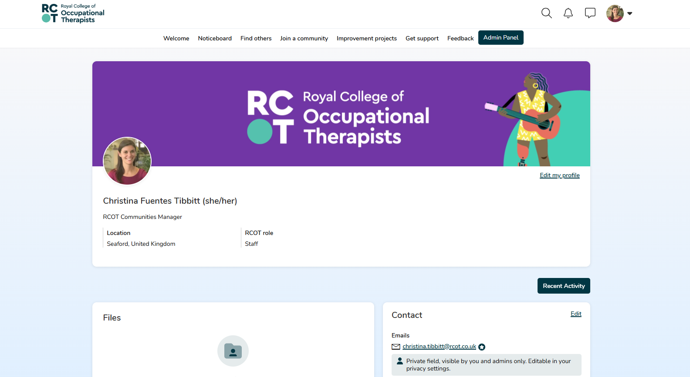
Your profile
Notes:
One of the first things you should so when you first join RCOT Communities is take a few minutes to complete your profile. You can get here by clicking the icon in the upper righthand corner on any page. Having information in your profile will help members know who you are and help you better connect.

Slide 14
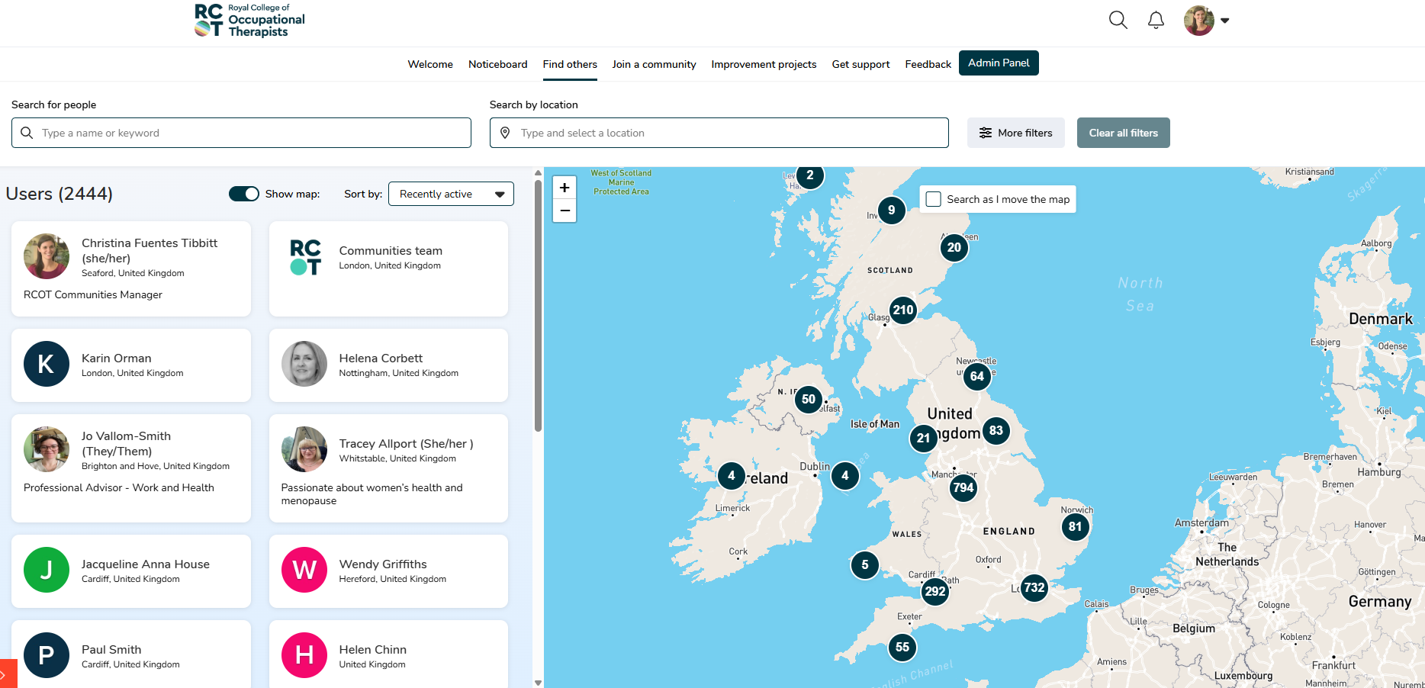
Finding others
Notes:
One of the most exciting features of RCOT Communities is the member directory. If you click on ‘Find others’ in the top toolbar, you’re taken to the directory of all members and staff on the platform who have agreed to share their rough location. The map is interactive, so you can zoom into different areas to see which members are nearby, and you can then click on their profiles and send them direct messages if you’d like.

Slide 15
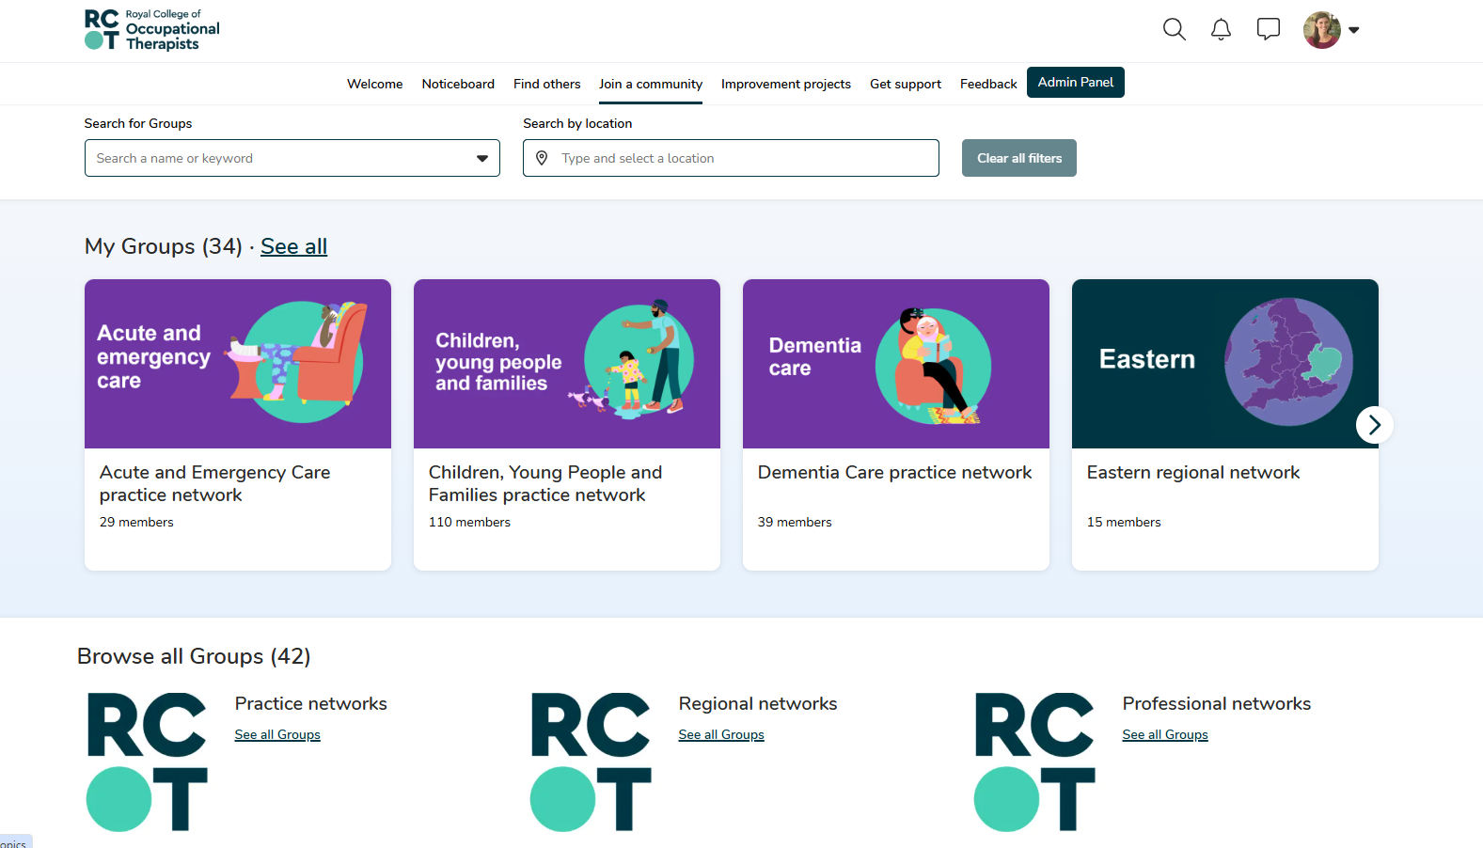
Joining communities
Notes:
Moving along on the top toolbar you’ll see ‘Join a community,’ which is where you’ll find our practice, regional and professional networks. Each network space has a welcome page, which outlines the purpose of the network. which members comprise the network leadership team and which leadership roles we’re still recruiting for.

Slide 16
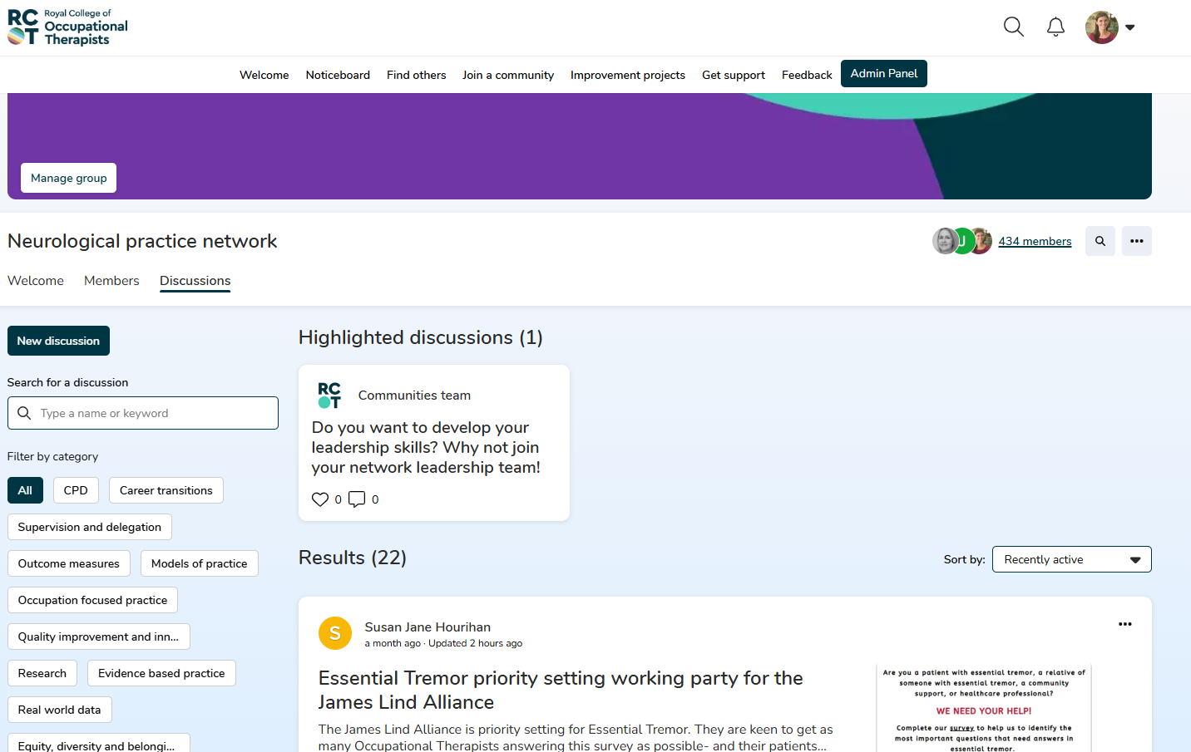
Sharing and discussing
Notes:
Each network also has its own discussion board. This is your space to share, ask questions and discuss. You can post your own thread and can search through and engage with other member threads.

Slide 17
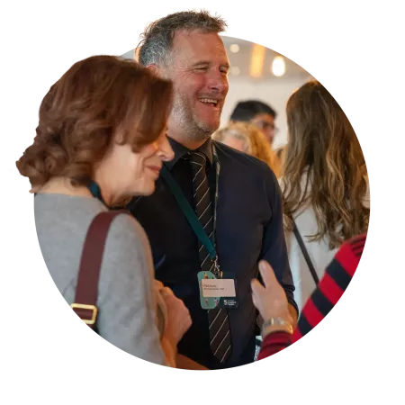
Get involved: Connect, grow and lead
Networks are powerful spaces for learning, growth and leadership
Reflect, share and learn through open, diverse conversations
Access mentorship, peer support and sustainable CPD
Solve problems, generate insights and stay up to date
Get involved through RCOT Communities, events and volunteering
Notes:
Networks are one of the most powerful tools we have for learning, growing, and leading. They give us space to solve problems together, hear different perspectives, and generate new insights.
Through open, organic conversations, we reflect on our experiences and deepen our understanding. We learn from each other — from lived experience, diverse viewpoints, and real-world practice.
These networks also support your career by offering efficient, sustainable CPD, mentorship, and peer support.
There are so many ways to get involved — from joining RCOT Communities and attending events to volunteering and leading change through the Innovation Hub or profile-raising cafés.
However you choose to connect, there’s a place for you in this community — and every contribution helps shape the future of occupational therapy.
Let's pause for a moment and hear from Dan

Slide 18
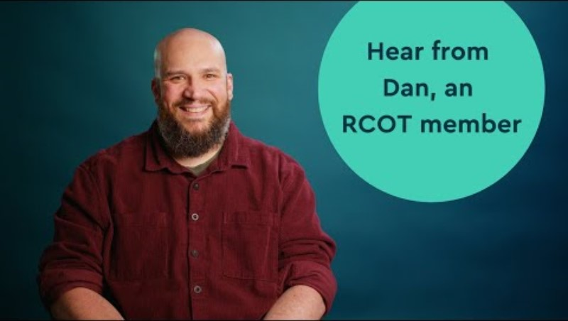
Notes:
Lets pause for a moment and hear from Dan
#If you can’t play the video online you can embed it from the Brand hub: Films - Brand & Steve launch

Slide 19
Your future
Invest in your development with RCOT
Notes:
As occupational therapists, your development never really stops — and neither should the support you receive.
That’s why your membership includes a powerful set of CPD tools and resources.
Whether you’re building your confidence, preparing for HCPC audits or planning your next career step, we’re here to help you grow.
In the next few slides, we’ll look at how RCOT supports your learning and development, every step of the way.

Slide 20
We know CPD is essential
We’ll help you develop good CPD habits
to ensure safe and effective practice, and to comply with HCPC CPD standards
We’ll support you to record your CPD
so you feel as prepared as possible for future CPD audits
We’ll give you a place to record your reflections
to support your lifelong learning and career development
Notes:
One of the most practical tools you get with RCOT membership is your very own CPD portfolio.
It’s designed to help you capture your learning and development throughout your career — all in one place.
You can record activities, reflections and evidence on the go, making it easy to stay organised and up to date.
It’s also built to help you meet HCPC CPD standards, so when audit time comes around, you’ll feel confident and prepared.
It’s about taking the stress out of CPD and making it work for you

Slide 21
Support you to learn, grow and progress
Help you to understand and meet the HCPC CPD standards with your own CPD portfolio
Improve your practice with access to our Digital Library and peer reviewed research with BJOT
Keep you up to date through our magazine, journal and newsletter
Plot your progress and journey through our Career Development Framework
Take the next step in your career with our easy-to-use jobs board
Build your knowledge through evidence spotlights and practice guidelines
Notes:
With your RCOT membership you’ll have access to a wide range of tools to support your learning and development.
We help you understand and meet HCPC CPD standards, so you can feel confident in your practice.
You can also build your knowledge with evidence spotlights and practice guidelines tailored to your area of work.
You can improve your practice with access to our Digital Library and peer-reviewed research through the British Journal of Occupational Therapy
And we’ll help you stay informed with our magazine, journal and newsletter — keeping you connected to the latest in the profession.
You can track your progress using our Career Development Framework — a great way to reflect on where you are and where you want to go.
And when you're ready for your next step, our jobs board makes it easy to find your first or next role.
Let's see what Alison has to share in the next video

Slide 22
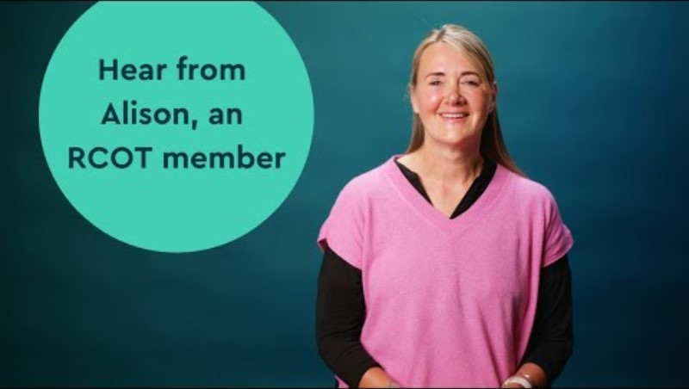
Notes:
Lets see what Alison has to share
If you can’t play the video online you can embed it from the Brand hub: Films - Brand & Steve launch

Slide 23
By your side
Feel confident knowing you have support when you need it
Notes:
Every occupational therapist faces challenges — but you don’t have to face them alone.
When you join RCOT, you gain a team that’s here to support, guide and protect you throughout your career.
In the next few slides, we’ll look at the practical ways RCOT is by your side — from advice and legal support to insurance and professional guidance.

Slide 24
Representation, professional advice, support, and insurance
UNISON membership offers workplace representation, legal support and financial assistance for you and your family
Professional Advisory Service helpline, guidance and support groups
HCPC CPD audit support
Professional Indemnity Insurance up to £10million per member
Financial support through our hardship fund to keep you connected with your community
Notes:
We’re here to support you — whether you need help right now or guidance for the long term.
Through our partnership with UNISON, you get access to legal services, financial assistance and compensation when you need it most.
You’re also covered by professional indemnity insurance — up to £10 million — whether you’re working, volunteering or on placement in the UK or overseas.
And if you ever face a complex professional issue, our dedicated advisory team is here to help you navigate it with confidence.
It’s about knowing you’re protected, supported and never alone.

Slide 25
A union that stands with you
Workplace representation with UNISON membership
  Legal help for you at work and your family at home
  Financial support and debt advice in times of need
  Compensation for you and your family
  Discounts including money off cars and holidays
  Helpline open six days a week
  Training to help develop your career
  Support when you most need it
Notes:
As part of your RCOT membership, you also join UNISON — one of the UK’s largest unions.
This means you have access to workplace representation, legal help and financial support when you need it most.
There’s also practical help — from debt advice and compensation to discounts on things like cars and holidays.
The helpline is open six days a week, and there’s training available to help you grow your career.
It’s all about making sure you’re supported — not just professionally, but personally too.
Let's hear now from one of our members, Sarah...

Slide 26
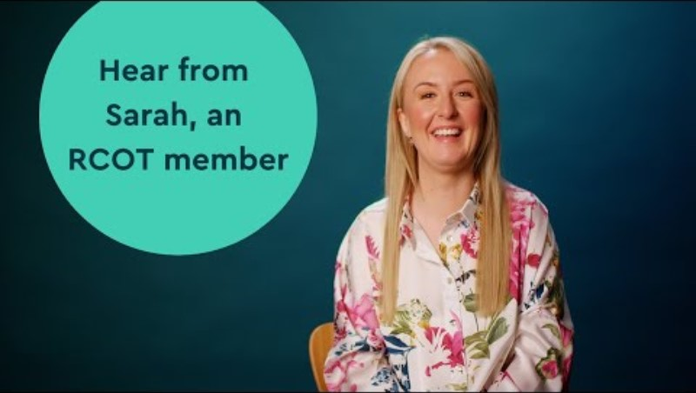
Notes:
I’m going to hand over to Sarah for a minute
If you can’t play the video online you can embed it from the Brand hub: Films - Brand & Steve launch

Slide 27
Your knowledge
Access exclusive resources and opportunities
Notes:
In a profession that never stands still, staying informed is essential.
RCOT membership gives you the tools to do just that.
As a member, you’ll have access to a rich and evolving collection of resources — all designed to support your learning, development and evidence-based practice.
Let’s take a look at what’s available to help you stay current and confident in your work.

Slide 28
Learn and research
Events and learning opportunities – attend webinars, workshops and conferences
Access resources 24/7 to support practice, learning, research and CPD
New digital resource centre
Digital Library with online databases, books, journals, RCOT publications, theses and grey literature
Alongside the OT titles, you’ll find topics such as leadership and equity, diversity and belonging
Standards and guidelines
Digital Library
OT topics
Practice guidelines
Student centre
Search by practice centre
Notes:
You’ll have access to a wide range of learning opportunities — from webinars and workshops to our Annual Conference.
You can access resources 24/7 to support your practice, learning, research and CPD.
Our new digital resource centre brings everything together in one easy-to-use space.
The Digital Library is packed with online databases, journals, books, RCOT publications, theses and grey literature.
And it’s not just OT-specific — you’ll also find content on leadership, equity, diversity and belonging to support your broader development.

Slide 29

Your essential updates and tools
OTnews, your membership magazine
Highlight, your monthly email update
Supplier Directory, connecting you to trusted products and services.
Social media stories and news
R&D Bulletin, your research newsletter
British Journal of Occupational Therapy (BJOT)
Notes:
We’ll keep you in the know with OTnews, your exclusive membership magazine full of real stories and insights.
Highlight lands in your inbox each month with quick updates and opportunities.
Follow us on social media for daily inspiration and news.
Into research? The R&D Bulletin and BJOT give you the latest thinking and evidence.
And when you're looking for trusted tools and services, our Supplier Directory helps you find the right fit for your practice.
However you like to stay informed and equipped, we’ve got you covered.
Let’s hear from Orla next

Slide 30
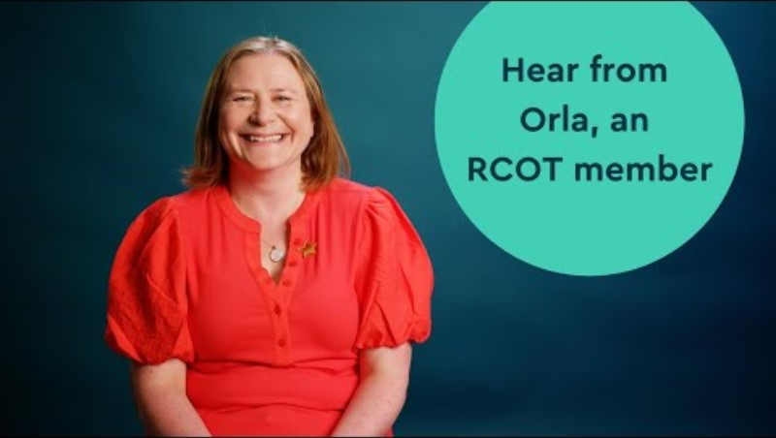
Notes:
Let’s hear from Orla
If you can’t play the video online you can embed it from the Brand hub: Films - Brand & Steve launch

Slide 31
Your impact
Your membership helps drive positive change
Notes:
As an occupational therapist, your insights shape the future of the profession.
We don’t just represent you — we empower you to lead.
We’re proud to be the voice of occupational therapy, and we want you to be part of it.

Slide 32






Leading the profession
Workforce Strategy and national action plans
Influencing policy and government across all four nations
Putting inclusion and EDB at the heart of everything we do
Raising awareness of the power of OT through our annual campaign and OT week
Funding to support research and innovation
Recognising excellence and lifetime achievement with our awards
Notes:
We’re not just supporting the profession — we’re leading it forward.
Our Workforce Strategy and national action plans are setting the direction for the future.
We’re making sure inclusion and equity are at the heart of everything we do — not just in words, but in action.
We’re investing in research and innovation, giving members the funding and support to explore new ideas and improve practice.
We’re influencing policy across all four nations, making sure occupational therapy has a strong voice where decisions are made.
Through our campaigns and OT Week, we’re raising awareness of the power of occupational therapy with the public and policymakers.
And we’re recognising the incredible work of our members through awards that celebrate excellence and lifetime achievement.

Slide 33
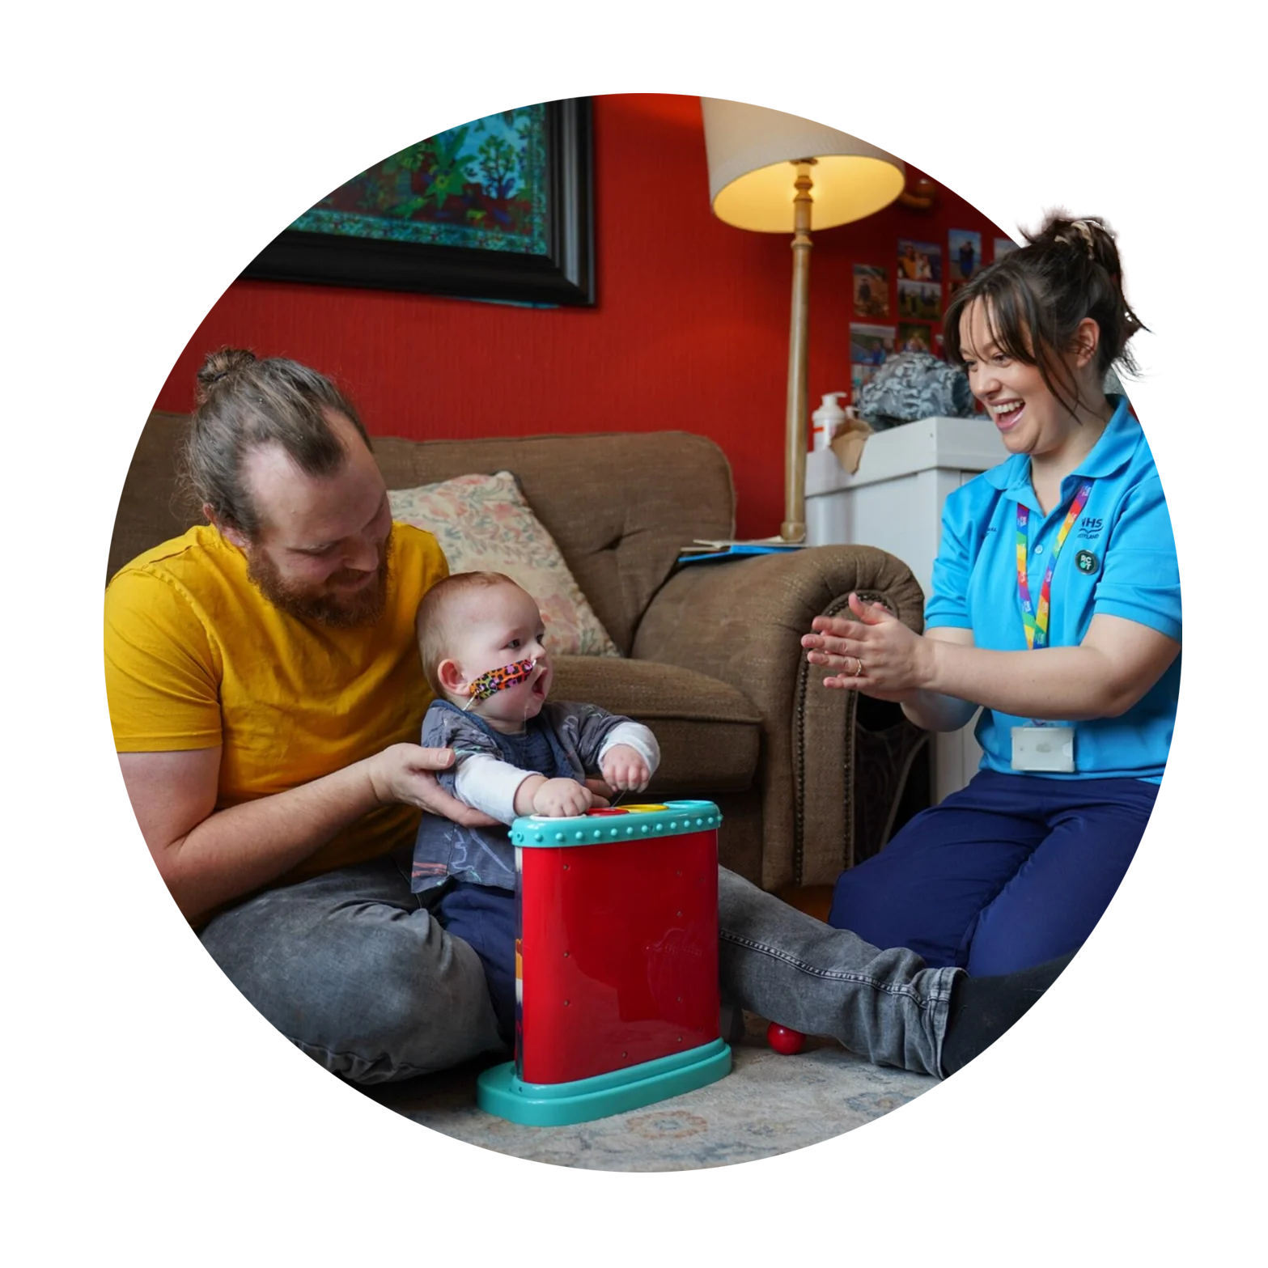
Driving change for occupational therapy
By 2035 we will have an occupational therapy workforce that is:
confident and skilled in championing inclusion
based primarily within communities
positioned to focus on prevention and early interventions
putting occupations at the forefront of their practice
Notes:
Our Workforce Strategy shows how investing in OTs can help fix the big challenges in health and social care.
It’s shaped by you — our members, service users and partners.
By 2035, we’re aiming for a workforce that’s:
• confident in championing inclusion
• rooted in communities
• focused on prevention
• led by occupation-first practice
Mary is going to share a few words about what being a member means to her.

Slide 34
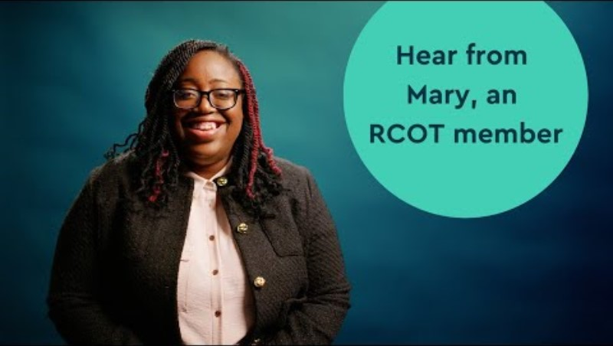
Notes:
Mary is going to share a few words about what being a member means to her.
If you can’t play the video online you can embed it from the Brand hub: Films - Brand & Steve launch

Slide 35
Your say
Shape the future of your profession and your professional body
Notes:
We believe the profession is stronger when members shape its direction.
Whether you want to contribute now and then or get more involved, there’s always a way to make your voice count.

Slide 36
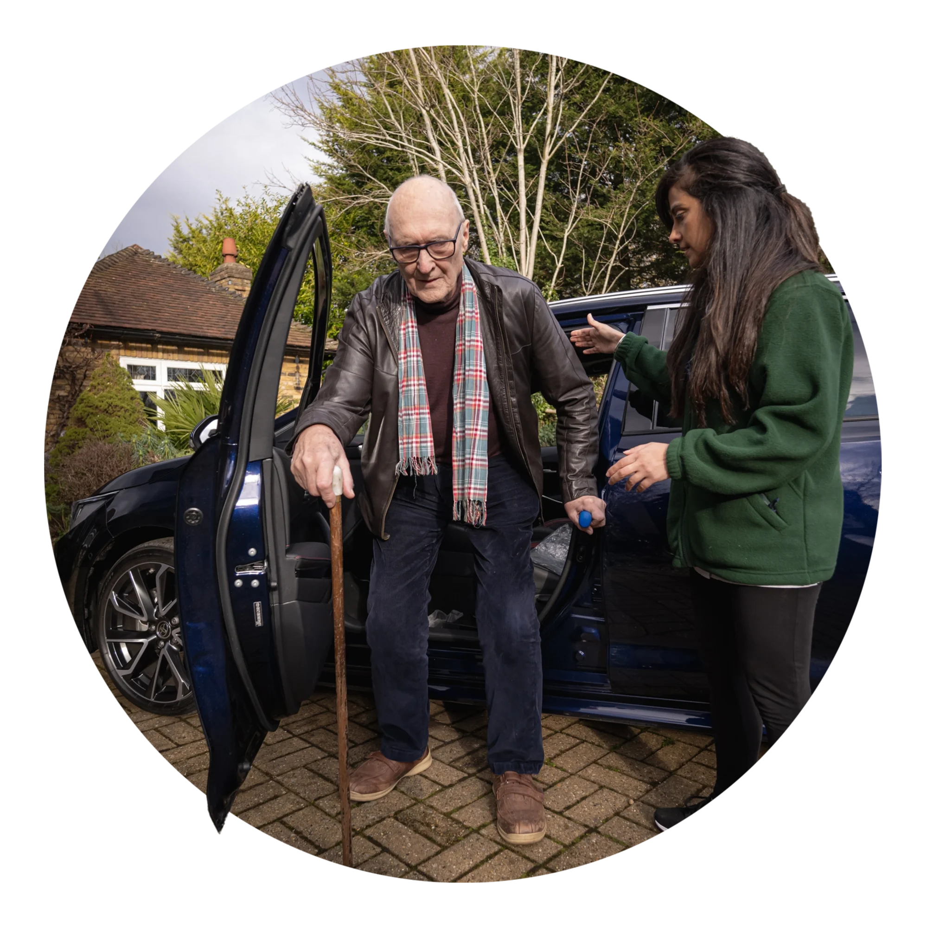
Make your voice count
Share your insights through consultations, surveys and RCOT Communities
Join networks, cafés and advisory groups
Collaborate on research, placements and innovation
Support campaigns like The Power of OT and the Innovation Hub
Shape national strategies and co-design change projects
Champion equity, diversity and belonging in your practice
Notes:
You bring the insight — and we’ll give you the platform.
Whether it’s through consultations, surveys, or discussions on RCOT Communities, your voice matters.
You can also get involved in networks, cafés, and advisory groups to collaborate on research, placements, and innovation.
Support campaigns like The Power of OT or contribute to projects like the Innovation Hub — and help drive meaningful change.
We believe every member has the power to lead change — and we’re here to help you do just that.
From shaping national strategies to championing equity and influencing policy, we’ll support you to lead with confidence.

Slide 37

Volunteer and be a change agent
Shape the future: build vibrant, connected communities
Develop new skills: leadership, collaboration and CPD
Build strong connections with like-minded professionals
Make an impact: lead initiatives that reflect your community’s needs
Gain recognition for your contributions
Notes:
Volunteering with RCOT is a powerful way to grow professionally while making a meaningful impact.
You’ll help shape vibrant communities, develop leadership and collaboration skills, and build strong professional networks.
Your contributions will be recognised, and you’ll be supported every step of the way — from onboarding to peer support and annual reflection.
It’s a chance to thrive while helping others do the same.

Slide 38
Your reputation
Celebrate your achievements and those of your colleagues
Notes:
Your work makes a difference — and it deserves to be seen.
We celebrate the achievements of occupational therapists across the UK.
Whether you’re publishing research, leading innovation or supporting your community, we’re here to help you shine.

Slide 39

Elevate your and your peers' professional reputation
Be proud of being part of your respected membership body
Become a volunteer, ambassador and changemaker
Get published in OTnews and BJOT
Share your stories
Nominate colleagues for awards and vote for Council peers
Get involved in OT Week and our annual campaign and raise your and the profession profile
Notes:
Your work — and the work of your peers — deserves to be recognised.
Use your member logo to show you’re part of a respected professional body.
Share your stories, publish in OTnews or the British Journal of Occupational Therapy, and help raise the profile of the profession.
You can also nominate colleagues for awards or vote for Council members — it’s a great way to celebrate others and shape the future.
Whether you volunteer, join a network or support a campaign, there are so many ways to get involved and make an impact.

Slide 40

Get involved!
Connect and collaborate
Develop and thrive
Drive change

Slide 41

Join our community today!
Connect and collaborate
Develop and thrive
Drive change
Notes:
Ready to join? Now’s the time.
Becoming a member means getting the support, resources and community you need to thrive.
Email us at hello@rcot.co.uk or call us — we’ll help you get started.

Slide 42
Events this autumn...
Maximise your membership: Understanding your insurance cover – 25 September 2025
EDB Insights: How OTs can comply with HCPC standard of proficiency on culture, equity and diversity – 1 October 2025
Full calendar: rcot.co.uk/events

Slide 43
Questions?

