Slide 1
Your RCOT
Your membership
Your growth
Your future
Notes:
JB
Welcome everyone and thank you for being here.
Today’s session is all about what it means to be part of RCOT — not just as a member, but as someone who’s shaping the future of occupational therapy.
Your membership is more than a subscription. It’s a connection to a professional home, a support system and a platform for growth.
Whether you're just starting out or well into your career, RCOT is here to help you thrive.
In this session, I’ll walk you through the value of being a member — from personalised support and professional development to advocacy, community and impact.
Let’s explore how RCOT can support your journey, every step of the way.

Slide 2
Who are you?
What’s your name?
Where are you studying?
What do you want to get out of today?
Notes:
JB

Slide 3
Congratulations on choosing occupational therapy
Welcome to the profession
Notes:
CH

Slide 4
Who we are
We’re RCOT, the Royal College of Occupational Therapists. We’ve championed the profession and the people behind it for over 90 years; today, we’re thriving with over 36,000 members.
Notes:
CH
So, who are we?
We’re RCOT — the Royal College of Occupational Therapists.
We’ve been championing the profession and the people behind it for over 90 years.
We’re proud to represent a thriving community of more than 36,000 members across the UK.
Our role is to support, connect and advocate for occupational therapists at every stage of their career.
Whether you're in practice, education, research or leadership, we’re here to help you make a difference.

Slide 5
Your programme
We’re already supporting you
Notes:
CH

Slide 6
Pop it in the chat
What’s your go-to self-care activity during busy placements or study weeks?
Notes:
JB

Slide 7
Your membership
With more than ever before, including innovative tools, vibrant networks, endless growth opportunities and support when you need it, you’ll have everything you need to achieve your best.
We’ve got your back and we’ll help you flourish.
Notes:
JB
So, why join RCOT?
In this next section, we’ll look at what membership really means — and how it supports you, your future career and the wider profession.
And how there is now more than ever before.
Let’s explore the value of being part of something bigger.

Slide 8
Your professional home
Belong, connect, support and celebrate with RCOT
Notes:
CFT
As occupational therapists, you deserve a professional home — somewhere that supports growth, celebrates achievements and connects you with others who truly understand your journey.
RCOT is that home.

Slide 9
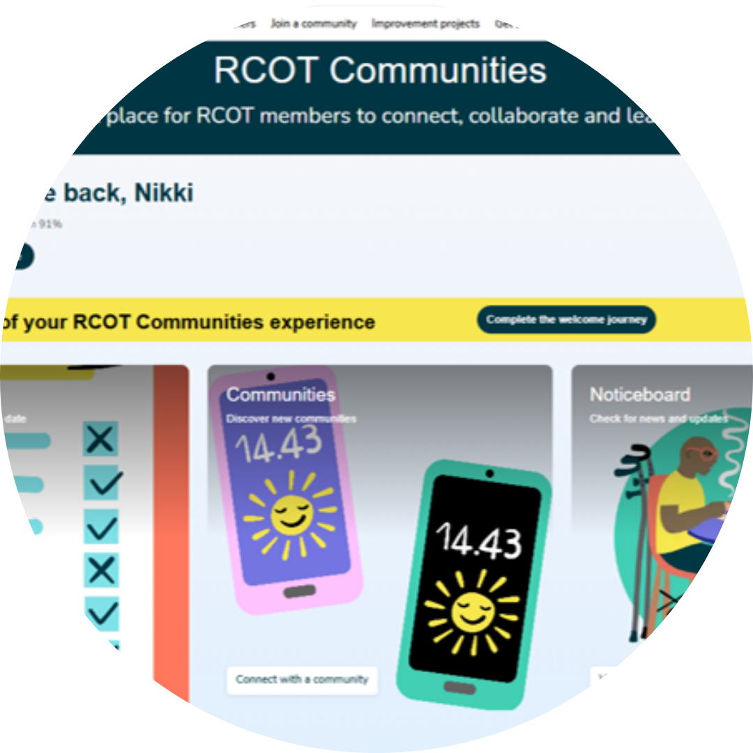
RCOT Communities: learners are very welcome!
Learn about the areas of your future profession you may be interested in.
Start making meaningful professional relationships and network for success.
Inclusive and accessible for all members.
Be willing to learn, challenge and lead.
Join member-led professional, practice and regional networks.
Ask questions, join member-led activities and co-create the future of OT.
Learn from diverse experiences and perspectives.
It may not feel like it, but you can already influence the future of occupational therapy in the UK.
Notes:
CFT
Let me now introduce you to RCOT Communities, our new online engagement platform, where you can foster meaningful professional relationships.
RCOT Communities is inclusive and accessible, ensuring that every member feels welcome and supported.
This is where you can connect with others who share your challenges, aspirations and values—whether through professional, practice, or regional networks that are led by members themselves.
What makes RCOT Communities unique is its flexibility. You can engage when it suits you—sharing resources, asking questions, or co-creating ideas.
The activities and resources available are shaped by member insights, making them highly relevant and responsive to your needs.
At its heart, RCOT Communities is about learning from each other’s diverse experiences. It’s a place to collaborate, drive innovation, and influence the future direction of occupational therapy across the UK.

Slide 10
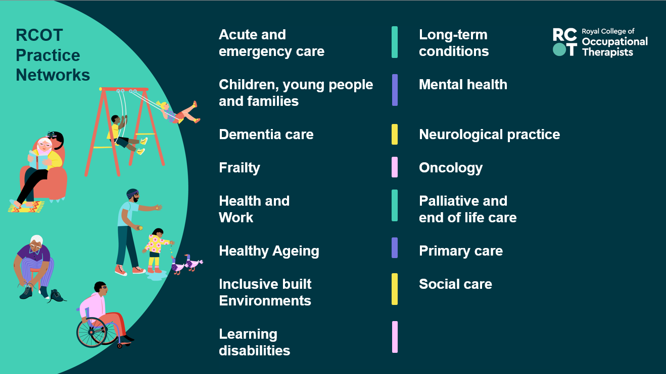
Notes:
CFT
Occupational therapists across the UK are connecting through vibrant practice networks on RCOT Communities.
These communities offer a space for peer support, shared learning, and professional growth.
Whether you're looking for guidance, inspiration, or simply to connect with others who understand an area of practice, these networks help OTs and learners feel supported and stay connected to the wider profession.

Slide 11
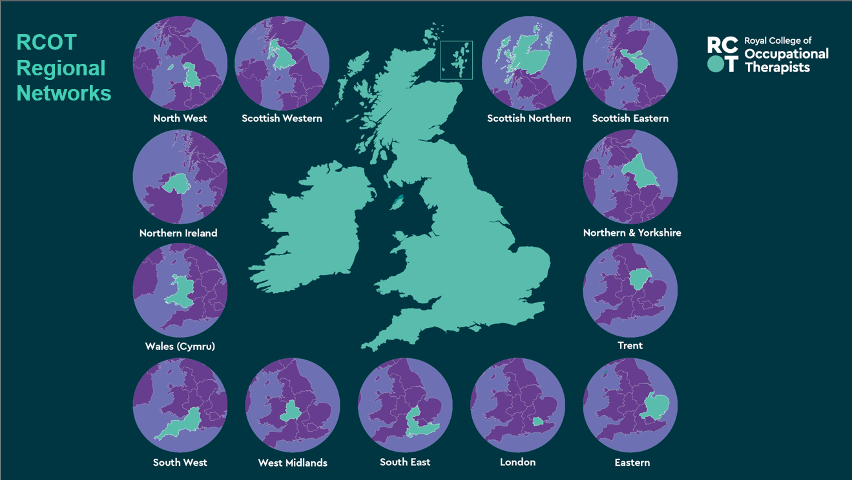
Notes:
CFT
You can also connect with OTs and fellow learners in your regional network.
Regional networks aim to strengthen our profession locally by raising our profile and optimising our impact. They bring local OT communities together so we can coordinate activities, share resources and build events near you.

Slide 12
RCOT Professional
Networks
Innovation Hub
Research Connect
Independent Practice
Leadership
Facilitation of Learning
Artificial Intelligence and Technology
Sustainability
Notes:
CFT
Our professional networks connect members around pillars of practice and professional issues.
Our initial professional networks include Research Connect and the Innovation Hub. We’ve also created networks for members to connect around leadership, independent practice, facilitating learning and AI and technology, and just today we’ve launched our new sustainability network.

Slide 13





RCOT EDB networks
Notes:
CFT
Finally, we’ve also recently launched our new equity, diversity and belonging networks.
These are visible, active and supportive member communities
Whatever your connection to these groups – from ally to advocate to lived experience – these are spaces to connect, reflect, champion and discover.

Slide 14
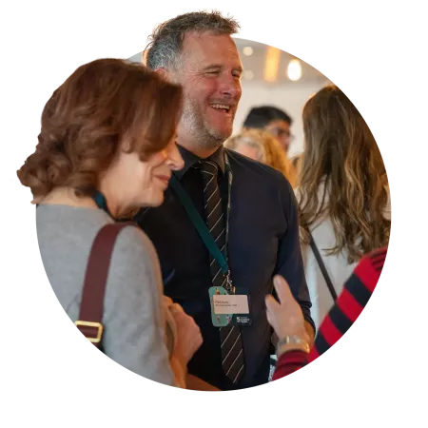
Get involved: Connect, grow and lead
Networks are the place to start building your professional profile.
Access mentorship, peer support and sustainable learning.
Get answers, generate insights and stay up to date on how your profession is changing before you step into it.
Start your career as you mean to go on – find the areas you can lead and support your community.
Notes:
CFT
Networks are one of the most powerful tools we have for learning, growing, and leading. They give us space to solve problems together, hear different perspectives, and generate new insights.
Through open, organic conversations, we reflect on our experiences and deepen our understanding. We learn from each other — from lived experience, diverse viewpoints, and real-world practice.
These networks also support your career by offering efficient, sustainable CPD, mentorship, and peer support.
There are so many ways to get involved — from joining RCOT Communities and attending events to volunteering and leading change through the Innovation Hub or profile-raising cafés.
However you choose to connect, there’s a place for you in this community — and every contribution helps shape the future of occupational therapy.

Slide 15
Your future
Improve your learning with RCOT
Notes:
EG
As occupational therapists, your development never really stops — and neither should the support you receive.
That’s why your membership includes a powerful set of CPD tools and resources.
Whether you’re building your confidence, preparing for HCPC audits or planning your next career step, we’re here to help you grow.
In the next few slides, we’ll look at how RCOT supports your learning and development, every step of the way.

Slide 16
Your studies are essential
We’ll help you develop good learning habits
to ensure safe and effective practice, ready to comply with HCPC standards
We’ll support you to record your learning
so you feel as prepared as possible for future job interviews
We’ll give you a place to record your reflections
to support your lifelong learning and career development from day one
Notes:
EG
One of the most practical tools you get with RCOT membership is your very own CPD portfolio.
CPD may not feel like something you need to be thinking about right now, but it’s a great tool for placement
It’s designed to help you capture your learning and development - all in one place.
You can use it to reflect on your professional experiences and consider what your next learning goals should be
You can record activities, reflections and evidence on the go, making it easy to stay organised, ahead of assignments and start building a solid foundation of examples for future job interviews
It’s also built to help you meet HCPC CPD standards, so learning how to use it now will help you feel confident and prepared when you’re qualified.
It’s about taking the stress out of learning and reflection and making it work for you

Slide 17
Support you to learn, grow and progress
Prepare you for practice with help to understand the HCPC CPD standards you’ll need to meet
Improve your practice with access to our Digital Library and peer reviewed research with BJOT
Keep you up to date through our magazine, events and Highlight newsletter
Plot your progress and journey using our Career Development Framework
Take the next step in your career with our easy-to-use jobs board
Build your subject knowledge through practice guidelines and handy evidence spotlights (great for essays)
Notes:
EG
You’ll have access to a wide range of tools to support your learning and development.
We help you prepare for the standards you’ll need to meet when you qualify, so you can feel confident when you start to practice.
Make assignments and research easier with evidence spotlights and practice guidelines.
Improve your research and knowledge-base with access to our Digital Library and peer-reviewed research through BJOT. This is all connected to OpenAthens. If your university library doesn't have it, check ours!
And stay informed with our magazine and email newsletter — keeping you connected to your future profession and providing you opportunities to get involved.
Plan your own path using our Career Development Framework — a great way to reflect on where you are and where you want to go.
And when you're ready for your next step, our jobs board makes it easy to find your first or next role.

Slide 18
Pop it in the chat
What’s one question you have about student life?
Notes:
JB

Slide 19
By your side
Feel confident knowing you have support when you need it
Notes:
JB
Every occupational therapist faces challenges — but you don’t have to face them alone.
When you join RCOT, you gain a team that’s here to support, guide and protect you throughout your career.
In the next few slides, we’ll look at the practical ways RCOT is by your side — from advice and legal support to insurance and professional guidance.

Slide 20
Professional advice, support and insurance when on placement
UNISON membership – although you won’t receive full industrial relations support, you’ll still benefit from the more general support they provide, including their helpline, training and discounts.
Professional Advisory Service helpline, guidance and support groups.
Professional Indemnity Insurance up to £10million per member whenever you’re on placement.
If you’re in a paid job while studying, you can claim income tax relief on your job expenses, including your RCOT professional membership.
Notes:
JB
We’re here to support you — whether you need help right now or guidance for the long term.
Through our partnership with UNISON, you get access to legal services, financial assistance and compensation when you need it most.
You’re also covered by professional indemnity insurance — up to £10 million — whether you’re working, volunteering or on placement in the UK or overseas.
And if you ever face a complex professional issue, our dedicated advisory team is here to help you navigate it with confidence.
It’s about knowing you’re protected, supported and never alone.

Slide 21
Your knowledge
Access exclusive resources and opportunities
Notes:
JB
In a profession that never stands still, staying informed is essential.
RCOT membership gives you the tools to do just that.
As a member, you’ll have access to a rich and evolving collection of resources — all designed to support your learning, development and evidence-based practice.
Let’s take a look at what’s available to help you stay current and confident in your work.

Slide 22
Learn and research
Events and learning opportunities – attend webinars, workshops and conferences.
Access resources 24/7 to support your learning research or practice.
New digital resource centre.
Digital Library with online databases, books, journals, RCOT publications and theses – connected to Open Athens.
Alongside the OT titles, you’ll find topics such as leadership and equity, diversity and belonging
Standards and guidelines
Digital Library
OT topics
Practice guidelines
Student centre
Resource centre
Notes:
JB
You’ll have access to a wide range of learning opportunities — from webinars and workshops to our Annual Conference.
You can access resources 24/7 to support your practice, learning, research and CPD.
Our new digital resource centre brings everything together in one easy-to-use space.
The Digital Library is packed with online databases, journals, books, RCOT publications, theses and grey literature.
And it’s not just OT-specific — you’ll also find content on leadership, equity, diversity and belonging to support your broader development.

Slide 23
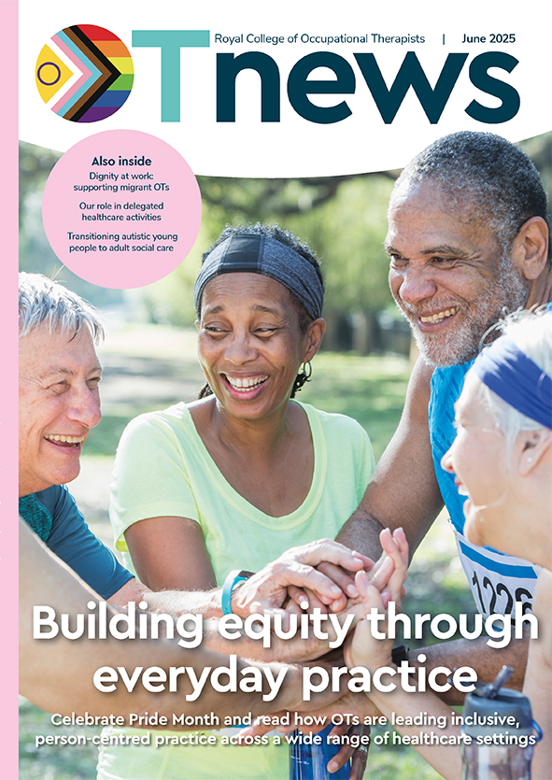
Your essential updates and tools
OTnews, your membership magazine
Highlight, your monthly email update
Supplier Directory, connecting you to trusted products and services.
Social media stories and news
R&D Bulletin, your research newsletter
British Journal of Occupational Therapy (BJOT)
Notes:
JB
We’ll keep you in the know with OTnews, your monthly magazine full of real stories and insights.
Highlight lands in your inbox each month with quick updates and opportunities.
Follow us on social media for daily inspiration and news.
Into research? The R&D Bulletin and BJOT give you the latest thinking and evidence.
And when you're looking for trusted tools and services, our Supplier Directory helps you find the right fit for your practice.
However you like to stay informed and equipped, we’ve got you covered.

Slide 24
Your impact
Your membership helps drive positive change
Notes:
CH
As an occupational therapist, your insights shape the future of the profession.
We don’t just represent you — we empower you to lead.
We’re proud to be the voice of occupational therapy, and we want you to be part of it.

Slide 25






Leading the profession
Workforce Strategy and national action plans
Influencing policy and government across all four nations
Putting inclusion and EDB at the heart of everything we do
Raising awareness of the power of OT through our annual campaign and OT week
Funding to support research and innovation
Recognising excellence and lifetime achievement with our awards
Notes:
CH
We’re not just supporting the profession — we’re leading it forward.
Our Workforce Strategy and national action plans are setting the direction for the future.
We’re making sure inclusion and equity are at the heart of everything we do — not just in words, but in action.
We’re investing in research and innovation, giving members the funding and support to explore new ideas and improve practice.
We’re influencing policy across all four nations, making sure occupational therapy has a strong voice where decisions are made.
Through our campaigns and OT Week, we’re raising awareness of the power of occupational therapy with the public and policymakers.
And we’re recognising the incredible work of our members through awards that celebrate excellence and lifetime achievement.

Slide 26
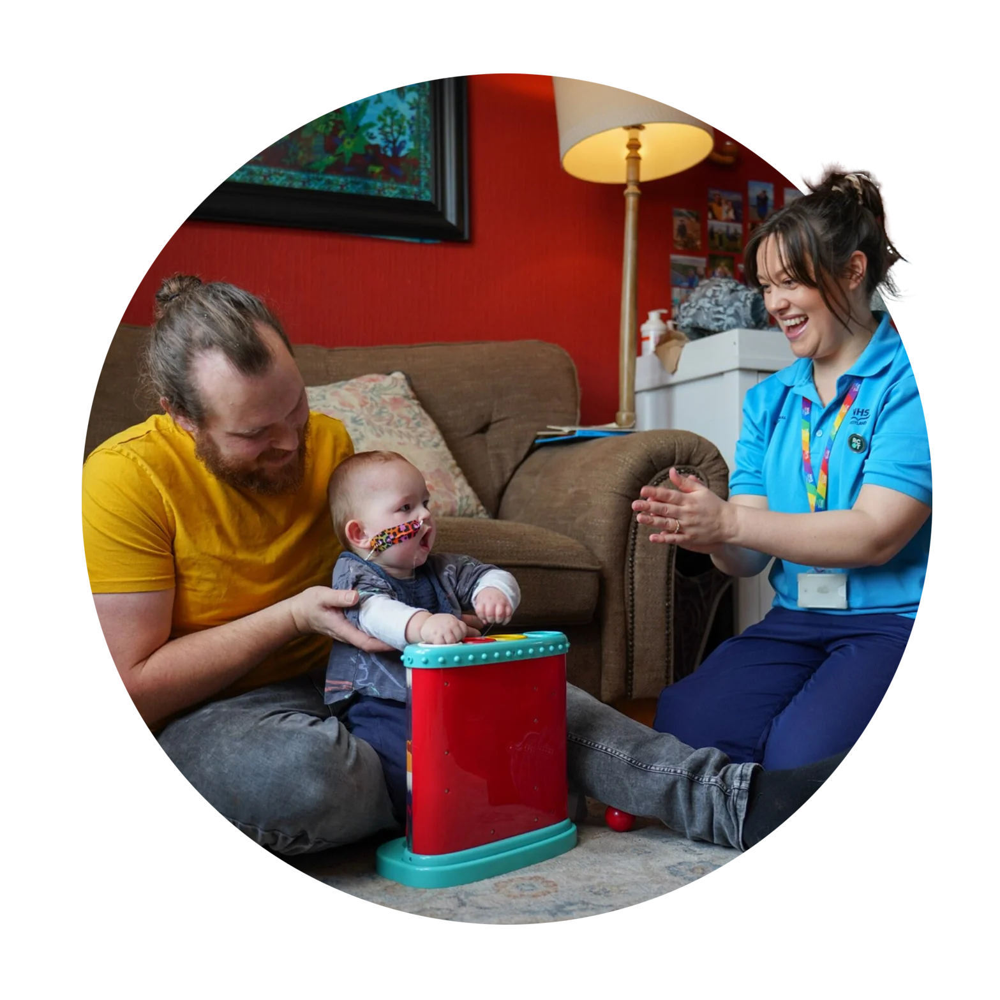
Driving change for occupational therapy
By 2035 we will have an occupational therapy workforce that is:
confident and skilled in championing inclusion
based primarily within communities
positioned to focus on prevention and early interventions
putting occupations at the forefront of their practice
Notes:
CH
Our Workforce Strategy shows how investing in OTs can help fix the big challenges in health and social care.
It’s shaped by you — our members, service users and partners.
By 2035, we’re aiming for a workforce that’s:
• confident in championing inclusion
• rooted in communities
• focused on prevention
• led by occupation-first practice

Slide 27
Your say
Shape the future of your profession and your professional body
Notes:
CFT
We believe the profession is stronger when members shape its direction.
Whether you want to contribute now and then or get more involved, there’s always a way to make your voice count.

Slide 28
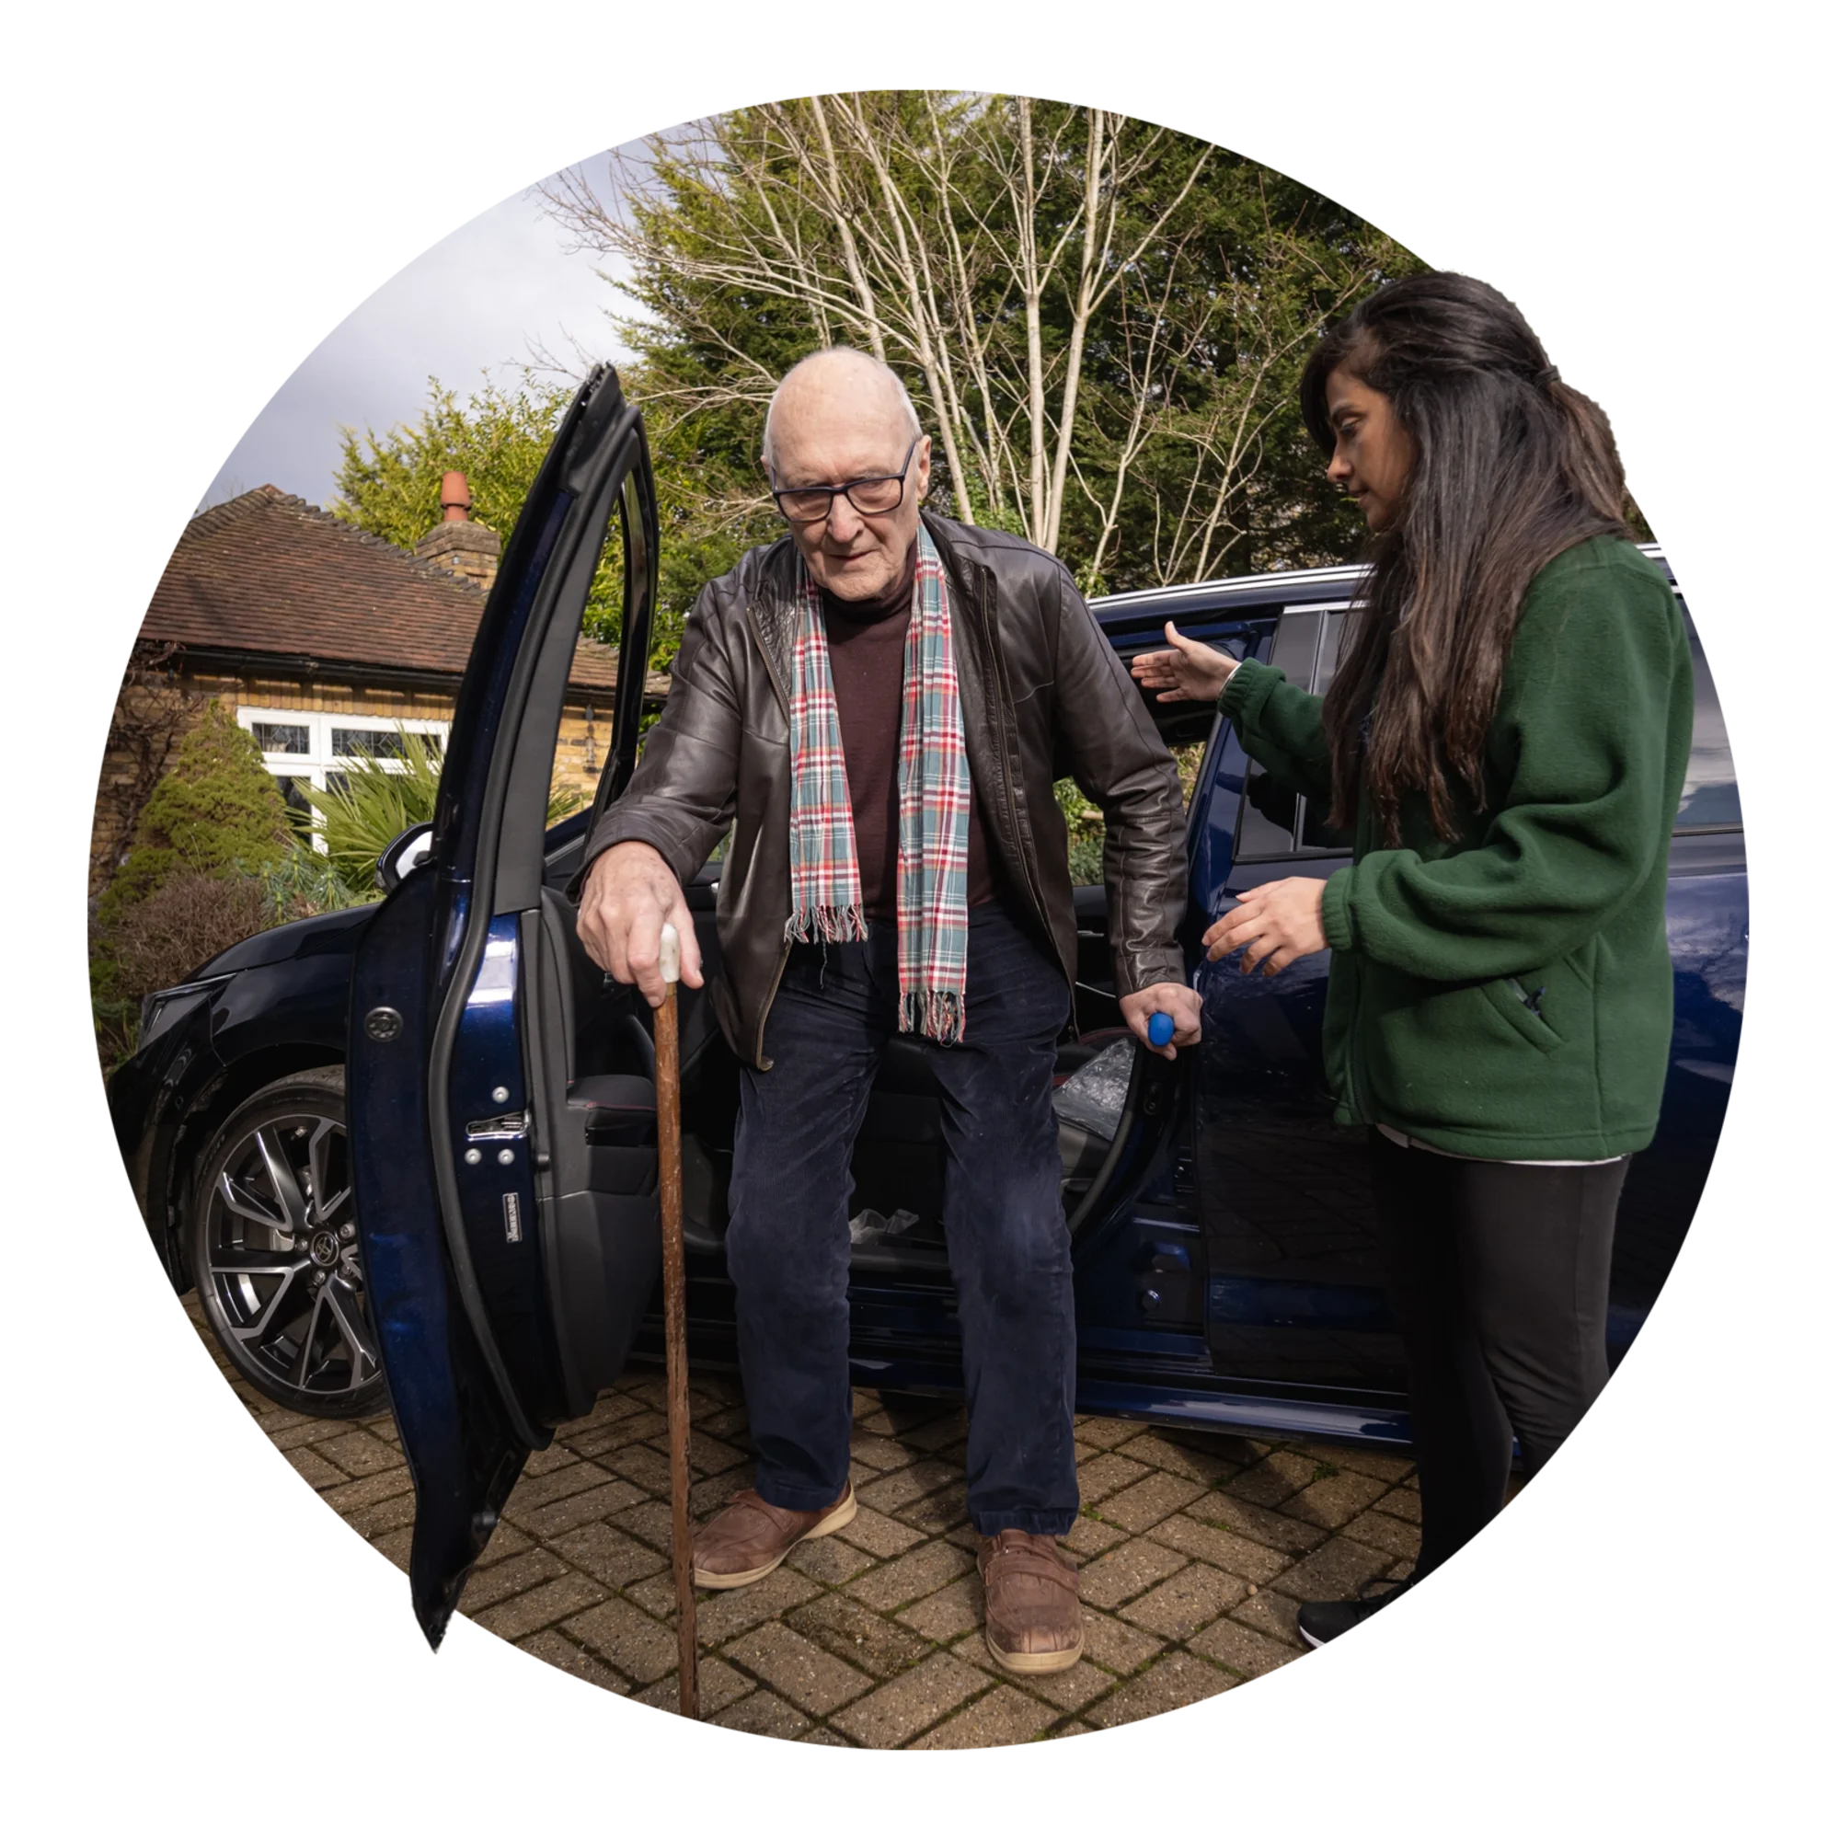
Make your voice count
Share your insights through consultations, surveys and RCOT Communities.
Join networks, cafés and advisory groups.
Collaborate on research, placements, and innovation.
Support campaigns like The Power of OT and the Innovation Hub.
Shape national strategies and co-design change projects.
Champion equity, diversity, and belonging in your practice.
Notes:
CFT
You bring the insight — and we’ll give you the platform.
Whether it’s through consultations, surveys, or discussions on RCOT Communities, your voice matters.
You can also get involved in networks, cafés, and advisory groups to collaborate on research, placements, and innovation.
Support campaigns like The Power of OT or contribute to projects like the Innovation Hub — and help drive meaningful change.
We believe every member has the power to lead change — and we’re here to help you do just that.
From shaping national strategies to championing equity and influencing policy, we’ll support you to lead with confidence.

Slide 29

Volunteer and be a change agent
Shape the future: build vibrant, connected communities.
Develop new skills: leadership, collaboration and learning – all for the CV.
Build strong connections with like-minded students and professionals.
Make an impact: lead initiatives that reflect your community’s needs.
Gain recognition for your contributions.
Notes:
CFT
Volunteering with RCOT is a powerful way to grow professionally while making a meaningful impact.
You’ll help shape vibrant communities, develop leadership and collaboration skills, and build strong professional networks.
Your contributions will be recognised, and you’ll be supported every step of the way — from onboarding to peer support and annual reflection.
It’s a chance to thrive while helping others do the same.

Slide 30
Pop it in the chat
If RCOT could offer one thing to make your student life easier, what would it be?
Notes:
JB

Slide 31
Your reputation
Celebrate your achievements and those of your colleagues
Notes:
JB
Your work makes a difference — and it deserves to be seen.
We celebrate the achievements of occupational therapists across the UK.
Whether you’re publishing research, leading innovation or supporting your community, we’re here to help you shine.

Slide 32

Elevate your and your peers' professional reputation
Be proud of being part of your respected membership body.
Become a volunteer, ambassador and changemaker.
Get published in OTnews or on our website.
Share your stories.
Nominate peers, placement leads or lecturers for awards and vote for Council.
Get involved in OT Week and our annual campaign and raise your and our professions’ profile
Notes:
JB
Your work — and the work of your peers — deserves to be recognised.
Use your member logo to show you’re part of a respected professional body.
Share your stories, publish in OTnews or BJOT, and help raise the profile of the profession.
You can also nominate colleagues for awards or vote for Council members — it’s a great way to celebrate others and shape the future.
Whether you volunteer, join a network or support a campaign like The Power of OT, there are so many ways to get involved and make an impact.

Slide 33
Join Orla, Farhat, Alison, Sarah, Dan & Mary
CPD made easy
‘Membership is value for money. The CPD platform alone is a huge benefit.’
Develop your career
‘RCOT resources have helped me to expand my knowledge.’
Equity, Diversity and Belonging
‘Being an RCOT member is inspiring, supportive and reassuring.’
Thriving community
‘Being a member of RCOT is being part of a community.’
Peace of mind
‘RCOT has our backs. I feel supported and as if we’re a collective group.’
Champion the profession
‘RCOT are at the forefront of research and innovation.’
Notes:
JB
You’ve heard from some of our members throughout this presentation — and their stories speak volumes.
They’ve shared how RCOT membership supports their learning, their confidence and their sense of community.
Whether it’s CPD, equity, innovation or simply feeling part of something bigger — their experiences show what membership can mean.
Join them — and thousands of others — in shaping the future of occupational therapy with RCOT by your side.

Slide 34
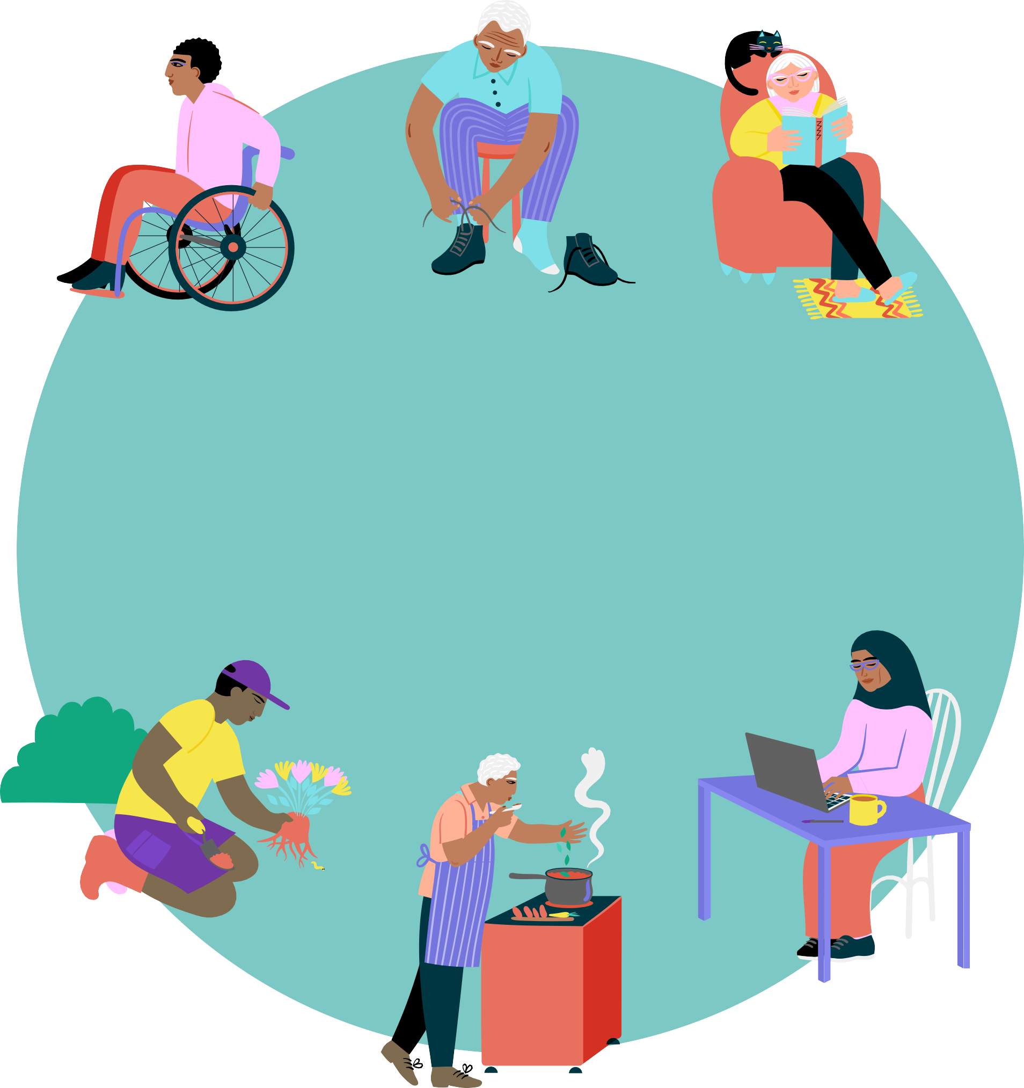
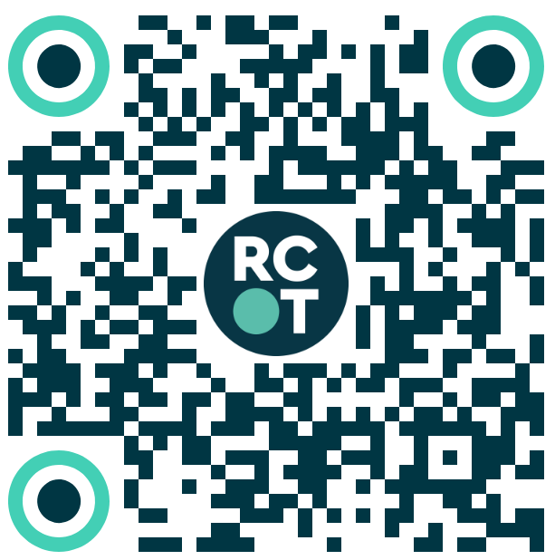
Join our community today!
Connect and collaborate
Develop and thrive
Drive change
Notes:
JB
Ready to join? Now’s the time.
Becoming a member means getting the support, resources and community you need to thrive.
You can speak to our Membership team, come to a “Maximise your membership” event or just get in touch.
Email us at membership@rcot.co.uk or call 020 3141 4600 — we’ll help you get started.
Ask you mum and dad for membership for Christmas

Slide 35
Please click on the following link to view the videos from the webinar recording: Event overview - YouTube
Notes:
JB
Ready to join? Now’s the time.
Becoming a member means getting the support, resources and community you need to thrive.
You can speak to our Membership team, come to a “Maximise your membership” event or just get in touch.
Email us at membership@rcot.co.uk or call 020 3141 4600 — we’ll help you get started.
Ask you mum and dad for membership for Christmas

Slide 36
Questions
Notes:
JB
Your work makes a difference — and it deserves to be seen.
We celebrate the achievements of occupational therapists across the UK.
Whether you’re publishing research, leading innovation or supporting your community, we’re here to help you shine.

