Slide 1
CPD portfolio
What you need to know about the CPD portfolio
Notes:
Welcome, introductions, notify if recording and how recording will be used.

Slide 2
Learning outcomes
This session will support you to:
Re-visit the HCPC CPD standards
Learn more about the CPD portfolio and how it supports us to meet HCPC CPD standards
See the CPD portfolio in action
Reflect on building CPD habits
Make a diary entry or add a reflection to your CPD portfolio
Notes:
Talk to points on slide.

Slide 3
HCPC CPD standards ask us to:
Carry out regular CPD and keep a record in a way that’s most convenient for you
Carry out different kinds of learning activities (relevant to your current or future work)
Think about how your CPD might improve your practice
Think about how your CPD benefits your service users
5. Take part in an audit if HCPC ask you to
Who are our service users?
Notes:
Talk to points on slide.

Slide 4
A little bit about audit
2.5% of registered occupational therapists are selected at random (newly registered are exempt for first cycle)
Current audit cycle is 01 November 2023 - 31 October 2025
The HCPC CPD standards are what we are being assessed against
Your CPD portfolio is designed around the CPD standards and makes the audit process easier
Notes:
Talk to points on slide.

Slide 5

What is the CPD portfolio?
It’s a web and app-based tool which supports members to record CPD activities, reflections and evidence in one place.
Designed to be dynamic and easy to fit CPD into busy working lives.
Provided by CPDme.
Notes:
Talk to points on slide.

Slide 6
A member benefit
A single place to capture lifelong learning and development, no matter your role or career stage.
Record activities, learning, reflections and evidence on the go.
Supports you to meet the HCPC CPD standards – helping you to feel as prepared as possible for future CPD audits.
Included in RCOT membership package and accessible via the RCOT website and CPDme app.
Notes:
Talk to points on slide.

Slide 7
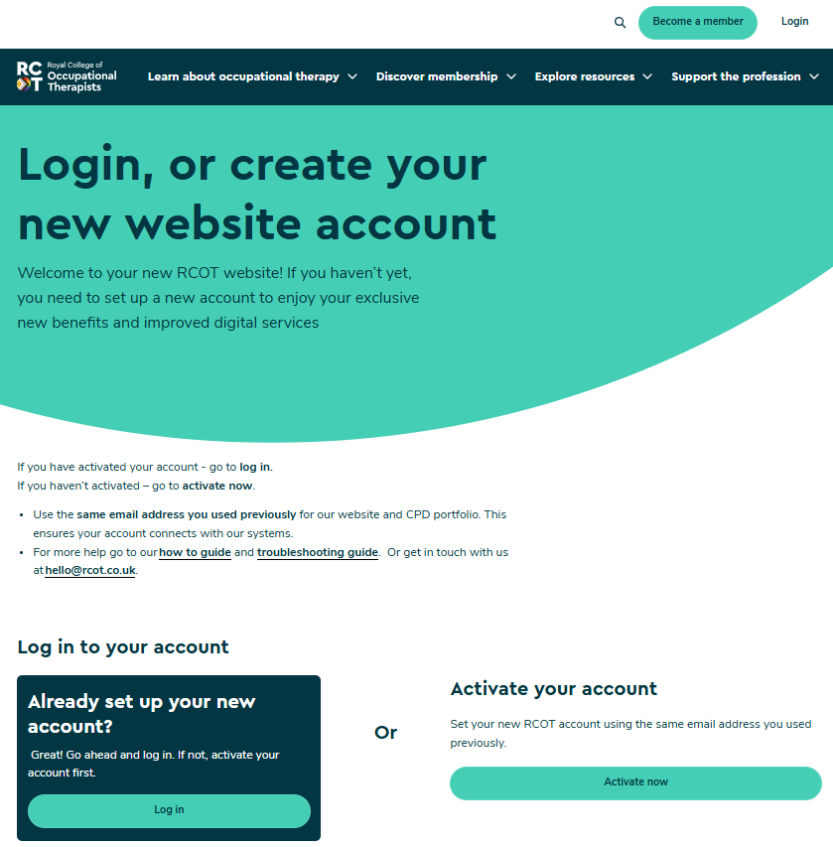
How to log into your portfolio via the RCOT website
Step 1
Go to rcot.co.uk and click log in
Click here
Then choose one of these options which applies to you

Slide 8
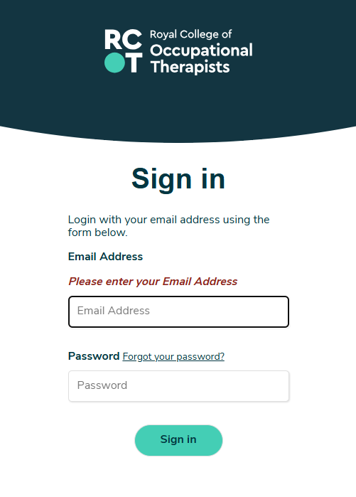
How to log into your portfolio via the RCOT website
Step 2

Slide 9
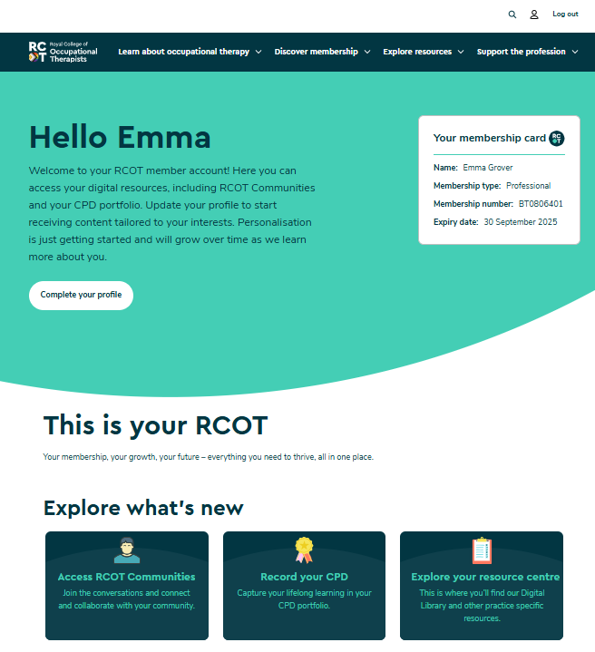
How to log into your portfolio via the RCOT website
Step 3
Your details will be listed here
Click here

Slide 10

How to log into your portfolio using the CPDme app
Go to an app store, search ‘CPD portfolio’ and download the free CPDme app
Use the same email address that you use for RCOT membership to log in. ​
Click on ‘forgotten password’. The app will then generate a one-off secure log in which will not affect your RCOT log in details.

Slide 11
Things to do if you’ve tried to log in, but it’s not working
Try clearing your browser history/ cache because sometimes cookies can get stuck and might block you being able to log in.
If you’ve used CPDme before, check you are using the same email address for both CPDme and RCOT so that previous CPD entries show.
You can update either one of your email addresses if you need to.
Email hello@rcot.co.uk or team@cpdme.com for support.

Slide 12
Let’s look at the portfolio in action – a demonstration
Notes:
It’s helpful for the demo to include the dashboard, profile settings, diary entries, reflections, and entry tags – how to set up entry tags, how to add them to an entry and how to filter CPD by tag in the Entries page.

Slide 13
Break
Notes:
Move this slide to where you plan to take a break, or remove if a shorter session without a break.

Slide 14
Resources to support you
Head to our CPD portfolio webpage
Find answers to frequently asked questions
Watch back a webinar with CPDme, which includes a demonstration of portfolio features
CPDme have several how-to-guide videos including how to create a diary entry and how to create a reflective entry
HCPC webpages
Notes:
Talk to points on slide.

Slide 15
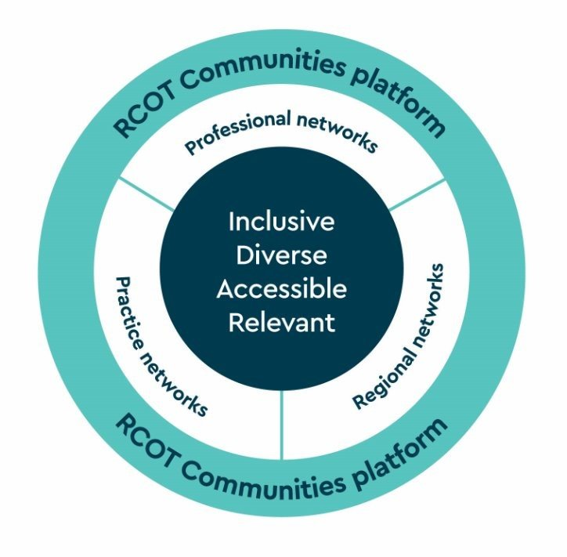
RCOT Communities and CPD
A dedicated online community platform
A range of networks – by practice area, RCOT region and professional focus
A growing volunteer leadership community
Included in your membership
Notes:
Tell others about RCOT Communities – encourage them to explore and join networks which feel relevant to them. Promote how online networking is a great CPD activity, and how the way you interact with others on the Communities platform count as CPD activities to record in your CPD portfolio.

Slide 16
Volunteering with RCOT
We’re on the lookout for passionate members to help us build dynamic and thriving communities within RCOT.
Are you ready to take your professional development to the next level?
Grow your skill set
Make meaningful impact
Enhance your career
Apply online for leadership roles
Notes:
Highlight how volunteering with RCOT is a valuable professional CPD activity, and supports leadership development.

Slide 17
Building CPD habits
Recognise the CPD you do as part of your everyday
Think about how this will work for you
Save the link to your portfolio as a favourite on your desktop browser and/ or download the free app for quick and easy access at work, home or on the go​
Use technology to support you
Find a CPD buddy
Plan your CPD across the four pillars of practice in the CDF
Aim for progress over perfection
Reflect on your growth over time
Notes:
Talk to points on slide.

Slide 18
Make a CPD pledge
Set intentions by making a CPD pledge
How will you use your CPD portfolio to help you stay on track?
When will you check back on the progress you’ve made?
Notes:
Ask delegates to make a CPD pledge:
Why not use some time now, just a few minutes, to make a CPD pledge. It’s great to share these with the people in the same room/ on the same call as you – we can feel inspired by ideas and actions of others that we might never have thought of ourselves. What CPD habits can you build that work for you? Think about everything you’ve heard today and how you will use the CPD portfolio to help you stay on track with recording your CPD. Our current CPD cycle runs from 1 November 2023 – 31 October 2025. When will you check back on your progress and ask yourself how your CPD pledge is going?

Slide 19
Reflect and record
This session counts as a CPD activity
What have you learned?
What actions will you take?
Log in to record a diary entry or reflection in your CPD portfolio
Notes:
Let’s take a moment to ask ourselves ‘What have we learned from this? What actions will you take now? How has this contributed to our work, and the people we work with?’. Recording these thoughts within your portfolio will help you to meet the HCPC CPD standards.

Slide 20
Questions?

