Slide 1
Return to practice webinar
12.00–13.00
Wednesday 22 April 2026
Please note that we’ll record this webinar.

Slide 2
Welcome!
Whilst we’re waiting to start, please pop your name in the ‘Chat’ and say what you hope to get out of today.

Slide 3
Welcome to our return to practice webinar!
The webinar is being run by three occupational therapists, two of which have returned to practice (RTP) following a career-break away from occupational therapy
Roxanne Mitchell-Nembhard, Specialist Occupational Therapist, NHS Lanarkshire
Rachael Harrison, RCOT Professional Advisor
Anne Keen, RCOT Professional Advisory Service Manager

Slide 4
This webinar will:
provide essential information regarding returning to practice and re-registering with the HCPC
give you the opportunity to hear from OTs who have been through the process
have a chat function for you to ask questions
inform you what support is available from RCOT
be recorded so you can listen back in your own time

Slide 5
What does RTP involve?
To practise as an occupational therapist in the UK, you must be registered with HCPC
If you’ve been off the HCPC register for 2 years or more, you will need to update your skills:
  Off the register for less than 2 years = no updating
  Off the register for 2–5 years = 30 days of updating
  Off the register more than 5 years = 60 days of updating
  These are minimum requirements

Slide 6
HCPC – updating knowledge and skills
Supervised practice
Formal study
Private study
Updating – is about making sure your skills and knowledge are up to date. You don’t have to do all three areas. Private study must not take up more than half of your period of updating
You have one year to complete your updating from when you start it.

Slide 7
As a returner, what do I need to know?
You are responsible for your updating and for making sure you meet the HCPC standards before you return Returning to practice | The HCPC
You need to submit the HCPC RTP forms and the HCPC readmission paperwork
Consider becoming a member of RCOT Join us | RCOT
We can support you all the way!

Slide 8
RTP across the four nations
  England – Return to Practice: allied health professionals, healthcare scientists and practising psychologists | Health Education England (hee.nhs.uk)
  Northern Ireland – enquiries should be made locally. Trusts may take requests on a case-by-case basis and try to support where possible

Slide 9
RTP across the four nations
  Scotland – returning to an AHP career, NHS Scotland
  Wales – Return to practice for allied health professionals and health care scientists – HEIW

Slide 10
As a supervisor, what do I need to know?
As a supervisor, you should only supervise activities that are within your scope of practice/competence
You need to have been on the HCPC register for a minimum of three years and not be subject to any fitness to practice proceedings or sanctions
It’s more straightforward than you may think:
  you don’t have to judge the returner’s competencies
  you don’t have to assess their fitness to practice

Slide 11
As an employer, what do I need to know?
As an employer, it is very beneficial to support returners
It is a quick, relatively cheap way to fill vacancies and retain staff
Flexible – fixed term/permanent/bank contract, Band 3 or 4, agency, voluntary or RTP scheme/course

Slide 12
How can supporting returners improve recruitment and retention?
Returners are motivated to return to work
They are a ready-made workforce
Returners are qualified and often very experienced
They can fill job vacancies
Returners view employers that host supervised placements in a favourable light which improves staff retention

Slide 13
Roxanne’s return to practice journey

Slide 14
Rachael’s return to practice journey

Slide 15
Looking forward….
When you’re back on the HCPC register, what’s next?

Slide 16
Guidance and support from RCOT
Professional Advisory Service | RCOT (PAS) is here to support you. We are open Monday to Friday, 9am–5pm
hello@rcot.co.uk or 020 3141 4630
RTP webpage
RCOT Communities | RCOT – Returning to Practice Community!
Early career principles and standards Early career principles and standards for occupational therapists | RCOT

Slide 17
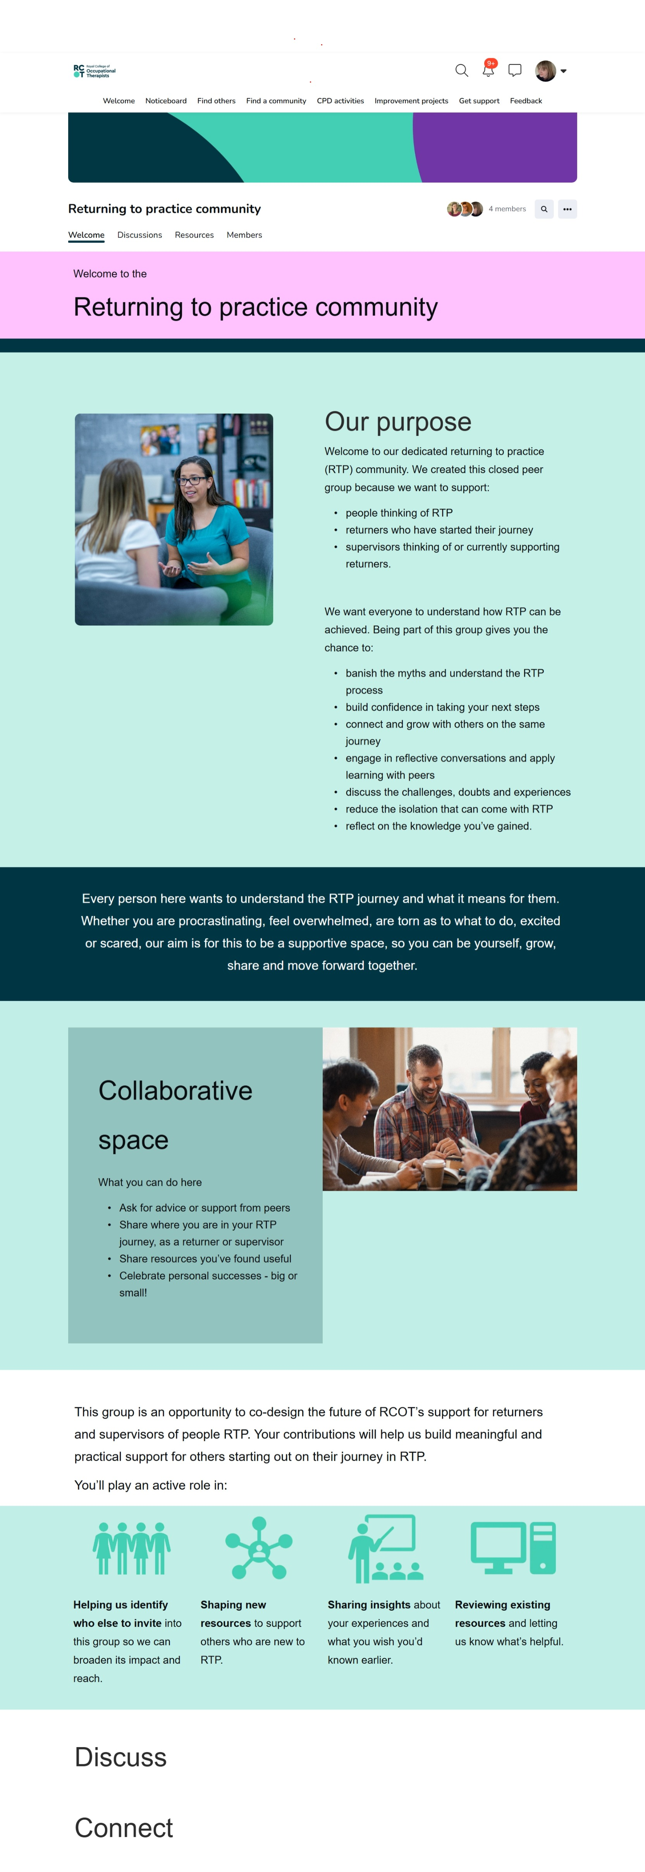
RTP community

Slide 18
Early career standards and principles for occupational therapists
Notes:
We are launching our Early career standards and principles for occupational therapists in the Spring. This is a brand new resource designed to support you as a newly registered occupational therapist. They are designed for those who’ve recently finished their pre-registration studies, have recently moved to the UK and registered with the HCPC and those who are returning to practice.

Slide 19


We want you to have the best possible introduction to your career
Students, apprentices, international recruits and those returning to practice have invested significantly – financially, emotionally and in time. We all share a responsibility to provide the guidance and support you need during this critical stage of transition to ensure that you thrive and develop.
The principles reflect the voices of early career occupational therapists, employers, academics and people who access occupational therapy services and are grounded in evidence.
They shine a light on what works, champion what is valued, and set out what is essential to build a confident, capable and inspired occupational therapy workforce.
Coming soon
Notes:
They’re designed to complement existing early career programmes while offering a unique occupational therapy perspective. Created by the profession, for the profession to support OTs in successfully kick-starting their careers.
This starts at the beginning of an occupational therapist’s career, and these standards support employers in playing their role in achieving the vision of our Workforce Strategy – for an expanded occupational therapy workforce positioned to have maximum impact in improving people’s health and quality of life.

Slide 20
Principle 1
Early career occupational therapists experience a sense of belonging, connection and feel valued as they begin or return to their professional journey.
Principle 2
Early career occupational therapists have access to regular, structured supervision that supports their individual transition into autonomous, safe and confident practice.
Principle 3
Early career occupational therapists are supported to engage in professional development, establish individual career trajectories and contribute to the development of the profession
Principle 4
Employers proactively promote the wellbeing of early career occupational therapists through supportive working practices that enable sustainable, reflective and self-directed engagement in the profession.
Principle 5
Early career occupational therapists develop a strong professional identity and engage with the wider profession.
Notes:
There's five principles and underneath each principle is four or five standards demonstrating the implementation of the Prinicples. It’s not a huge document! Each principle reflects a different theme:
Establishing a sense of belonging and connection
Structured supervision and support
Career development and lifelong learning
Sustaining personal health and wellbeing
Professional identity and networking

Slide 21
Principle 1
Early career occupational therapists experience a sense of belonging, connection and feel valued as they begin or return to their professional journey..
1.1 Induction processes support integration into the team, profession and wider service, with emphasis on distinct occupational therapy identity and values (Royal College of Occupational Therapists, In press 2026).
1.2 There are processes in place to actively promote an anti-racist and anti-discriminatory culture of inclusion through team engagement, and the principles of equity, diversity and belonging.
1.3 Employers facilitate access to peer support networks, both locally and nationally, including early career communities and occupational therapy-specific groups. .
1.4 There is a process in place for early career occupational therapists to access mentorship opportunities that offer tailored guidance beyond supervision structures.
Notes:
Here’s an example, so this is the first principles…
You can see that this is about having a sense of belonging, connection and feeling valued. This is about having good induction processes ensuring there are clear processes in place to promote an anti-racist, anti-discriminatory culture of inclusion. We want employers to facilitate and support access to peer support networks -that could be locally and nationally. We also need employers to have a process in place for you to access mentoring opportunities - that's not necessarily with another occupational therapist but somebody who's able to mentor you and give that guidance beyond the structured supervision as you begin to establish, or re-establish, yourself as an occupational therapist.

Slide 22
Next steps…
Visit our webpages.
Think about how you can work with your employer to meet these principles and standards.
Get involved – with RCOT and the OT community.
Notes:
The principles launch in the spring. We're really excited. It's just the beginning of our commitment to supporting early career occupational therapists
So when they are launched please do take a look at the document: visit our web pages - will continue to add to those web pages over the months: and have a conversation with your employer if you're in work about how you can meet these principles and standards and what they have in place to demonstrate these principles.
Also get involved. You’ll hear today about RCOT communities. Get connected and find people who are going through similar experiences with you so you can share learn and celebrate together.

Slide 23
Thank you
Any questions?

