Slide 1

The AHP Framework for System Impact for England 2027- 2032
Workshop in a box
For the use facilitator only

Slide 2



For the facilitator use only
What is our ‘workshop in a box’?
This pack can be used by colleague to run structured and engaging workshops within their team.
It provides:
suggested speaking points, in the notes section
tips for managing the session
questions for discussion that relate to the 6 key themes for the framework
This workshop in a box is designed to be used flexibly: please adapt it to your teams’ needs.
You can adjust the timings and length of the workshop to suit the needs of your team.
Please refer to the speakers notes for guidance on each slide.
Notes:
Include who is in the room
Everyone's voice is equally important

Slide 3
For the facilitator use only
Your role as a facilitator
You don’t need to be an expert to run these sessions
Your role is to:
Help your team connect around the new AHP framework
Guide the conversation
Encourage everyone to contribute
Capture people's ideas and thoughts in the online survey
Sessions can be virtually or in person
You will need:
A laptop/ computer to run the session
Access to online meeting platform or projector to display the slides
Access to the online form to capture peoples feedback (mobile or laptop)

Slide 4
The AHP Framework for System Impact for England 2027- 2032
Workshop
Date:
Notes:
Welcome the team and give a brief introduction about the which is an important part of the engagement across the AHP workforce to develop a new AHP framework that will replace AHPS deliver when that comes to the end of its course in June 27
Explain we’ll be using the time today to capture your thoughts on 6 key themes
Peoples thoughts will be captured using an online form, however individuals are very welcome to submit individual forms in addition to the team one.
If you are recording the conversations, please remind participants of that at this point, and confirm that they are comfortable before turning on the recorders.

Slide 5
Agenda
Item | Speaker | Slides | Duration
Setting the scene – review of AHP Delivers and rational for the framework | Host | 4 – 13 | 10 minutes
Theme group discussion session 1 – survey questions 1-3 | All (complete feedback in the survey) | 14-15 | 15 minutes
Theme group discussion session 2 – survey questions 4-6 | All (complete feedback in the survey) | 16-18 | 15 minutes
Close | All | 19 | 5 minutes
Notes:
Please tailor the agenda to the time you have , you may want to cover the questions in more that one session, that is fine, submit the form at the end of each session and start a new one next time

Slide 6
Objectives for today
Development of the AHP Framework for System Impact for England 2027-2032
Today, we want to:
Share a brief history of our successes and the importance of an AHP strategy within this
Share how the next national AHP framework will be developed
Capture what you think is important, for each of the 6 themes identified
Enable you to deliver the workshop in a box locally with your teams

Slide 7

How we will work together
Respect each other’s views
Not everyone here will think the same thing. If you disagree with someone, please share that but always be respectful.
Giving time for everyone to speak
We will make sure we finish on time and cover everything we are here to talk about. We might politely move the conversation on if we are short of time, or if we would like to hear what others have to say.
There are no silly questions or comments
Please ask if you aren’t sure about something.
Notes:
Facilitator notes:
Include who is in the room
Everyone's voice is equally important
If you have breakout tables, then explain that you’ll mostly be working around your tables but will also share opinions across the room.
If you are recording the conversations, please remind participants of that at this point, and confirm that they are comfortable before turning on the recorders.

Slide 8




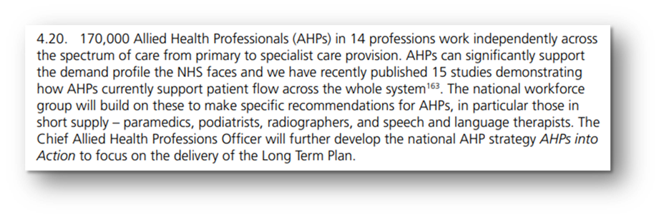
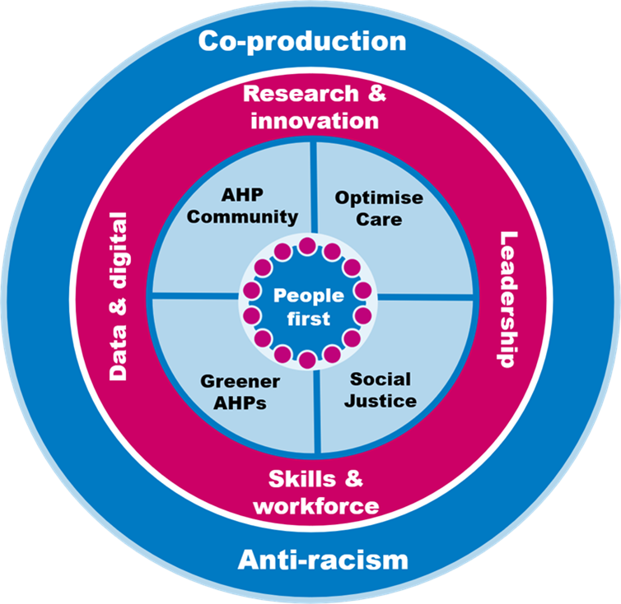
The AHP Strategies for England 2016-2027
Notes:
The first AHP strategy for England, “AHPs into Action”, was launched in 2017, ground-breaking in its use of crowdsourcing.
AHPs into Action was written as a response to the Five-Year Forward View to present a vision for translating national policy into action for AHPs. It captured the wisdom of AHPs from across the nation and helped to nurture and accelerate the emerging AHP movement in England.
Building on this, ‘AHPs Deliver’ was published in 2022, co-created with people, the AHP community, and other health and care professionals in three engagement phases. Over 3,200 registrants in 500 English postcodes made 21,000 contributions.
AHPs Deliver incorporated the delivery of the NHS Long Term Plan.
The priorities remained relevant but with expanded scope. These ‘enhanced foundations’ were reshaped into critical enablers for the new five ‘areas of focus.
There have been phenomenal work in realising five areas of focus: people first, optimising care, social justice, greener AHP, and the AHP community.

Slide 9


Key successes from AHPs Deliver
Anti-Racism | Anti-racism structures and regional networks established, but further work needed as evidenced by NHS Staff survey and WRES data
Co-production | Clear practice examples emerging
Diverse and inclusive leadership | More AHP leadership roles in provider organisations, need for professional and ethnic diversity
Right skills, place, time | Broader deployment across services
Research | Stronger NIHR links and more research-active AHPs, need for more clinical academics and translation of research into practice
Social Justice | "What matters to me" conversations embedded, challenges in understanding data and equity of services
Optimising care | FCP and radiographer-led discharge scaling work to do regarding scope of practice
AHP community | Awards and external recognition growing
Notes:
In 2024 an evaluation of the implementation of AHPS deliver was undertaken which highlighted a number of successes delivered by the strategy but highlighted there was more to do specifically in terms of optimising care, research, digital and data and skills

Slide 10







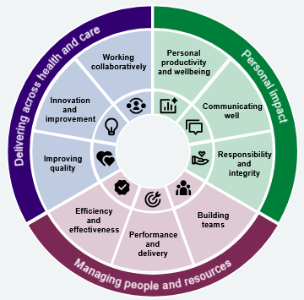
A third AHP framework
Notes:
More recently documents such as the Darzi review, AHPs were barely visible highlighting the need for greater visibility of AHPs
The Impact of the AHP public health strategic framework has highlighted good progress
The need for further work in the digital space has been evidenced by the recent digital maturity assessment and the pace of technology development in the NHS
And the policy research priorities provide a direction for the knowledge base we need to build
The 10 year health plan provides a revised focus for the delivery of health services
Demand for services is continuing to grow due to population ageing, increasing long‑term conditions, and widening health inequalities.
NHS has fallen behind technologically, with outdated systems and administrative burdens.
Staff are under sustained pressure, with workforce shortages, low morale and rising burnout.
The current hospital‑centred, reactive model is no longer fit for future needs.
Transformational change is required sustainability, improve outcomes and protect NHS values.
We also need to consider the implications of the NHS leadership and Management framework and the 10 year workforce plan ( when published) for AHP leadership and the AHP workforce.
However the next strategy will be evolution not revolution

Slide 11





AHP Framework timetable
June - September
October - December
2027
Launch
Engagement
Regional workshops
Provider led workshop in a box
Citizen Jury’s
Help shape the future impact survey
Draft new framework
Publish framework
Notes:
Engagement to develop the AHP framework commenced on 2 June these workshop in a box session provide a vital link with clinical staff to ultimately inform the content of the document and influence AHP strategy for the next 5 years and beyond

Slide 12


Our themes
Providing safe, high quality and accessible services
Better care – quality, safety and access
More care – productivity
1
2
Keeping people healthy
Prevention
Earlier intervention
Reducing unequal outcomes
3
People and workforce
Education and training
Leadership
Equity
Retention
6
Data, Digital and technology
Technology
Capability
Data capture
4
5
Research, improvement and innovation
Future proofing AHP services
Working Differently
Places, pathways, teams, patterns of working, scope of practice
Core Values - Anti‑racism • Co‑production • Sustainability
Notes:
These are the 6 themes that have been identified as a result of all the scoping work and what we would like your view upon
The scoping work has also identified that Anti racism, co production and sustainability remain important as core values to all the work that we do

Slide 13


Engagement survey
1 June – 18 September 2026
https://forms.cloud.microsoft/e/npHPD6LnP2
To capture:
Individual responses
Team responses
Responses from local workshop in a box sessions
Regional networks
Notes:
The survey has been designed to capture all feedback for the consultation and will be reviewed by the national CAHPO team
By submitting your thoughts this way it enables all information to be collated and analysed.
For the group work you will need access to a computer or mobile to access the survey this is the link to pop In the chat if online: https://forms.cloud.microsoft/e/npHPD6LnP2

Slide 14
Collating your thoughts
Instructions
The form allows you to move forward to specific theme
Theme 1: Providing safe, high-quality and accessible services- Questions 1-4
Theme 2: Keeping people healthy- Questions 5-8
Theme 3: People and AHP workforce- Questions 9-12
Theme 4: Working differently- Questions 13-16
Theme 5: Research, improvement and innovation – Questions 17-20
Theme 6: Data, digital and technology- Questions 21-24
At the end of the discussion move to the end of the survey select:
Region
Completing as part of a group
Submit
https://forms.cloud.microsoft/e/npHPD6LnP2
Notes:
Each theme has a main question and 3 prompt questions
We will be capturing your discussion via the online survey
You can navigate forward to the section you have been allocated to complete

Slide 15
Theme 1: Providing safe, high- quality and accessible services
What would make the biggest difference to delivering safe, high-quality and accessible AHP services?
How do you know when AHP services are safe and high quality?
What helps AHP services deliver safe, high-quality care?
What concerns you most about the quality, safety or accessibility of AHP services?

Slide 16
Theme 2: Keeping people healthy
How can AHPs have the greatest impact in helping people stay well and lead healthier lives?
Which people or communities would benefit most from earlier access to AHP support, and why?
Which people or communities face the biggest barriers to accessing AHP services or achieving good outcomes, and why?
What one change would most help AHPs focus more on prevention (for example pathways, roles, partnerships, data or funding)?

Slide 17
Theme 3- People and AHP workforce
What changes would best support and strengthen the AHP workforce now and for the future?
What changes would most improve retention of AHPs across all career stages in health and social care?
Where are the main gaps in capability, skills and training that limit AHP impact?
What changes would have the greatest effect on building a sustainable, skilled and inclusive AHP workforce (including funding, leadership capacity & strategic skills)

Slide 18
Theme 4: Working differently
How can AHPs work differently to better meet people’s needs and deliver care in the most appropriate setting?
What would help most to make this change possible (for example workforce, pathways, digital, data or standards)?
Where do current ways of working need to change most?
If you could prioritise one change now, what would have the greatest impact?

Slide 19
Theme 5 – Research, improvement and innovation
How can we embed research, improvement and innovation more sustainably to improve everyday care and future services?
How can we better connect service improvement, research and innovation to strengthen everyday practice?
How can we turn evidence into real-world change more quickly?
What strengths, capabilities or support are needed to make this happen?

Slide 20
Theme 6: Data, digital and technology
How can make better use of data, digital and technology to improve AHP services and demonstrate their impact?
What would improve how AHPs use data, digital and technology including Artifical Intelligence (AI) to support people and deliver care?
What knowledge and skills will AHPs need to use data, digital and technology effectively in the future?
What do we need to get the basics right in data, digital and technology?

Slide 21



Feedback & next steps
Spread the word about the survey
Stay connected and receive updates
Everyone's voice matters
Share the survey with colleagues, student’s, patients and friends and family
Use the same survey to share what is important to you
https://www.england.nhs.uk/email-bulletins/chief-allied-health-professions-bulletin/
Notes:
Brief feedback of some of the contributions through the session
Encourage people to have another look at the survey and provide their own thoughts for anything that hasn’t been captured.
Updates will be provided through the Chief AHP officers bulletins, encourage people to sign up to this

