Slide 1
Participation Changes Everything
OT Week 26
Notes:
Welcome and thank you for joining.
As members of the Royal College of Occupational Therapists, we work together to champion the profession and maximise its contribution to people's health, wellbeing, participation and quality of life.
This session introduces Participation Changes Everything, our theme for OT Week 2026.
We'll explore why participation matters, why it should be a priority across health, care, education and communities and the role occupational therapists play in enabling it.

Slide 2
Participation Changes Everything
Participation is fundamental to health and wellbeing.
It is about being able to take part in the activities, roles and relationships that matter to us.
Notes:
Let's start by looking at what we mean by participation.
It's about being able to take part in the activities, roles and relationships that matter to us.
Participation includes many aspects of everyday life, from learning and working to caring for others, maintaining relationships, contributing to communities and enjoying hobbies and interests.
Participation is not a luxury or an optional extra. It is fundamental to health, wellbeing and quality of life.
That's why participation must be a priority across health, care, education and communities.

Slide 3
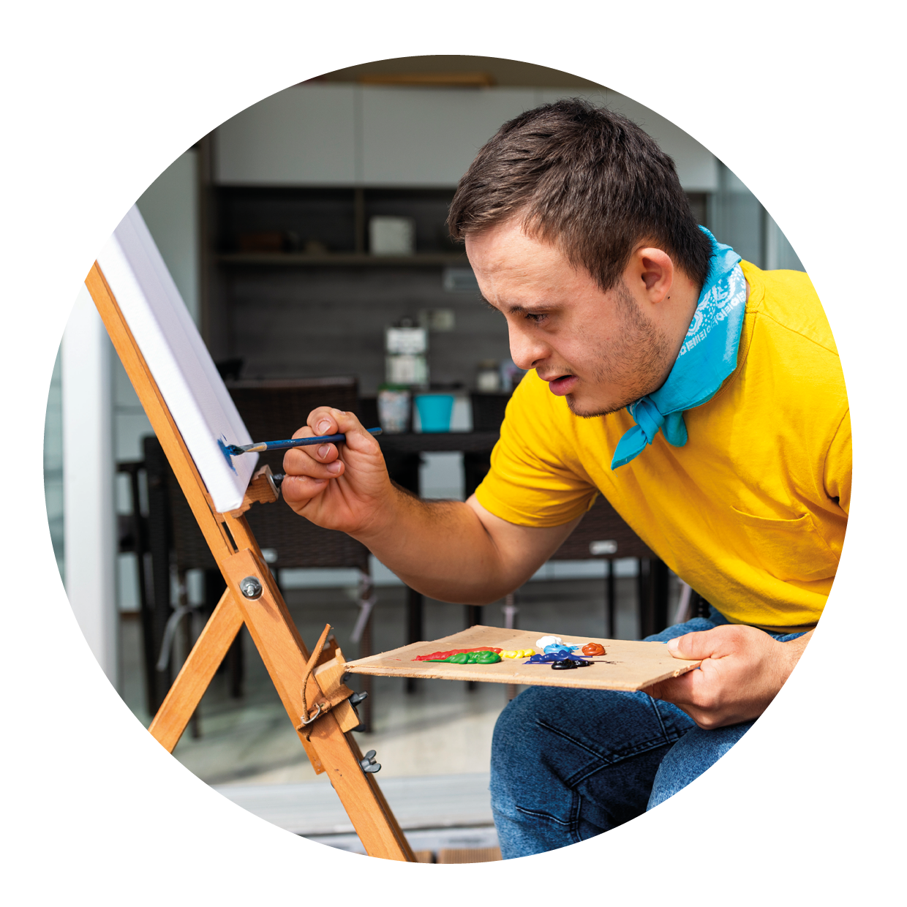
Why participation matters
Participation supports:
  health
  wellbeing
  identity
  connection
  purpose
  quality of life
Notes:
Being able to take part in the activities that matter helps people live healthy, connected and meaningful lives.
Through participation, people develop a sense of identity, purpose, connection and belonging.
Participation supports health, wellbeing, confidence and quality of life.
It helps people maintain relationships, fulfil valued roles and stay connected to their communities.
When people are unable to participate, the impact can be felt across every aspect of life.
The benefits of participation extend beyond the individual to families, communities and wider society.

Slide 4
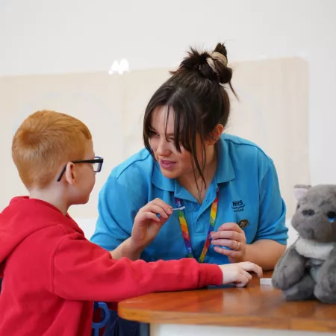
Occupational therapists enable participation
When barriers get in the way, occupational therapists are experts in enabling participation.
We:
  understand people, occupations and environments
  take a whole-person approach
  remove barriers
  build skills and confidence
  develop practical solutions
Notes:
When barriers get in the way of doing the things that matter, occupational therapists are experts in enabling participation.
We understand the relationship between people, their environments and the activities that matter to them.
We take a whole-person approach, considering goals, strengths, routines, relationships and contexts to identify barriers and develop practical solutions that enable participation.
This might involve adapting environments, developing skills, introducing equipment, changing routines or working with families, employers, educators and communities.
Our focus is helping people continue doing the things they need, want and love to do.
Occupational therapists work across homes, communities, schools, workplaces and health and care services, helping people overcome barriers to participation.

Slide 5

Participation helps children thrive
Participation helps children and young people:
  learn
  play
  build relationships
  gain confidence
  develop skills
Notes:
Participation begins in childhood.
Children and young people learn, develop and grow through participation in everyday activities.
Being able to take part in education, play, family life and friendships helps children build skills, confidence and a sense of belonging.
When barriers are identified and addressed early, children are more likely to thrive in education and everyday life.
Supporting participation early can have benefits that last a lifetime.

Slide 6

Participation in work supports health and wellbeing
Participation in work can provide:
  purpose
  routine
  financial security
  social connection
  identity
  contribution
Notes:
Work is a meaningful occupation for many people and an important form of participation.
For many individuals, work provides more than an income. It provides purpose, social connection, structure and opportunities to contribute.
Ill health, disability and life events can create barriers to participation in work.
Supporting participation in work benefits individuals, families, employers and wider society.
Work is one example of how participation supports health, wellbeing, identity and quality of life.

Slide 7
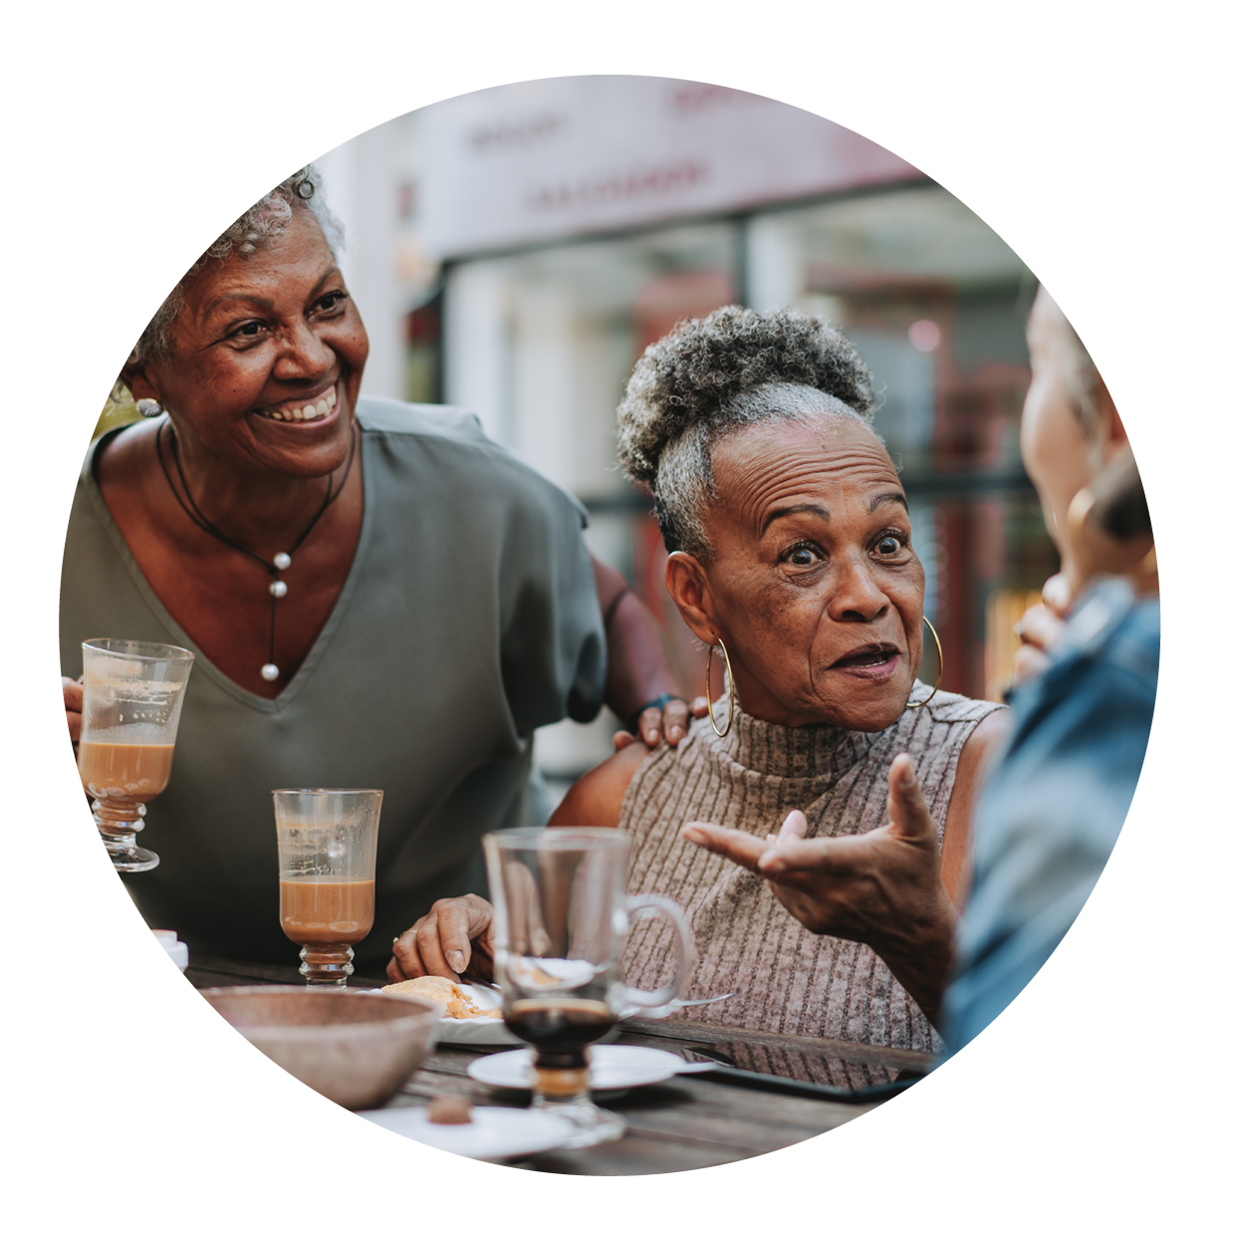
Participation supports ageing well
Participation helps people:
  stay connected
  maintain relationships
  continue doing the things that matter
  take part in everyday life
  enjoy valued activities
  live well
Notes:
Participation remains important throughout later life.
As people age, health conditions, life circumstances and social changes can affect opportunities to participate.
Being able to continue doing the things that matter supports wellbeing, connection and quality of life.
Too often, people become disconnected from the activities, relationships and communities that matter to them.
Ageing well is about more than living longer. It's about continuing to participate in the activities, relationships and roles that give life meaning and purpose.

Slide 8
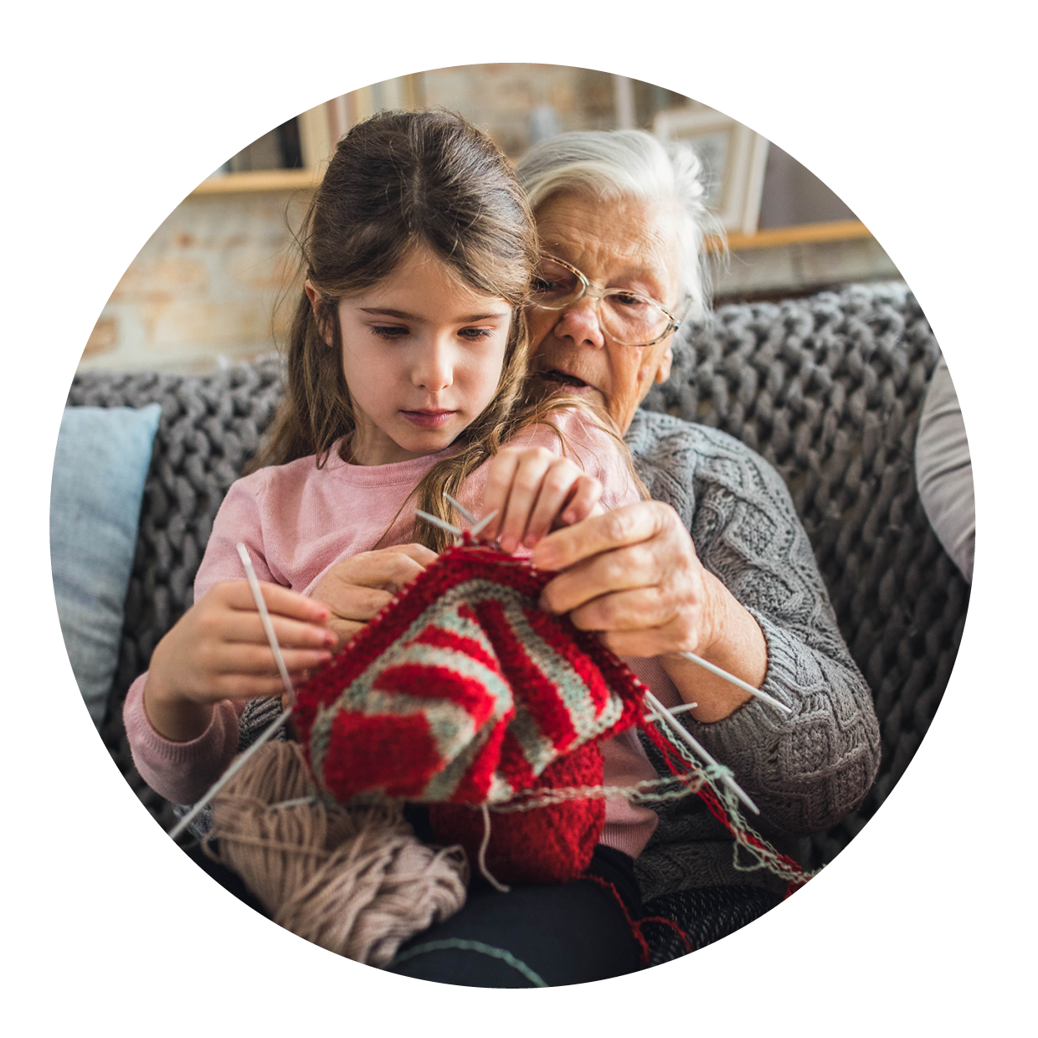
Support should work around people's lives
Support should:
  start earlier
  focus on what matters to people
  work together around people’s goals
  address barriers to participation
  enable people to participate in everyday life
Notes:
Too often, support comes only after challenges have escalated.
Support should work around people's lives, not around services.
As occupational therapists, we know that meaningful outcomes start with understanding what matters to the individual.
Support should start earlier and be built around people's goals, aspirations and everyday lives.
Health, social care, education, employment, housing and community services should work together to remove barriers and improve outcomes.
This means looking beyond a diagnosis, condition or service pathway and focusing on the outcomes that matter most to people.
Addressing the wider factors that shape participation is essential to tackling inequalities.
Success should be measured by whether people can do the things that matter to them.

Slide 9
Are we measuring what matters?
Success should not be measured only by treating illness, responding to crisis or delivering services.
Success should be measured by whether people can do the things that matter to them.
Notes:
We've talked about the importance of participation and the difference it makes to people's lives.
If participation is fundamental to health, wellbeing and quality of life, then it should also be central to how we define success.
Too often, success is measured through treating illness, responding to crisis or delivering services.
Those measures matter, but they don't tell us whether people can do the things that matter to them.
The more important question is: can people learn, work, maintain relationships and participate in everyday life?
As occupational therapists, we focus on outcomes that are meaningful to people's lives.
Success should be measured by whether people are able to do the things that matter to them.
When people can do the things that matter to them, we know support is making a real difference.

Slide 10
Participation Changes Everything
Find out more:
www.rcot.co.uk/Partciapton
Notes:
Thank you for taking the time to explore Participation Changes Everything.
We all have a role to play in helping others understand the importance of participation and the role occupational therapy plays in enabling it.
If you'd like to learn more, access campaign resources or find additional ways to support the profession, please visit the campaign webpage and explore the resources available.
Thank you.

