Slide 1
EBD Insights: Increasing OT Knowledge, Skills and Confidence for EDB Incident Reporting
Simone Welch
Specialist Stroke Occupational Therapist- Imperial NHS healthcare Trust

Slide 2
Special Thanks
EDI Incident reporting team: Ama Minney (Physiotherapist)
The LITE Project- Sponsor Davina Richardson
Chris Flatt, Head of Therapies, Imperial NHS Healthcare Trust
RCOT
BAME OT
Arnie Puntis and HEE
Annette Coomer
Anita Atwal
Stroke Team at Imperial NHS Healthcare Trust

Slide 3
Session Outline
Background Theories
  EDI vs EDB
  Understanding importance of EDB
  Grounding theories
  Supporting theories
Current statistics
EDI incident reporting workshop
  Project background
  Workshop structure
  Workshop outcomes
Implementation and impact of cultural change
Q&A

Slide 4
Background Theories
EBD Insights: Increasing OT Knowledge, Skills and Confidence for EDB Incident Reporting

Slide 5
EDI vs. EDB
Equality Diversity & Inclusion (EDI)
Ensures fair treatment and equality of opportunities for all. It aims to eradicate prejudice and discrimination on the basis of an individual or group of individual's protected characteristic
An EDI Incident
Would breach this concept and our Trust values (ie kindness).
Equity, Diversity and Belonging
Disrupting normal patterns of behaviour and recognising and appreciating differences. Action belonging to ensure true inclusivity

Slide 6
Understanding the importance of EBD
Diversity
Belonging
Equity
Notes:
Equity: Takes difference into account to ensure a fair process and ultimately a fair outcome. Recognises that some groups are disadvantaged in accessing opportunities in all aspects of occupations such as educations/social/career/family life/ health opportunities and therefore are often underrepresented or marginalised in many organisations and institutions. Think how this also shows in the research and grounding theories one size does not fit all. Think about ensuring that everyone has access to all opportunities
Diversity: Recognising the diversity of the population. Thinking about the workplace some of the benefits of diversity can be:
Better opportunity or creativity and problem-solving
Smarter decision-making
An increase in profits and productivity
Retention of staff
Improved reputation
Fair opportunities and identify potential bias
Belonging:
Ensuring everyone feels welcome and are able to be their authentic selves in difference spaces to support indviduals and groups to feel confidently to contribute and participate.

Slide 7

Grounding Theories
Overt discrimination
Institutional discrimination/racism
Micro agressions
Unconsious bias
Societal barriers- emotional and physical
Inequalities

Slide 8
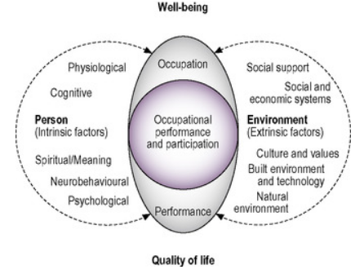
EDB and occupational Therapy models
Notes:
Intrinsic factors including protected characteristics and how this impacts on the person
Environment
Think about the physical environment and society are the barriers to supporting optimal occupational performance and participation
It is important to recognise that EBD issues are not restricted to the workplace but occur across the lifespan in all areas on occupation from education, to social inclusion, health opportunities, career etc.
Need to understand the bigger picture on how institutional inequalities that form the backbone of our cultural norms within the workplace influence the structure of how we run our organisation and how ultimately this leads to discrimination towards certain groups. discrimination or unequal treatment on the basis of membership of a particular ethnic group (typically one that is a minority or marginalized), arising from systems, structures, or expectations that have become established within an institution or organization

Slide 9
Supporting Theories
Anti- racism
Challenging unconscious bias
Reflecting on privilege
Active-Allyship

Slide 10
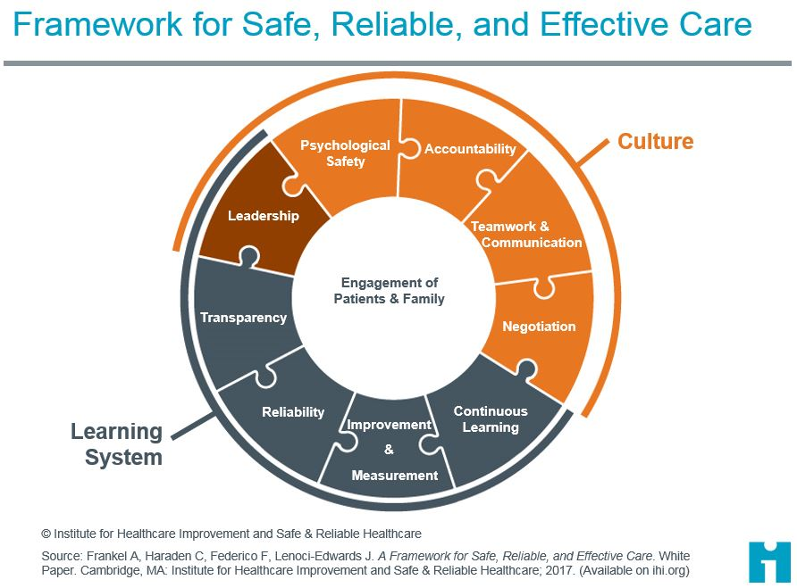
Supporting Theories

Slide 11
Current Statistics
EBD Insights: Increasing OT Knowledge, Skills and Confidence for EDB Incident Reporting

Slide 12
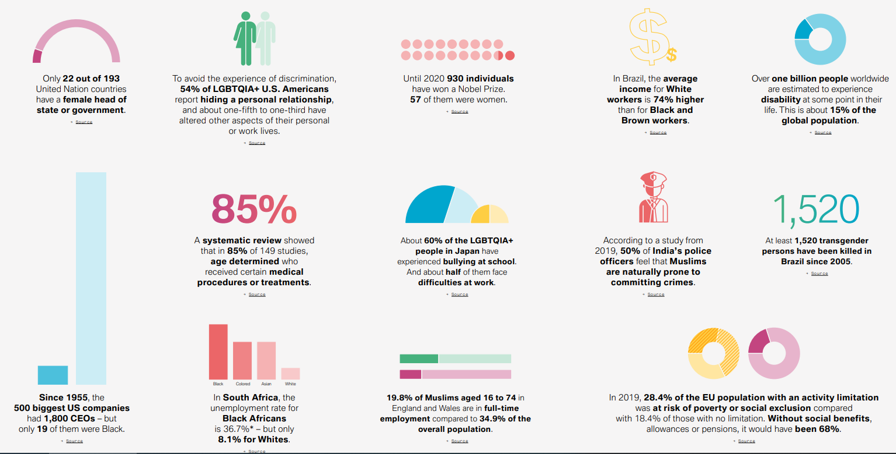
The Global Picture
BMW Foundation, 2021

Slide 13
Workforce Race Equality Standards 2020/2021

Slide 14
Workforce Race Equality Standards 2020/2021

Slide 15
EDI Incident Reporting Workshop
EBD Insights: Increasing OT Knowledge, Skills and Confidence for EDB Incident Reporting

Slide 16
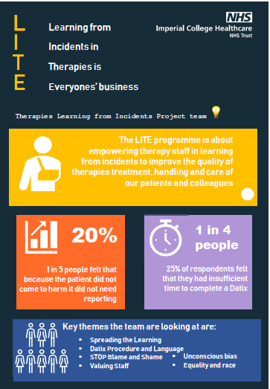
Background

Slide 17


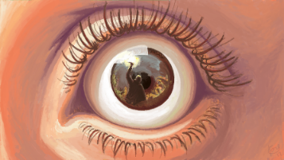



Key Messages from the EDI Trust AHP Survey
> 50% reported being shocked and saddened by the two scenarios in the survey
Variety of responses for action
75% said that they would educate and challenge if they observed either scenario
A range of EDI incidents experienced/witnessed
Highest percentage involved race (56%)
25% reported no experience
Lack of consistency in how incidents were reported
50% spoke amongst colleagues
35% reported to senior
14% did nothing
8% completed Datix
Notes:
This EDI incident reporting project has stemmed from a larger project within the therapies team on incident reporting. Simone (OT) was part of the task force and felt that EDI incidents were not being focussed on and decided to be the person to do it. A survey was circulated amongst allied healthcare professionals and these were the responses – of note that there was 25% who reported no experience with EDI incidents and 56% if the incidents involved race. The other thing to note is that 50% of people reported that they spoke to their colleagues/peers when an incident happened with only 8% completing a formal DATIX.
So we know that there are discriminatory incidents happening to our staff that are underreported and ultimately, not dealt with. As staff we are very good at reporting (completing a DATIX) when a patient falls or if they accidentally took the wrong medication but we are not good at reporting inappropriate comments, physical abuse such as being kicked or other discriminatory or abusive things that happen to us.

Slide 18
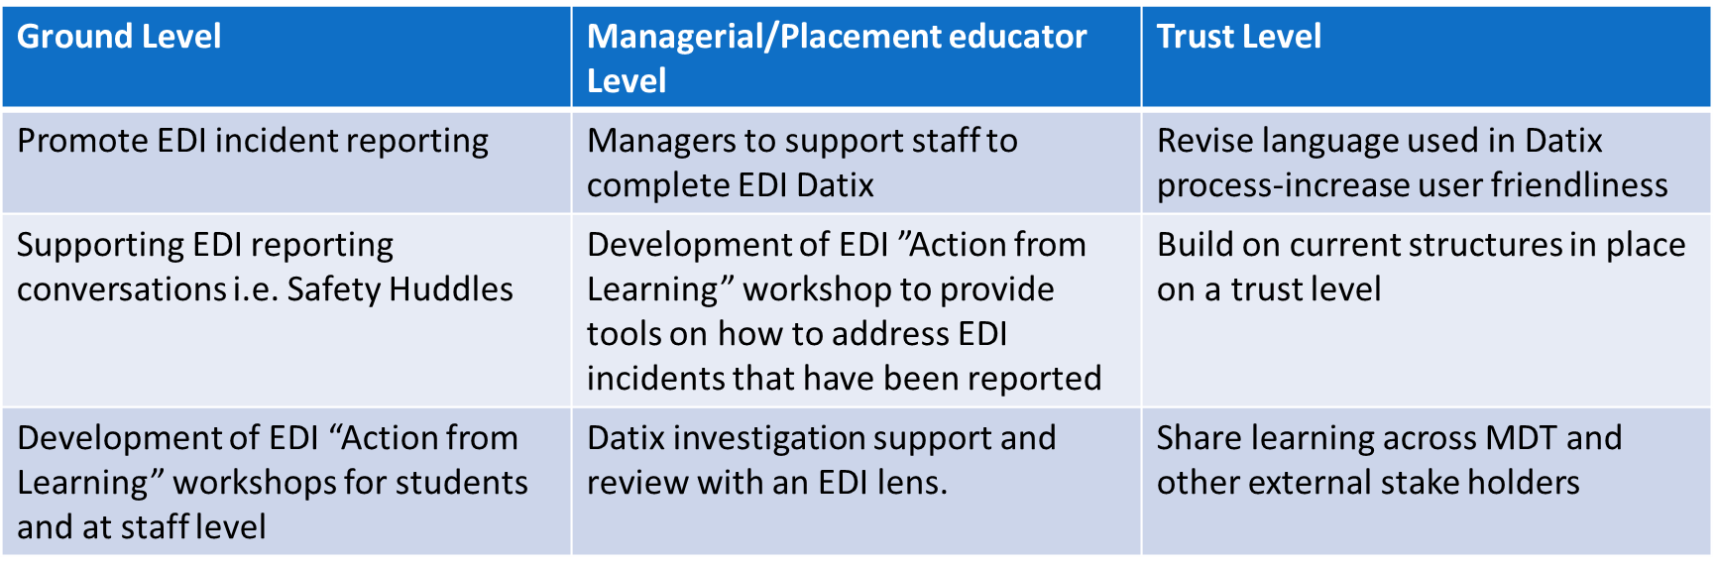
Focused Steps
Notes:
The external stakeholders who are interested in replicating this work

Slide 19
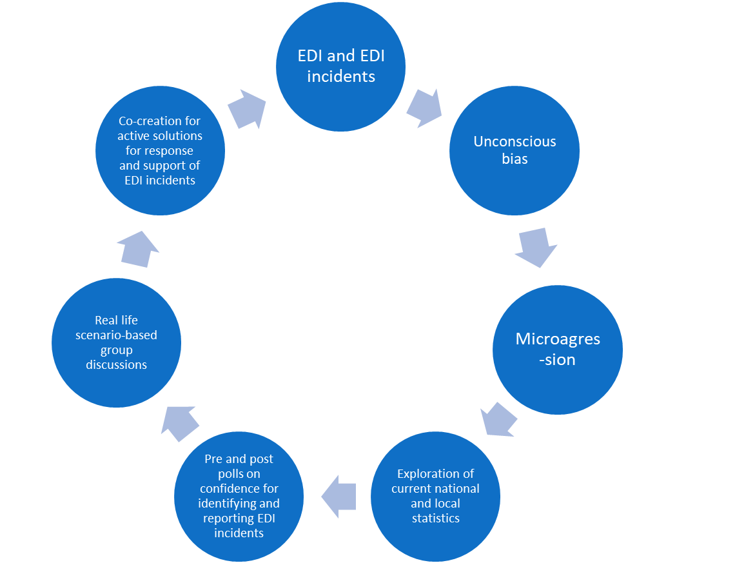
EDI Incident Reporting Workshop
Total: 12 Sessions; 85 participants
Notes:
Simone to add in…what happens in the workshop
Basic statistics on how many how been run.

Slide 20
Key Findings
Half of staff stated that they’ve never witnessed a EDI incidents. Those that do, are more like to discuss it with colleagues. Followed closely by reporting it to a manager or supervisor.

Slide 21
Key Findings
Staff are unclear what to do when discrimination comes from patients, especially if patients are vulnerable.
What our workshop participants said:
“Don’t know what to do or how to deal with it”
“awkward talking about it”
“uncomfortable”

Slide 22
Barriers to Incident Reporting
Process
Unknown process for reporting
Ward pressures
Perception of Trusts attitude to whistle blowing
Uncertainty on what can be reported
Reporting patients
Fear of aggressive reaction
Feel unable to make a difference to patient’s bias
Reasoning behaviours based on health conditions

Slide 23
Barriers to Incident Reporting
Emotional barriers
Fear of negative consequences
Awkward conversations
Anxiety on how will be perceived by others
Confidence
Conflict with emotions and maintaining professionalism
Reporting Colleagues
Impact of having to work with someone you have reported
Difficult is individual is senior

Slide 24
Co-production Reflection
Environmental
Safe environment for debrief
Intervention to restore ‘normal working environment
Process
Knowledge of supporting policies
Co-production of solution
MDT to escalate to NOK
Understanding what zero tolerance means in practise
MDT debrief
Individual debrief
Anonymous reporting
Development of escalation pathway

Slide 25
Co-production Reflection
Training and tools
Signpost to existing training i.e active bystander
Specialist investigator training
SIM training
Conflict resolution tools
Emotional support
Referral to Contact/counselling
Choice to not have to work with that individual
Feedback
Feedback pathway
Awareness of statistics on how often these incidents occur

Slide 26
Managerial/Educator Focused Workshop

Slide 27
Support Tools for Managers
Resources
Development of Tool kit
Resolution options for investigators
Prompt sheet with useful support phrases
Top Tips guide
Training
Specific training on managing EDI incidents
Leadership unconscious bias training
Awareness of terminology
Expert
Development of pathway for zero tolerance
Champion in each area

Slide 28
Key Findings
On average, our people are somewhat confident in identifying and reporting EDI incident. However, this confidence is increased by these sessions

Slide 29
Implementation and Impact of Cultural Change
EBD Insights: Increasing OT Knowledge, Skills and Confidence for EDB Incident Reporting

Slide 30
EDI Incident reporting case study:
Case Study
CHECK HOW INDIVIDUALS FEEL
TAKE ACTION
EXPLORE OPTIONS
PROVIDE SUPPORT
Terminate session if required/provide safe space
Support staff to complete Datix
Escalate to medical team/nursing team
MDT exploration on immediate actions
Check in with staff members involved
Listen to concerns
Flexibility in staff supporting patient
Choice to switch caseload
Individual debrief session
Team debrief session
Signposting for wellbeing support
Share learning across department
MDT involvement
Consider impact on whole team
Capacity assessment **
Behavioural chart
MDT boundaries to patient (involved psychology support ensure consistency)
Escalation as needed
Notes:
Simone Welch

Slide 31
EDI Resources and Events
@BAMEOTUK
@ABLEOTUK
Join a local staff network )race equality, women’s, I-CAN (disability), LQBTQAI network
Local Mandatory equality and diversity training
@LGBTQIAOTUK
Race and equity leadership training (managers)
Leadership courses (staff group level)
Sign up to events by RCOT Affinity Groups (Follow their Twitter pages!)
Read up on journal articles
EDI Resources/ Toolkits
EDI newsletters
RCOT EBD Insight sessions
Notes:
Here is some more resources and events from the EDI team

Slide 32
Q&A
EBD Insights: Increasing OT Knowledge, Skills and Confidence for EDB Incident Reporting

Slide 33
Resources
https://storage.googleapis.com/bmw-foundation/1/2021/10/publication-edb-final-bmwfoundation-oct2021-compressed.pdf
https://www.england.nhs.uk/wp-content/uploads/2021/02/Workforce-Race-Equality-Standard-2020-report.pdf
Equality Act (2010)
Frankel et al., (2017)

