Slide 1


RCOT resources to support professional practice and development
May 2021

Slide 2

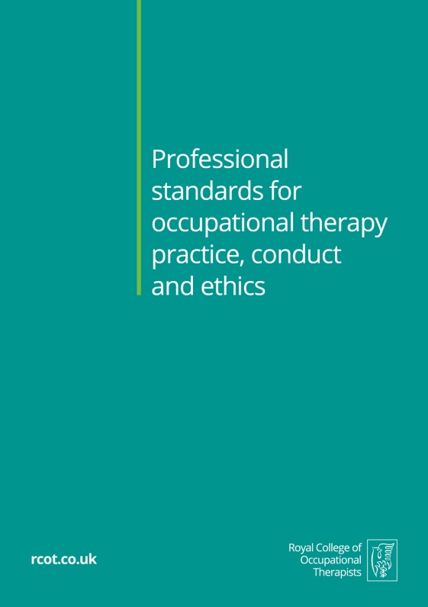

Key RCOT resources to support your professional practice and development
rcot.co.uk

Slide 3
By the end of the session, you will…
Be up-to-date about the latest edition of the Professional standards for occupational therapy practice, conduct and ethics (RCOT 2021)
Be up-to-date about the latest edition of the Career development framework: guiding principles for occupational therapy (RCOT 2021)
Be able to identify ways these resources can help your current and future career plans
rcot.co.uk

Slide 4
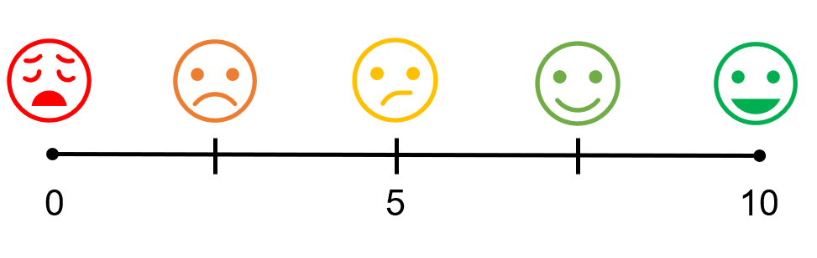
But first… please rate your level of confidence
Q1. I feel confident using the Professional Standards in practice
Q2. I feel confident using the Career development framework in practice
rcot.co.uk

Slide 5
Part one
Describing the new editions of the Standards and the Framework
rcot.co.uk

Slide 6
Professional Standards
What are they?
  Professional standards for occupational therapy practice, conduct and ethics
A set of ethical principles and standard statements that underpin and define the requirements for professional practice and conduct
Together they describe a level of practice and a way of thinking that RCOT expects its members to abide by
rcot.co.uk

Slide 7
Professional Standards
What are they?
Which words would you highlight in this statement?
‘These Standards describe the essential practice, behaviours and values that you have a responsibility to abide by at all times. They may be taken as appropriate standards of reasonable care, as defined by the professional body, which may be referred to by the HCPC, your regulatory body.’
(RCOT 2021, p4)
rcot.co.uk

Slide 8
Career Development Framework
What is it?
A structured set of guiding principles to inform career, learning and workforce development
(what is it not… a performance management tool or linked to NHS banding)
rcot.co.uk

Slide 9

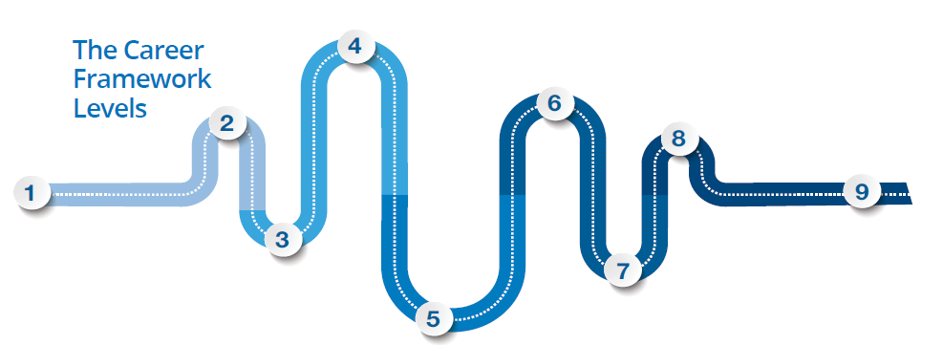
The Framework is structured on the four Pillars of Practice and nine Career Levels
rcot.co.uk

Slide 10
Who are the resources for?
Applicable to:
The whole occupational therapy workforce
Wherever you work, whatever the scope and level of practice
Also available to:
Managers, employers, commissioners, other health professionals
People who access services and the public
rcot.co.uk

Slide 11
What’s new in these editions?
Code of Ethics and Professional Standards merged into one resource
EDI consultation feedback enabled changes to enhance inclusivity of resources
More accessible layout to Framework with use of identifying codes for individual principles
All contemporary multiprofessional frameworks mapped into Framework
More Standards audit tools available to monitor, inform and re-evaluate practice
rcot.co.uk

Slide 12
Part two
Thinking about ways to use the Standards and the Framework
rcot.co.uk

Slide 13
How are you using the Standards and Framework?
Q3. In what ways are you already using the Standards?
Q4. In what ways are you already using the Framework?
Q5. How else could you use these resources in practice?
rcot.co.uk

Slide 14
Professional Standards
How do they help you?
Maintaining these standards will help you to:
Be a safe, effective and ethical practitioner
Provide a high-quality, evidence-informed and inclusive service
Provide a personalised service
Explain and promote the work that you do in the language of occupation
Make the best use of and sustain resources (financial, human and environmental)
Meet the HCPC registration requirements
rcot.co.uk

Slide 15
Meeting HCPC requirements
2.3.2 A key function of RCOT is to inform, support and encourage you as members of the profession. It is not RCOT’s role to judge a practitioner’s fitness to practise. The Professional standards for occupational therapy practice, conduct and ethics are developed in line with the HCPC standards (HCPC 2013, 2016). If you use the RCOT Standards as an informative and convenient way to monitor and maintain your professional practice, they will help you to meet the HCPC requirements
2.3.3 The results of monitoring and improving your practice can be included in your continuing professional development (CPD) portfolio, along with your other evidence of learning and development
Professional standards for occupational therapy practice, conduct and ethics
rcot.co.uk

Slide 16
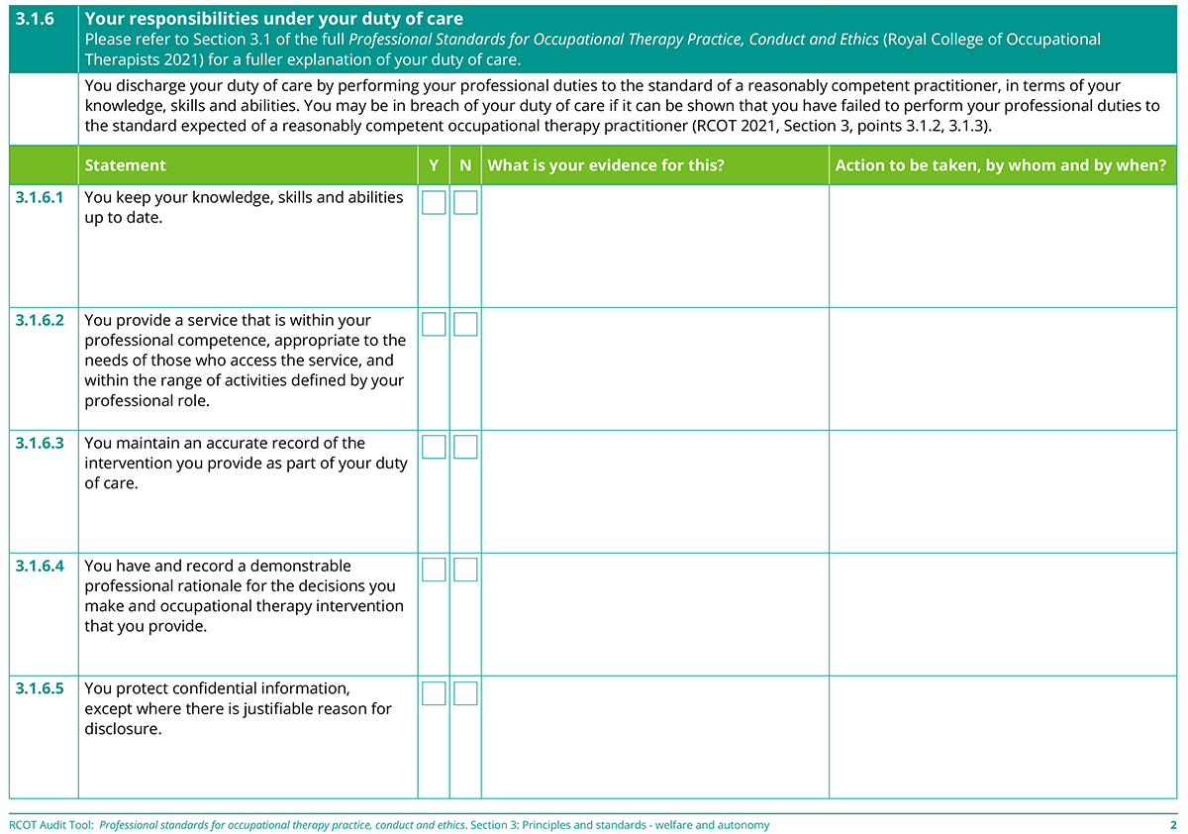
Using Standards in practice
rcot.co.uk

Slide 17
The Framework
How can it help you?
Appraisals
Practice-based learning
Supervision
Job applications and reviews
Planning CPD in teams
HCPC audit
Planning your retirement
https://www.rcot.co.uk/cpd-rcot for tools and templates
rcot.co.uk

Slide 18
Part three
And finally...
Keeping in touch and confidence revisited
rcot.co.uk

Slide 19
Working together with RCOT
We need your feedback so we can…
Ensure resources meet the needs of all members
Recognise and celebrate your achievements and developments
rcot.co.uk

Slide 20
Confidence revisited
Q1. I feel confident using the Professional Standards in practice
Q2. I feel confident using the Career development framework in practice
rcot.co.uk

Slide 21
Where next?
Please consider:
Capturing your learning using the five-minute reflective template rcot.co.uk/cpd-rcot
Reviewing the audit tools and templates for the Professional Standards rcot.co.uk/publications/professional-standards-occupational-therapy-practice-conduct-and-ethics
Reviewing the tools and templates for the Career Development Framework rcot.co.uk/cpd-rcot
rcot.co.uk

